Slide 1
MB-300 Core Module 1 – Describe Finance and Operations UI Elements, Basic Navigation, Apps
Duration: 180 min

Slide 2
Agenda
Introduction to Dynamics 365 Finance and Operations
Basic UI and Navigation
Dynamics 365 FO features and functionality
Module summary.
Test your knowledge.

Slide 3
Lesson 1: Introduction to Dynamics 365 Finance and Operations
Notes:
Dynamics 365 Finance helps you to:
Automate and modernize your global financial operations.
Monitor performance in real time, predict future outcomes, and make data-driven decisions to drive business growth.
Drive strategic financial decisions with artificial intelligence (AI), unify and automate your financial processes, reduce operational expenses, and decrease global financial complexity and risk.
Dynamics 365 Supply Chain Management helps you to:
Transform your manufacturing and supply chain operations.
Use predictive insights and intelligence from AI and the Internet of Things (IoT) across planning, production, inventory, warehouse, and transportation management.
Maximize operational efficiency, product quality, and profitability.
Innovate with intelligent manufacturing operations, modernize warehouse management, optimize production performance, maximize the life of your assets, and automate and streamline your supply chain.

Slide 4
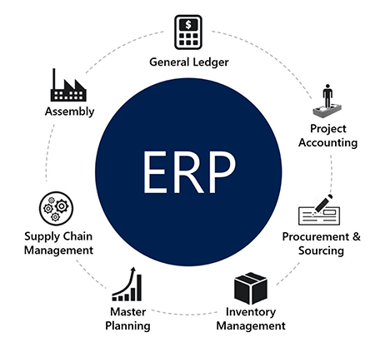
Discover Enterprise Resource Planning (ERP)
An effective ERP system allows an organization to analyze transactional data, resulting in more streamlined processes and greater efficiency.
Dynamics 365 is a set of intelligent business applications that work together seamlessly and span marketing, services, sales, operations, finance, commerce, and human resources.
Finance and operations apps help businesses manage their global financial systems, operational business processes, and streamlined supply chains to empower people to make fast, informed decisions.
Notes:
Enterprise resource planning (ERP) is business process management software that manages and integrates a company's financials, supply chain, operations, reporting, manufacturing, and human resource activities. Fundamentally, ERP software enables you to run the core processes of a business.
Generally, ERP software consists of a set of integrated business functions that automate many back-office processes such as procurement, inventory management, and assembly. By leveraging one central database, organizations can gain a real-time view across their operations.
An effective ERP system allows an organization to analyze transactional data, resulting in more streamlined processes and greater efficiency.
https://docs.microsoft.com/en-us/learn/modules/get-introduced-finance-operations-apps/2-discover-enterprise-resource-planning-erp

Slide 5
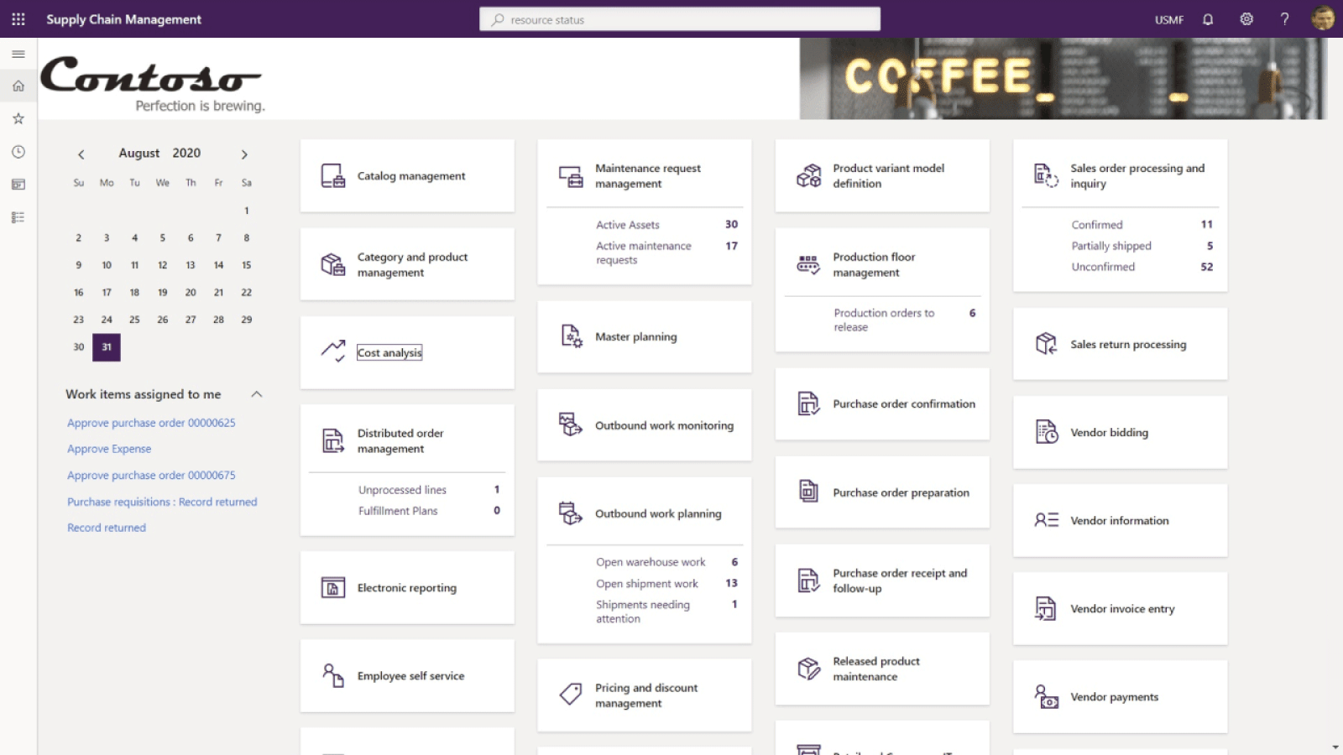
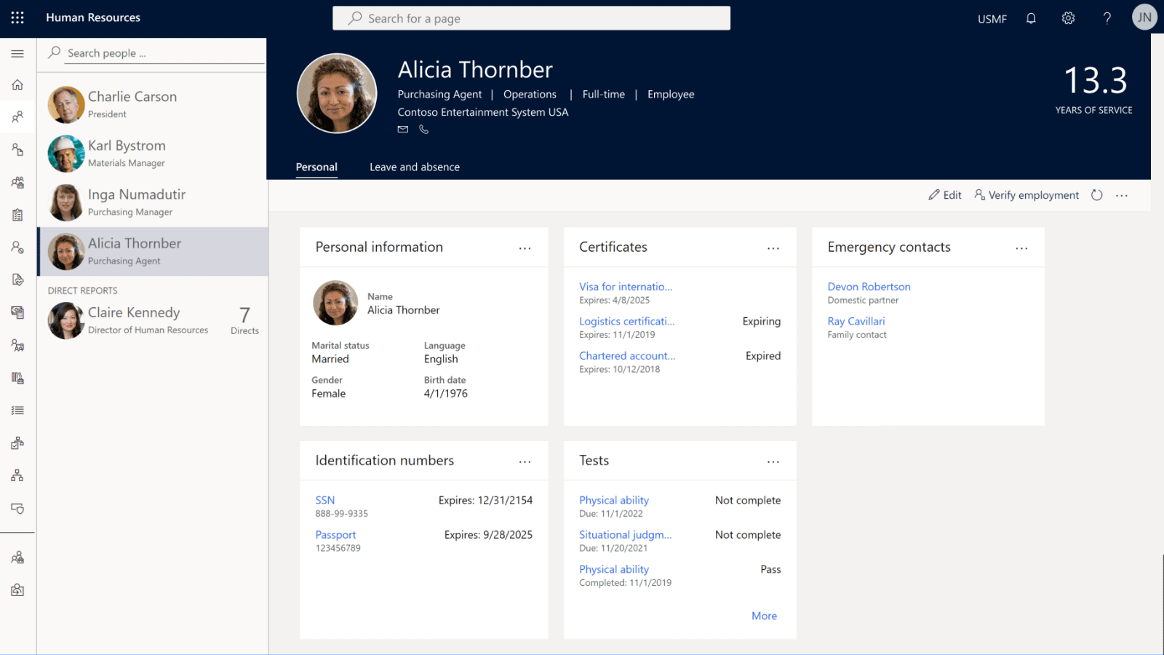
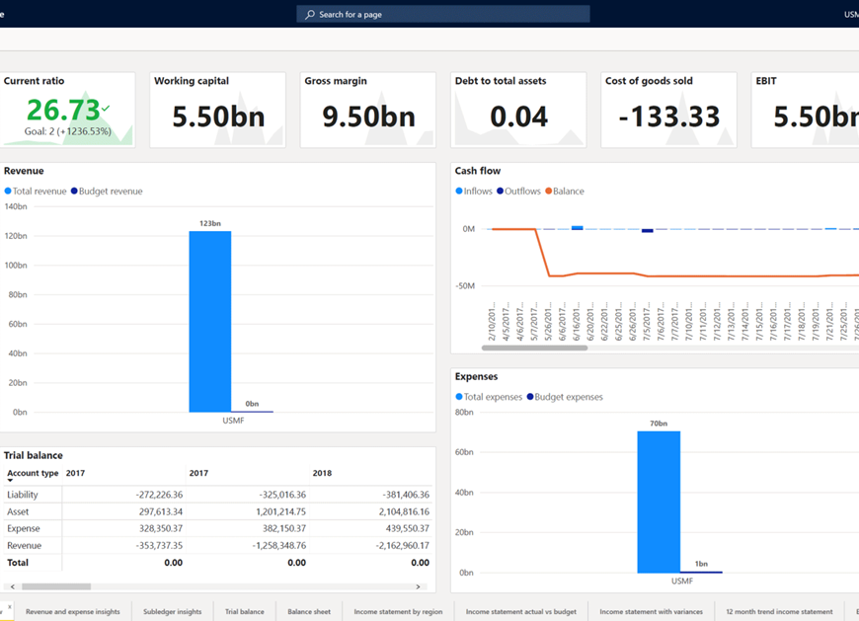
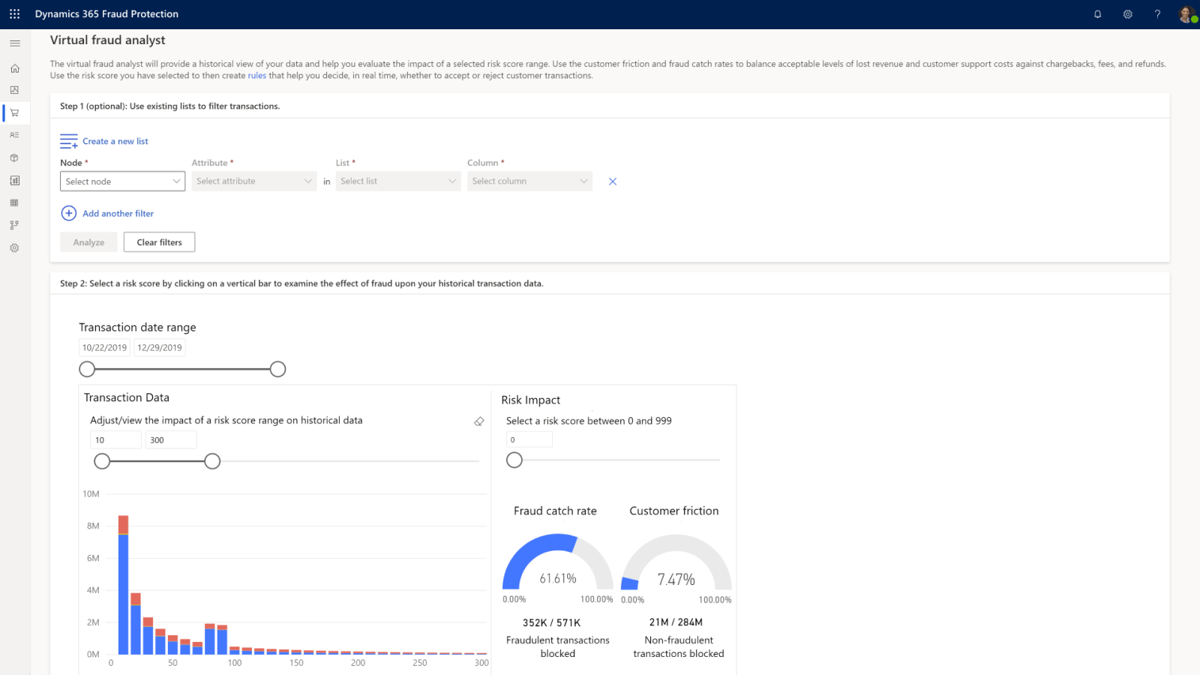
Dynamics 365 Finance and Operations Apps
Dynamics 365 Supply Chain Management
Dynamics 365 Human Resources
Dynamics 365 Finance
Dynamics 365 Commerce
Resolve product quality issues and accelerate time to market.
Gain planning agility to fulfil customer demand.
Optimize stock and logistics.
Transform employee experiences.
Optimize your HR programmed.
Increase organizational agility.
Redefine your traditional global financial management to monitor performance in real time, predict future outcomes.
Make data-driven decisions to drive business growth
A comprehensive omnichannel solution that unifies your back-office, in-store, call center, and digital experiences
Optimize operations to reduce costs and drive supply chain efficiencies
Notes:
Finance and operations apps
Dynamics 365 Supply Chain Management helps you deliver robust reporting, increase profitability through predictive business intelligence, and ensure global compliance. Dynamics 365 Supply Chain Management brings agility and efficiency to manufacturing by connecting and optimizing production planning, scheduling, operations, and cost management. It gives you real-time visibility into warehousing and transportation business processes to reduce costs, reduce delivery time, and increase accuracy.
Dynamics 365 Finance helps you redefine your traditional global financial management to monitor performance in real time, predict future outcomes, and make data-driven decisions to drive business growth. You can automate processes to increase efficiency, decrease operational expenses, and handle financial complexities.
Dynamics 365 Commerce delivers a comprehensive omnichannel solution that unifies your back-office, in-store, call center, and digital experiences. Dynamics 365 Commerce enables you to build brand loyalty through personalized customer engagements, increase revenue with improved employee productivity, and optimize operations to reduce costs and drive supply chain efficiencies, ultimately delivering better business outcomes.
Dynamics 365 Human Resources provides the workforce insights you need to build data-driven employee experiences. Dynamics 365 Human Resources can improve organizational agility, optimize programs, discover workforce insights, and transform employee experiences. Your HR team can centralize personnel data, automate processes, and enable self-service.
Ref: https://docs.microsoft.com/en-us/learn/modules/get-introduced-finance-operations-apps/2-discover-enterprise-resource-planning-erp

Slide 6
Lesson 2: Basic UI and Navigation

Slide 7
Basic UI and Navigation
In this lesson, you will learn how to:
1
Demonstrate Dynamics 365 FO UI elements and basic navigation techniques
6
Configure User options and Add attachments to Dynamics 365 records
2
Describe the uses and capabilities of workspaces
7
Demo 1: Personalize a workspace
Demonstrate how you can use the Personalization feature to customize pages and workspaces
3
8
Exercise 1: Work with an operational workspace
4
Understand the differences between customization and personalization
9
Group discussion: List top five benefits gained by using operational workspaces
5
Describe and implement filters
10
Exercise 2: Perform searches and work with filters

Slide 8
Basic UI and Navigation – Continued
In this lesson, you will learn how to:
1
Exercise 3: Create search queries and save for future use
6
Describe Help options
2
Create and use record templates.
7
Create and use Saved Views
3
Exercise 4: Work with record templates
8
Exercise 6: Work with Saved Views
4
Generate and select output options for documents and reports – Financial Reporting
9
Add KPI to a dashboard workspace and Menu item to favorites
5
Exercise 5: Prepare, enable, and use business document management

Slide 9
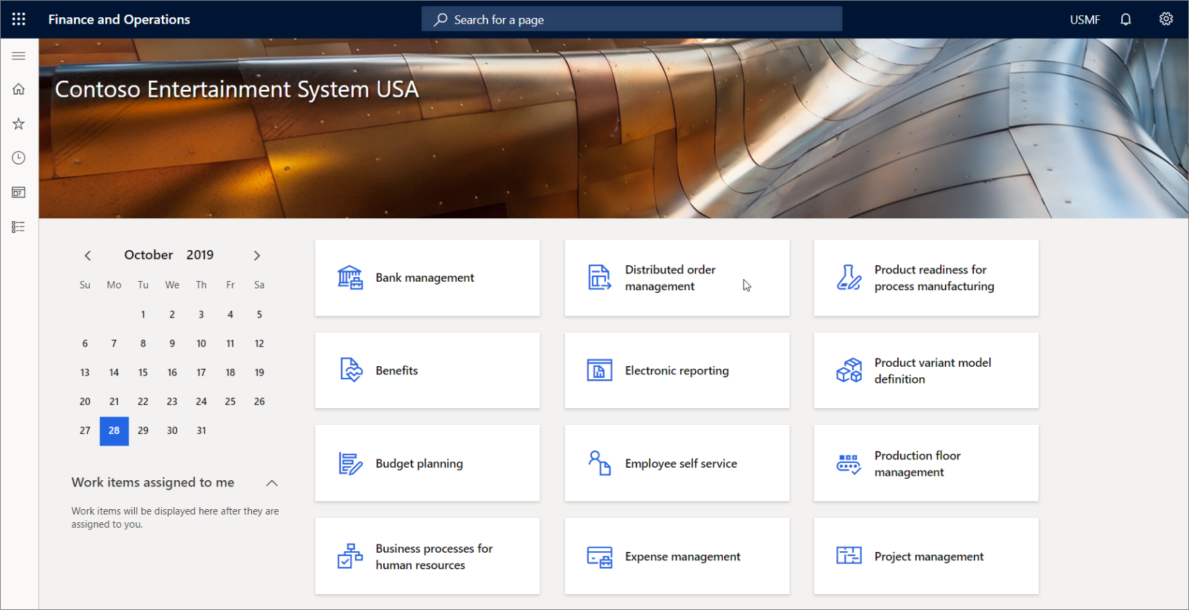
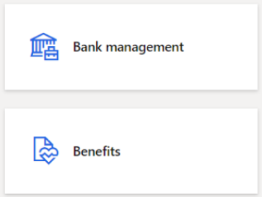
Navigation Elements
The primary navigation concepts in Finance and Operations apps are:
Dashboard
Tiles
Dashboard
Navigation pane
Workspaces
Tiles
Navigation search
Notes:
dashboard
The dashboard is the first page that you will see in Finance and Operations apps. It contains tiles that show various information. You can return to the dashboard at any time by clicking Finance and Operations apps on the navigation bar at the top of the frame.
The dashboard consists primarily of a large section of workspace tiles.
Tiles
A tile is a rectangular button that behaves like a menu item button. It is used to navigate to, or open pages. Tiles can also display relevant data, such as counts or key performance indicators (KPIs). A tile can include images that provide you with additional visual context.
The screenshot below shows the Bank management, and Benefits tiles.
Ref: https://docs.microsoft.com/en-us/learn/modules/navigate-finance-operations/2-navigation-elements

Slide 10
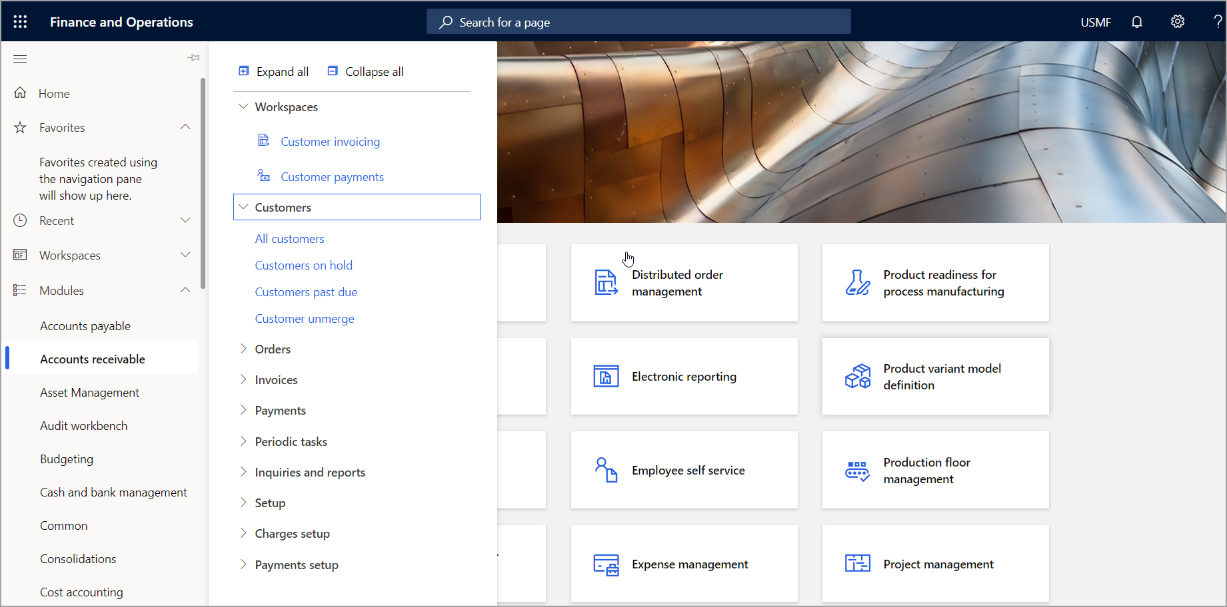
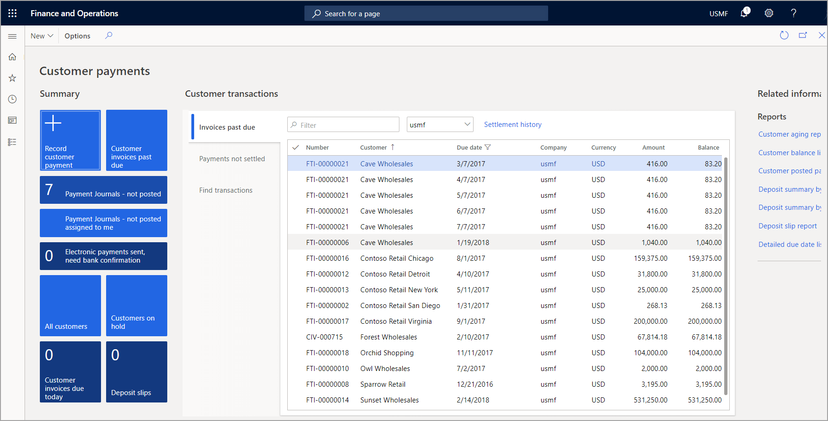
Navigation Elements – Navigation Pane & Workspaces
Navigation pane
Workspaces
Notes:
Navigation pane
The navigation pane provides access to workspaces, main menu elements, recently opened pages, and user-defined favorites. You can open the navigation pane by selecting the Show navigation pane button under the navigation bar.
The navigation pane consists of four collapsible sections.
Favorites - This section provides quick access to the list of pages the user has explicitly marked as a favorite. Marking a page as a favorite is accomplished by clicking the star icon next to the page in the navigation pane. This can be helpful for areas of the system that are used frequently, or, conversely, areas of the system that are not used frequently but could benefit from being easily accessible when the need arises.
Recent - This section is a list that is auto populated with links to the areas in the system that have been viewed most recently. This can be helpful for Reference purposes, as well as easily switching back and forth between separate areas of the system.
Workspaces - This is the set of workspaces a user has access to.
Modules - This section provides the full list of modules. Clicking on a module will open the right side of the navigation pane, where you can navigate to a specific page in that module.
Workspaces
Workspaces are activity-oriented pages that are designed to increase your productivity by providing information that answers your most pressing activity-related questions. This is where you store your more frequent tasks.
Access to the various workspaces depends on the roles that users have in the organization.
To navigate to a workspace, you can click a tile on the dashboard, click a link in the navigation pane, or find the workspace using the navigation search feature.
Below is an image of the Customer payments workspace.
Workspaces contains sections of content that are relevant to the task for which the workspace is intended.
The first section will usually be a set of tiles that you can click to begin new tasks or access lists of items. The second section contains a set of relevant lists for the activity. The last section contains several links to pages that are important but not frequently used for this activity.
In between the list and links section are a few optional sections that might contain charts and graphs. One important distinction of workspaces is that they do not have a data source.
If the content requires a data source, it can be updated to include that.
Ref: https://docs.microsoft.com/en-us/learn/modules/navigate-finance-operations/2-navigation-elements

Slide 11
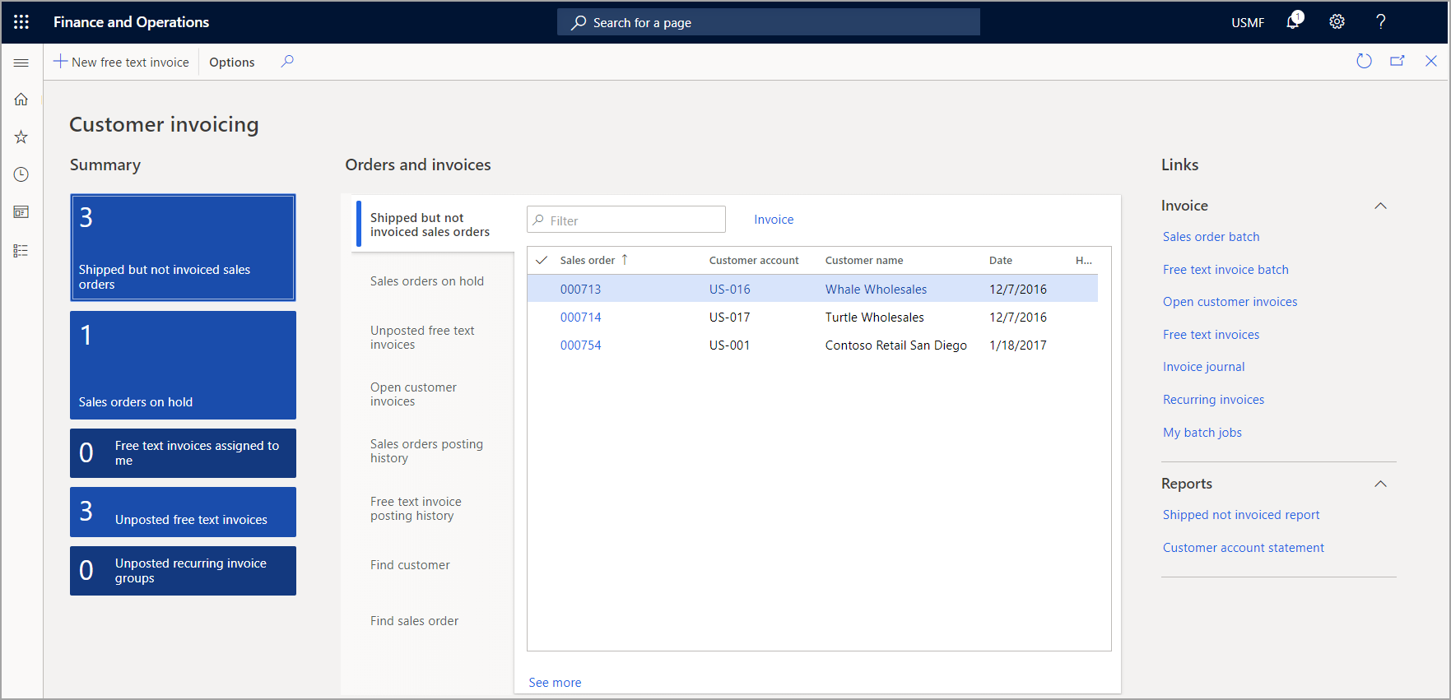
How workspaces drive productivity
360-degree view of activities
No need to navigate to multiple lists
Answers specific questions – Questions such as
Are there urgent cases that need to be attended
How difficult will my workload be?
Are cases easy or difficult to solve?
Provides insight
Compare multiple sources of data.
Provide a big picture view that might be difficult to achieve when only looking at lists in specific modules
Navigates by data
Less time spent filtering to find results
Direct access to tasks
Tasks can be performed directly from the workspace
Notes:
A workspace is a one stop-shop for specific activities. Here are some of the ways a workspace can help drive productivity:
360-degree view of activities - No need to navigate to multiple lists.
Answers specific questions - Questions such as:
Are there urgent cases that need to be attended
How difficult will my workload be?
Are cases easy or difficult to solve?
Provides insight - Compare multiple sources of data. Provide a big picture view that might be difficult to achieve when only looking at lists in specific modules.
Navigates by data - Less time spent filtering to find results
Direct access to tasks - Tasks can be performed directly from the workspace.
Let’s take a look at some key areas of the Customer invoicing workspace.
Summary - This section contains tiles for various types of orders and invoices. Each tile will also display how many orders belong to each category. You can click a tile to open a relating list page. For example, the Shipped but not invoiced sales orders tile shows there are three orders on hold. You can click the tile to see the three orders on hold.
Filter - The Filter search box allows you to easily find orders and invoices.
Orders and invoices - Various tabs provide access to various sections of the workbench. Each tab contains any sales orders or invoices relating to the tab. The first tab includes shipped but not invoiced sales orders.
Links - The Links section is broken into two sections: links relating to invoices and links relating to reports.
New free text invoice - New free text invoices can be created directly on the Customer invoicing workspace page by clicking the New free text invoice button on the Action Pane.
Ref: https://docs.microsoft.com/en-us/learn/modules/navigate-finance-operations/3-workspaces-driving-productivity

Slide 12
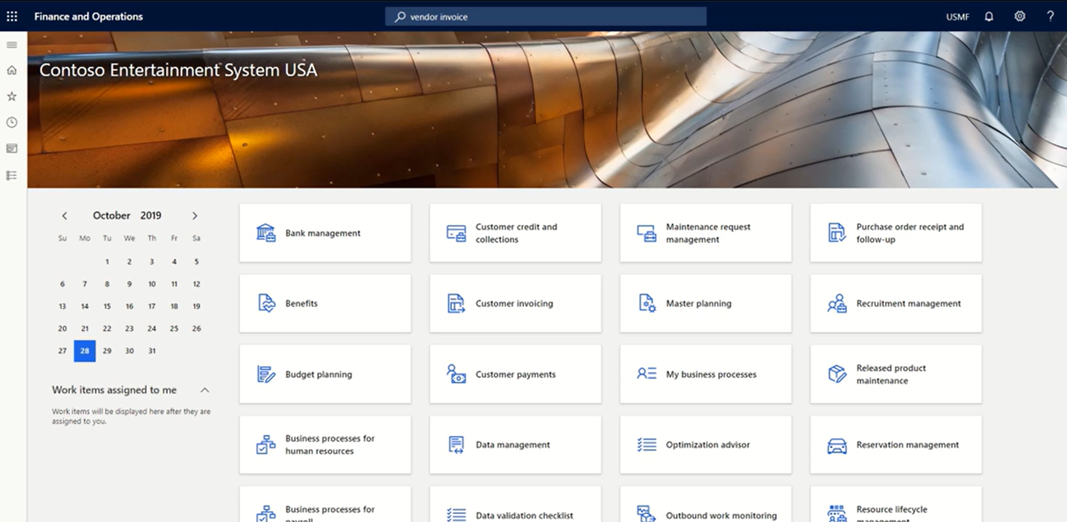
Video: How to use workspace
Use workspace
Notes:
Show about workspaces from
https://www.microsoft.com/en-us/videoplayer/embed/RE450W7?postJsllMsg=true

Slide 13
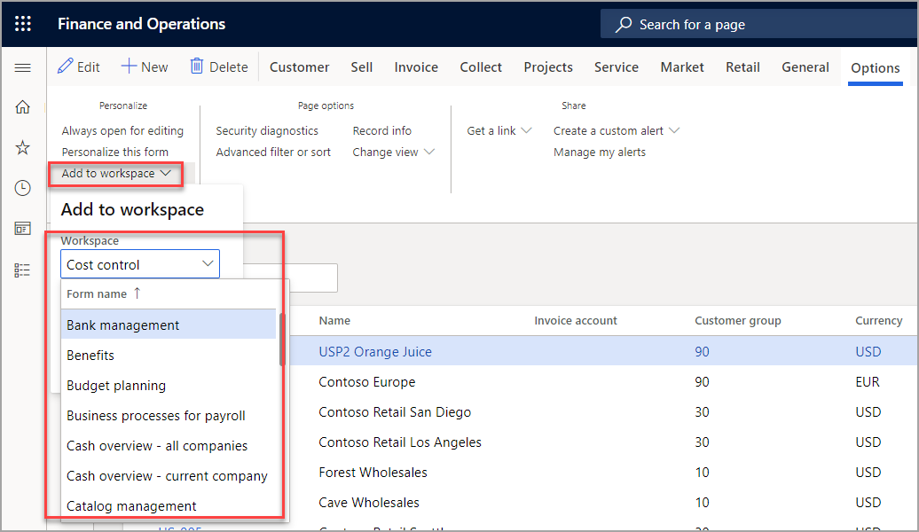
Personalize a workspace
You can specify that the information appears –
Add a List
Add a tile
Add a link
Notes:
For some pages that include lists, an additional personalization feature is available. The Add to workspace button in the Personalize group on the Options tab of the Action Pane lets you show the information from the current list in a specific workspace.
You can show a filtered and sorted view of the information in the workspace, or you can show the default view. You can also specify whether the information appears in the workspace as a list, as a summary tile that can show the number of items in the list, or as a link.
Add a list to a workspace
To add a list to a workspace, first sort or filter the list on the page so that it shows the information as you want it to appear in the workspace. Then select Add to workspace. Select a workspace, and then, in the Presentation field, select List. After you select Configure, a dialog box appears, where you can select the columns that should appear in the list in the workspace. You can also specify the label to use for the list in the workspace.
Add a tile to a workspace
To add a tile to a workspace, first filter the list on the page so that it shows the data that you want to be summarized or that want quick access to. Then select Add to workspace. Select a workspace, and then, in the Presentation field, select Tile. After you select Configure, a dialog box appears, where you can specify the label to use for tile in the workspace. You can also specify whether the tile should show a count. After the tile is added to the workspace, you can select it to open the current page from the workspace and view the filtered list that is associated with the tile.
Add a link to a workspace
To add a link to a workspace, first filter the list on the page so that it shows the data that you're interested in. Then select Add to workspace. Select a workspace, and then, in the Presentation field, select Link. After you select Configure, a dialog box appears, where you can specify the label to use for the link. You can also optionally specify a label for a new section that will contain this link.
After your list, tile, or link has been added to a workspace, you can open that workspace and reorder the elements in it, as needed.
Ref: https://docs.microsoft.com/en-us/learn/modules/personalize-finance-operations/8-workspace

Slide 14
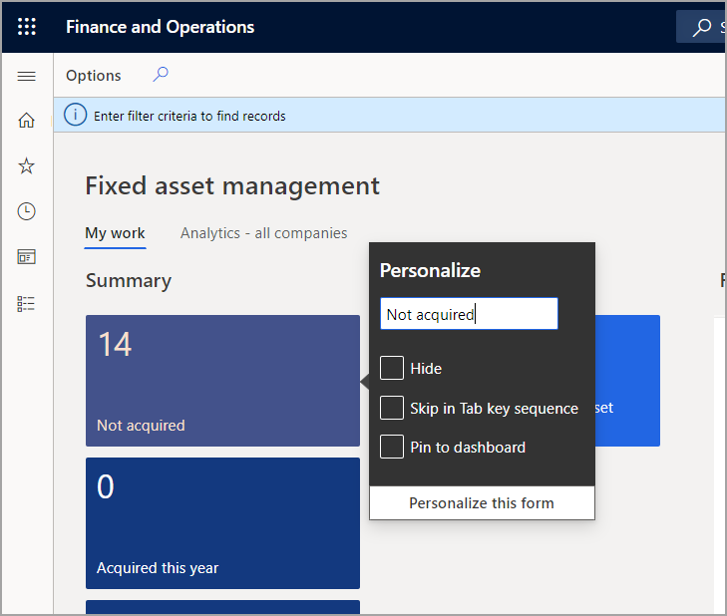
Adding a Summary from a Workspace to a Dashboard
Workspaces contain count tiles, and those tiles can appear on your dashboard
Steps to add a tile to Dashboard-
Right click on a count tile
Select Personalize
Select Pin to Dashboard
Notes:
Add a summary from a workspace to a dashboard
Some workspaces contain count tiles (that is, tiles that have numbers on them), and you might want those tiles to appear on your dashboard too. In a workspace, right-click a count tile, and then select Personalize. Then, in the tile's property window, select Pin to dashboard.
The next time that you open (and Refresh) the selected dashboard, the count will appear below the navigation tile for that workspace. You can select that count to go directly to the data that it represents.
Ref: https://docs.microsoft.com/en-us/learn/modules/personalize-finance-operations/8-workspace

Slide 15
Personalize the user experience
1
System-wide options – These personalization options are made on a setup page and are available to all users. Examples include the color theme and time zone.
2
Restricted personalization access – At this access level, user actions that are associated with typical page usage are automatically saved by the app and restored the next time that you visit the page.
3
Full personalization access – At this access level, users have access to all personalization capabilities in the app. They have access to the Personalization toolbar.
4
Sharing personalizations – Users who have full personalization access can export their page personalizations and share them with other users.
5
Administration of personalizations – Privileged users can access the Personalization administration page to manage all personalizations at an organizational level.
Notes:
System-wide options – These personalization options are made on a setup page and are available to all users. Examples include the color theme and time zone.
Restricted personalization access – At this access level, user actions that are associated with typical page usage are automatically saved by the app and restored the next time that you visit the page. For example, the app stores the width of grid columns if you adjust them, and the expanded or collapsed state of FastTabs.
Full personalization access – At this access level, users have access to all personalization capabilities in the app. In particular, they have access to the Personalization toolbar.
Sharing personalizations – Users who have full personalization access can export their page personalizations and share them with other users.
Administration of personalizations – Privileged users can access the Personalization administration page to manage all personalizations at an organizational level.
https://docs.microsoft.com/en-us/dynamics365/fin-ops-core/fin-ops/get-started/personalize-user-experience

Slide 16
System-wide options for the current user
The User options page contains several system-wide settings for the current user. These options are available to all users, even users who haven't been given any access to personalization
Visual
Preferences
Account
Workflow
Select a color theme and the default size of elements on pages.
Select default values that are used every time while opening the system. These values include the default company, the initial page, and the default view/edit mode.
View or adjust your username and other account-related options.
Select workflow-related options.
Notes:
System-wide options for the current user
The User options page contains several system-wide settings for the current user. These options are available to all users, even users who haven't been given any access to personalization. To open the User options page, select the Settings button on the navigation bar, and then select User options. The User options page has four tabs that contain various user settings:
Visual – Select a color theme and the default size of elements on pages.
Preferences – Select default values that are used every time that you open the system. These values include the default company, the initial page, and the default view/edit mode. (The view/edit mode determines whether a page is locked for viewing or opened for editing every time that you open it.) This tab also includes options for the language, the time zone, and date, time, and number formats. Finally, this tab includes several miscellaneous preferences that vary from release to release.
Account – View or adjust your user name and other account-related options.
Workflow – Select workflow-related options.
In addition to changing your user settings, you can also view and delete your usage data and personalizations from the User options page. To see your usage data, select Usage data on the Action Pane. On the Personalization tab, you can view and manage the personal changes that you've made to pages in the system. On this tab, you can also reset feature callouts (that is, the pop-up windows that introduce new system features). You will then be alerted again about previously encountered features.
Note
If the Saved views feature is turned on, you can view and manage your personalizations by selecting Personalization on Action Pane on the User options page.
https://docs.microsoft.com/en-us/dynamics365/fin-ops-core/fin-ops/get-started/personalize-user-experience#system-wide-options-for-the-current-user

Slide 17
Restricted Personalization Access (Formerly Implicit Personalizations)
1
Grid column widths
6
QuickFilters
2
Grid footer and column totals
7
Column header filters
3
FastTabs
8
Navigation pane
4
FactBoxes
5
Action Panes
Notes:
Restricted personalization access (formerly implicit personalizations)
At the restricted personalization access level, user actions that are associated with typical page usage are automatically saved by the app and restored the next time that you visit the page. No explicit save action is required.
Here is a list of the actions that fall under typical page usage and are covered by restricted personalization access:
Grid column widths – You can adjust the width of a column in a grid by selecting the sizing bar to the left or right of the column header, and then sliding it left or right until the column is the desired width. The app stores the width that you set for a column. Then, the next time that you open that page, the column will be resized to that width.
Grid footer and column totals – (Available only when the new grid control is turned on) You can decide whether a total should be shown at the bottom of any numeric column in a grid, and whether the grid footer should be visible. The app stores these preferences and applies them the next time that you open the page. For more information, see Grid capabilities.
FastTabs – Some pages have expandable sections that are known as FastTabs. The app stores information about the FastTabs that you've expanded or collapsed. The next time that you open the page, the same FastTabs will be either expanded or collapsed, based on your last interaction with the page. In some cases, you can help improve system performance by collapsing a FastTab, because the app doesn't have to retrieve the information for FastTabs until they are expanded. As is explained later in this article, you can also change the order of the FastTabs on a page.
FactBoxes – Some pages have a Related information pane that shows read-only information that is related to the current subject of the page. Each section in the Related information pane is known as a FactBox. You can expand or collapse the Related information pane, and you can also expand or collapse individual FactBoxes. The app stores these preferences. The next time that you open the page, the Related information pane and the individual FactBoxes will be either expanded or collapsed, based on your last interaction with the page. In some cases, you can help improve system performance by collapsing the Related information Pane or a FactBox, because the app doesn't have to retrieve the information for FactBoxes until they are expanded.
Action Panes – An Action Pane appears near the top of most pages. The Action Pane contains buttons for many of the actions that you can perform on the current page. These buttons are often organized on tabs. You can pin the whole Action Pane open, or you can have it collapsed by default. The next time that you open the page, the Action Pane will be either open or collapsed, based on your last interaction with the page. If you pinned the Action Pane open, the last tab that you were using will be shown.
QuickFilters – A QuickFilter appears above many grids. The QuickFilter lets you filter the grid based on a single column that you select. The app stores the column that you filtered on. Then, the next time that you open that page, the grid will use that same column for filtering by default. However, you can still select a different column to filter the grid on.
Column header filters – When you filter a grid by using column header filters, you can change the filter operator as you require to find the data that you want. For example, you can change the operator from begins with to is exactly. Every time that you use a column header filter and change the filter operator, the app stores the change. Then, the next time that you filter on that column, the filter operator will be restored.
Navigation pane – You can open the navigation pane by selecting the Expand the navigation pane button in the upper left of any page. (This button is sometimes Referred to as the Menu button, hamburger, hamburger menu, or hamburger button.) You can pin the navigation pane open, or you can have it collapsed by default. After you pin the navigation pane open, the app will keep it open until you collapse it.
https://docs.microsoft.com/en-us/dynamics365/fin-ops-core/fin-ops/get-started/personalize-user-experience#restricted-personalization-access-formerly-implicit-personalizations

Slide 18
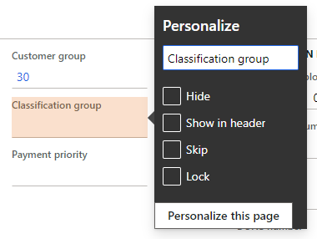
Full Personalization Access (Formerly Explicit Personalizations)
The Personalization capabilities that are available to users at the full personalization access level.
Shortcut menu options
The Personalization toolbar
Adding tiles, lists, and links to workspaces
Adding a summary from a workspace to a dashboard
Personalizing the dashboard
Notes:
Full personalization access (formerly explicit personalizations)
At the full personalization access level, users have access to all the personalization capabilities that the app provides. Because different people and companies have different needs when they interact with the app, especially in terms of utilized fields, personalization provides tools that let users and organizations tailor the way that information is ordered and interacted with in the app. These capabilities are key to providing simplified, optimized experiences in the app that are tailored to you and your organization.
If the Saved views feature is turned on, an explicit save is required to persist these changes to the user experience for a specific view. When the Saved views feature is turned off, these changes are automatically saved.
The following sections cover the extent of personalization capabilities that are available to users at the full personalization access level. Here are some of these capabilities:
Shortcut menu options
The Personalization toolbar
Adding tiles, lists, and links to workspaces
Adding a summary from a workspace to a dashboard
Personalizing the dashboard
https://docs.microsoft.com/en-us/dynamics365/fin-ops-core/fin-ops/get-started/personalize-user-experience#full-personalization-access-formerly-explicit-personalizations

Slide 19
Shortcut menu options
Shortcut menus provide one way to change a page’s interface so that it better meets your requirements or the requirements of your organization.
You can use the property window to personalize an element in the following ways
Change the element’s label.
Hide the element so that it isn’t shown on the page.
Include the information in the FastTab’s summary section.
Skip the field so that it never receives focus while you tab through the page.
Prevent data in the field from being.
Designate a field to be required for data entry.
Notes:
Shortcut menu options
Shortcut menus provide one way to change a page's interface so that it better meets your requirements or the requirements of your organization. (A shortcut menu is also known as a right-click menu or a context menu.)
Some of the most typical and important changes that can be made to a page are available directly as options on a shortcut menu. For example, if you want to add or hide columns in a grid, just right-click a column header, and then select Insert columns or Hide this column.
Additionally, the most basic types of personalizations are available by right-clicking an element and then selecting Personalize. (Note that not all elements on your page can be personalized.) When you use this personalization method, the element's property window appears.
You can use the property window to personalize an element in the following ways:
Change the element's label.
Hide the element so that it isn't shown on the page. The data in the field isn't deleted or modified. The information just isn't shown on the page any longer.
Include the information in the FastTab's summary section (if the element is on a FastTab).
Skip the field so that it never receives focus when you tab through the page.
Prevent data in the field from being edited (for any record).
Designate a field to be required for data entry. If no value has been entered in this field, it will appear with a red border and an asterisk to indicate this state. This option is only available starting in version 10.0.11 when the Saved views and Designate fields as required using personalization features are turned on.
The property window might include other personalization capabilities, depending on the element. For example, the property window for a tile might let you promote that tile to a dashboard, and property windows for elements on the default dashboard might let you create a new custom workspace.
https://docs.microsoft.com/en-us/dynamics365/fin-ops-core/fin-ops/get-started/personalize-user-experience#full-personalization-access-formerly-explicit-personalizations

Slide 20
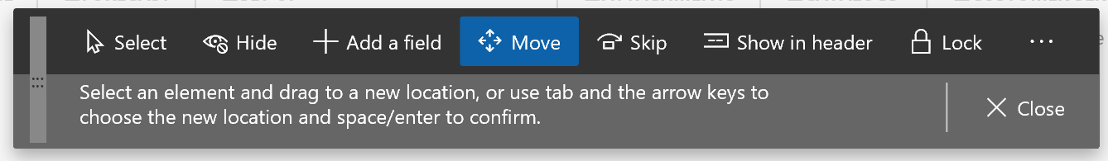
Personalization Toolbar
The tools are available on the Personalization toolbar:
Select tool
Hide tool
Add fields tool
Move tool
Skip tool
Show in header tool
Require tool
Lock tool
Add an app from Power Apps tool
Add an app button
Clear tool
Import tool
Export tool
Close button
Notes:
Personalization toolbar
If you want to make multiple changes to a page, or changes that aren't available through other mechanisms (for example, if you want to reorder elements), you can use the Personalization toolbar. To open the Personalization toolbar, follow one of these steps:
Select Ctrl+Shift+P from any element on the page.
Select Personalize this page in an element's property window.
Select Personalize this page in the Personalize group on the Options tab of any page's Action Pane.
Select the Settings button (the gear symbol) on the navigation bar, and then select Personalize.
Navigating the page
When the Personalization toolbar is open, the underlying page is read-only (in other words, you can't edit data), but it's still interactive. Specifically, you can expand or collapse the Related information pane, switch tabs, and expand or collapse sections, just as you would usually perform those actions on the page. To apply a personalization to a collapsible section or tab (for example, to hide a FastTab), you just have to select the button that appears next to that section or tab when it gains keyboard focus or when you hover over it.
Personalization tools
The following tools are available on the Personalization toolbar:
Use the Select tool to select and change the properties of an element. To use this tool, select the Select button on the toolbar, and then select the desired element. The element's property window appears, where you can change any of the properties of that element. You can repeat the process for other elements that can be personalized on the page. Note that some personalization properties might not be available in some scenarios. For example, you can't lock a field that is required.
Use the Hide tool to hide an element on the page. To use this tool, select the Hide button on the toolbar, and then select the element to hide. When you use the Hide tool, all elements that are currently hidden are made visible, but they are shown in a shaded container. You can then make an element visible by selecting it. To see how the page will look when elements are hidden, switch to another personalization tool or close the personalization toolbar.
Use the Add fields tool to add fields to your page. When you use this tool, you can only add fields that are part of the page definition. For information about how to create new fields that aren't part of the current page definition, see Create and work with custom fields. After you select the Add fields button on the toolbar, you must first select the grid or section where you want to add a field. A dialog box will show the list of fields that are related to the selected grid or section. In the dialog box, select one or more fields to add from either the Recommended fields or All fields list. After choosing the desired fields, select Update. To remove a field that you previously added, repeat the process, but clear the selection of the field in the dialog box.
The Recommended fields list shows fields that have been previously added by other users in your organization. This list of fields is updated based on the recurrence frequency of the Recommendation batch job. A similar experience exists when adding new filter fields using the Filter pane on a page.
Use the Move tool to move an element to a different location in the current group of elements. Note that you can't move an element outside its parent group. To use this tool, select the Move button on the toolbar, and then select the element to move. When you select an element, the app determines the locations where the element is allowed to be moved. These locations are known as drop zones. As you drag the element around in the current group, each drop zone is shown as a colored, bold line next to the area where the element can be dropped.
Use the Skip tool to remove an element from the page's keyboard tab sequence. When you select the Skip button on the toolbar, all elements that are currently skipped are shown in a shaded container. You can interactively remove or add fields to the tab sequence.
Use the Show in header tool when you want a field to appear in the FastTab's summary section. When you select the Show in header button on the toolbar, all fields that have been selected as summary fields are shown in a shaded container. You can interactively add fields to the FastTab summary and remove fields from the summary by selecting the fields.
Use the Require tool to designate an element as required for data entry. When you select the Require button on the toolbar, all elements that have been personalized to make them required are shown in a shaded container. You can then make them not required again. This option is available in version 10.0.12 and later when the Designate fields as required using personalization feature is turned on.
Use the Lock tool to mark an element as either editable or noneditable. When you select the Lock button on the toolbar, all elements that are currently noneditable are shown in a shaded container. You can then make them editable again. Note that some fields are required and can't be made noneditable. A padlock symbol appears next to those fields.
Use the Add an app from Power Apps tool to embed an app that was created by using Microsoft Power Apps into the page. For detailed information about how to embed an app from Power Apps into a page, see Embed apps from Power Apps. This option is available only when the Saved views feature is turned off.
Use the Add an app button to embed an app, either one created from Microsoft Power Apps or a third-party, into the page. This option is only available when the Saved views feature is turned on.
Use the Clear tool to reset the page to its default, installed state. All personalizations on the current page will be cleared. You can't undo this action. Therefore, use this tool only if you're sure that you want to reset the page. When the Saved views feature is turned on, this tool clears the personalizations for the current view.
Use the Import tool to load a personalization from a file that you or someone else previously created.
When the Saved views feature is turned off, you can choose whether to add or replace your existing personalizations with the personalizations that are being imported for the page. You can't undo this action. Therefore, after you import personalizations, you must manually clear or undo any changes that you don't want.
When the Saved views feature is turned on, the imported personalizations will become a view on the page. If the view already exists, you will have the option to skip the import, replace the current view that has the same name, or rename the imported view.
Use the Export tool to save your personalizations for the page to a file. You can then share your personalizations with other users. Those users just have to import the file that contains your personalizations for the page. When the Saved views feature is turned on, this tool saves your current view to a file for sharing.
Select the Close button to close the Personalization toolbar and return the page to its previous interactive state.
Traditionally, when the Personalization toolbar is used, your personalizations take effect as soon as you make them. However, if the Saved views feature is turned on, you must explicitly save personalizations to a view that you choose.
In some cases, when you select a tool, a padlock symbol appears next to an element. This symbol indicates that you can't modify the element properties that are related to the selected tool, because changes to those properties will prevent the page from working correctly.
https://docs.microsoft.com/en-us/dynamics365/fin-ops-core/fin-ops/get-started/personalize-user-experience#full-personalization-access-formerly-explicit-personalizations

Slide 21
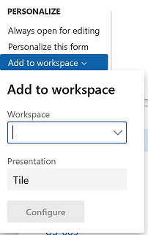
Other capabilities for full personalization access
Adding tiles, lists, and links to a workspace
This feature lets you push relevant information from the current list to a specific workspace.
Adding a summary from a workspace to a dashboard
Some workspaces contain count tiles and those tiles to appear on your dashboard too. select Personalize, and then, in the tile’s property window, select Pin to dashboard.
Personalizing your dashboard
If the Full-page apps feature is turned off, add a new tile by right-clicking an element on the dashboard and then selecting Add a workspace.
If the Full-page apps feature is turned on, add a new tile by right-clicking an element on the dashboard and then selecting Add an app.
Notes:
Adding tiles, lists, and links to a workspace
For some pages that include lists, the Add to workspace personalization feature is available in the Personalize group on the Options tab of the Action Pane. This feature lets you push relevant information from the current list to a specific workspace. The information that appears in the workspace can be based on either the whole list, or a filtered and sorted version of the list. You can also specify whether the information appears in the workspace as a list, a summary tile that can show the number of items in the list, or a link.
Note
If the Saved views feature is turned on, the content that you push to a workspace is directly linked to a view. The view's query is used to retrieve data into the workspace, and the corresponding tile or link in the workspace opens the page to that view, so that the view's query and personalizations are applied to it. If the view is updated, the corresponding workspace elements will be adjusted to the new view definition.
To add a list to a workspace, first sort or filter the list on the page so that it shows the information as you want it to appear in the workspace. (If the Saved views feature is turned on, you can't continue until you save a view that has these conditions.) Then select Add to workspace. Select a workspace, and then, in the Presentation field, select List. After you select Configure, a dialog box appears, where you can select the columns that should appear in the list in the workspace. You can also specify the label that is used for the list in the workspace.
To add a tile to a workspace, first filter the list on the page so that it shows the data that should be summarized or that you want quick access to. (If the Saved views feature is turned on, you can't continue until you save a view that has these conditions.) Then select Add to workspace. Select a workspace, and then, in the Presentation field, select Tile. After you select Configure, a dialog box appears, where you can specify the label that should be used for the tile in the workspace. You can also specify whether the tile should show a count. After the tile is added to the workspace, you can select it to open the current page from the workspace. You can then view the filtered list that is associated with the tile.
Starting in version 10.0.26, if the Allow users to select and change tile sizes feature is enabled, you can select one of four available Tile sizes for your new tile in the Configure tile dialog. This feature also allows you to adjust the tile size after it's created directly from the workspace.
To add a link to a workspace, first filter the list on the page so that it shows the data that you're interested in. (If the Saved views feature is turned on, you can't continue until you save a view that has these conditions.) Then select Add to workspace. Select a workspace, and then, in the Presentation field, select Link. After you select Configure, a dialog box appears, where you can specify the label that should be used for the link. You can also optionally specify a label for the section where this link can be placed. If that section doesn't exist, a new section will be created.
Note
As of version 10.0.25, when you configure your list, tile, or link, you might also have to select the workspace views that you want to add the element to if the (Preview) Saved views support for workspaces feature is enabled. The available workspace views will appear in the Workspace options section of each Configure dialog box.
After you've added a list, tile, or link to a workspace, you can open that workspace and rearrange the elements in it as you want.
Adding a summary from a workspace to a dashboard
Some workspaces contain count tiles (that is, tiles that have numbers on them), and you might want those tiles to appear on your dashboard too. In a workspace, right-click a count tile, select Personalize, and then, in the tile's property window, select Pin to dashboard. The next time that you open and Refresh the dashboard, the count will appear below the navigation tile for that workspace. You can select that count to go directly to the data that it represents.
Changing the size of a tile
Starting in version 10.0.26, the Allow users to select and change tile sizes feature allows users to modify the size of any non-KPI tile via personalization. In a workspace, right-click a tile, and then select Personalize. In the tile's property window, select the desired size from the Tile size options. The tile size will adjust immediately. If the (Preview) Saved views support for workspaces feature is enabled, you can save this personalization to a workspace view.
Personalizing your dashboard
The dashboard is often the first page that you see when you open the app. It can be personalized like any other page in the system, by using the same mechanisms that are described earlier in this article.
Warning
Currently, when you hide content on the dashboard, it's important that you directly target a tile, not the space around it. If you hide the group around a tile, there could be unexpected results if more tiles are added later, or if the system is switched to a different language.
One unique personalization capability that is available on the dashboard is the ability to add tiles.
If the Full-page apps feature is turned off, you add a new tile by right-clicking an element on the dashboard and then selecting Add a workspace. A new workspace tile is created at the bottom of the dashboard. You can rename this new workspace tile as you want. You can also add lists, tiles, and links to the workspace, as described in the Adding tiles, lists, and links to a workspace section of this article.
If the Full-page apps feature is turned on, you add a new tile by right-clicking an element on the dashboard and then selecting Add an app. In the dialog box, select whether you want to add a tile for a new workspace or a tile that has content from Power Apps or a website. Then follow the steps to configure the option that you selected. A new tile is created at the bottom of the dashboard. For more information about how to add, edit, delete, and share these embedded apps, see Embed canvas apps from Power Apps and Embed third-party apps.
https://docs.microsoft.com/en-us/dynamics365/fin-ops-core/fin-ops/get-started/personalize-user-experience#full-personalization-access-formerly-explicit-personalizations

Slide 22
Administration of personalizations
1
Apply – Import or select a personalization for one or more users. To apply a personalization to one or more users, first select a role and users who have that role.
2
Clear – Clear all personalizations for a page or workspace for one or more users. First select a page or workspace to see a list of the users who have personalized it.
3
Users – Select a user to see a list of the pages that the user has personalize, then turn the user’s ability to use personalizations for specific pages, or for the whole system, on or off.
4
System –Temporarily turn off personalization for all users in the system. In this case, all personalizations are deleted for all users, and all pages are reset to their default state.
Notes:
Administration of personalizations
The Personalization page is the central hub for managing personalizations at an organizational level. The content and capabilities on this page depend on whether the Saved views feature has been turned on.
For customers who have turned on the Saved views feature, see the "Managing views globally" section in the Saved views article.
For customers who haven't yet turned on the Saved views feature, this page has four tabs:
Apply – You can import or select a personalization for one or more users. To apply a personalization to one or more users, first select a role and users who have that role. Then either select an existing personalization to apply to the selected users, or import a personalization file. The personalization is validated and will be applied to all the selected users the next time that they open the selected page.
Clear – You can clear all personalizations for a page or workspace for one or more users. First select a page or workspace to see a list of the users who have personalized it. Then select the users who should have personalizations for that page or workspace cleared, and select Clear. All personalizations that the selected users have applied to the selected page or workspace are deleted. This action can't be undone. However, if a personalization was saved for the page or workspace, that personalization can be reimported.
Users – Select a user to see a list of the pages that the user has personalized. You can then turn that user's ability to use personalizations for specific pages, or for the whole system, on or off. You can also import, export, or clear a personalization for the user. In addition, you can reset feature callouts for the user. In this case, if the user previously dismissed any pop-up windows that introduce new features, they will appear again the next time that the user encounters those features.
System – You can temporarily turn off personalization for all users in the system. In this case, all personalizations are deleted for all users, and all pages are reset to their default state. If you turn personalization back on later, all personalizations are reapplied. You can also permanently delete all personalizations for all users in the system. Personalizations that have been deleted can't be recovered. Therefore, before you perform this task, be sure to export any personalizations that you might want later.
Service updates and personalization
Personalization data does not need to be cleared or reset when moving to a new version of the product. Personalizations and saved views data will continue to work across updates. Exceptions to this would include changes to the form itself that invalidate a personalization (such as a removed control) or changes to the form's base query that changes its data source subtree so that it no longer matches the data source subtree associated with the view query.
https://docs.microsoft.com/en-us/dynamics365/fin-ops-core/fin-ops/get-started/personalize-user-experience#administration-of-personalizations

Slide 23
Understanding the differences between customization and personalization
What is customization?
What is personalization?
As a functional consultant you have already identified a gap in your customer’s requirements and identified a solution that needs to be created to address the gap.
Developers on your team can use extensions to customize the standard functionality of Finance and Operations apps to address the customer’s business requirements.
Changing the user interface by, for example, adding or removing fields to meet a customer’s requirements may be achieved by using the built-in Personalization feature of Finance and Operations apps.
The main goal of personalization is to deliver content and functionality that matches a specific role, user, or group of users’ needs, without customizing Finance and Operations apps.
Notes:
What is customization?
The term customization means that you as a functional consultant have already identified a gap in your customer’s requirements and identified a solution that needs to be created to address the gap.
Because Finance and Operations apps has locked the code for standard functionality out-of-the-box, developers are no longer able to use the over-layering concept. This means that modifying standard code is no longer possible. However, developers on your team can use extensions to customize the standard functionality of Finance and Operations apps to address the customer’s business requirements.
After meeting with your team members and discussing with the customer, you decide to extend the functionality of Finance and Operations apps by, perhaps, creating new entities, user interfaces, tables, and more.
The developer team will then identify the entities that need to be extended and possibly create new entities to find a solution that address the gap.
What is personalization?
Changing the user interface by, for example, adding or removing fields to meet a customer’s requirements may be achieved by using the built-in Personalization feature of Finance and Operations apps.
The main goal of personalization is to deliver content and functionality that matches a specific role, user, or group of users’ needs, without customizing Finance and Operations apps.
Always try to avoid customization and extensions, and use personalization where possible. This is because customization and extensions can result in higher costs during implementation.
It is important to point out that not many business users change default settings. Often, it is the manager of each department of your customer’s business that needs a specific user interface, or functionality to be imposed for their staff.
It’s worth noting that customization and extensions, as well as personalization, require work and maintenance over time.
Ref: https://docs.microsoft.com/en-us/learn/modules/personalize-finance-operations/2-custom-personalize

Slide 24
Filters
There are several filtering options that you can use in Finance and Operations apps:
1
Filter Pane – An inline pane that slides in from the left, and that contains multiple filter criteria that can be applied to the targeted content.
2
QuickFilter – A framework-provided filtering mechanism that can appear above any list or grid, and that provides fast single-column filtering.
3
Grid Column filtering – The user can define filter conditions and perform single-column sorting by using a drop dialog that is opened from the grid column header.
4
Advanced Filter – For most advanced filtering scenarios, the migrated Advanced filter form from Dynamics AX 2012 is still available.
Notes:
Filter pane
The Filter pane provides an easy-to-use interface for filtering full page lists. The Filter pane is an inline pane that slides in from the left side of the screen and pushes the page content to the right, so that users can see the data that they want to filter. You can open this filter mechanism by clicking the system-defined Show filters button on the left side of the page. After it has been opened, the Filter pane remains visible until you go to a new page, or until you close the Filter pane by using the Hide filters button. QuickFilter
In Finance and Operations apps, the QuickFilter is a modeled control that can be associated with any grid in the system. As the user starts to type, a column selector drop-down menu appears to guide the user toward the column that the filter will be applied to. The developer can also specify the default column for the QuickFilter. If no column is specified, the default column is the first field that can be filtered in the grid.
Grid column header filtering/sorting
The grid filtering experience is more closely aligned with the experience in Microsoft Excel. When you click a column header (for columns that can be filtered), a drop-down menu appears, and you can use it to filter the column. The filtering experience here mimics the filtering experience in the Filter pane. Additionally, there are options to sort the grid based on the column that is currently selected.
Advanced filter or sort
For most advanced filtering scenarios, the migrated Advanced filter form from Dynamics AX 2012 is still available.
Wildcards
You can use the asterisk to indicate that any value before or after this point is valid, which is great for searching for records that all start and/or have the same characters somewhere within the field.
To read more about filtering options and filtering expressions in Filtering options.
https://docs.microsoft.com/en-us/learn/modules/navigate-finance-operations/4-filtering-techniques?ns-enrollment-type=learningpath&ns-enrollment-id=learn-dynamics.get-started-with-dynamics-365-for-finance-and-operations

Slide 25
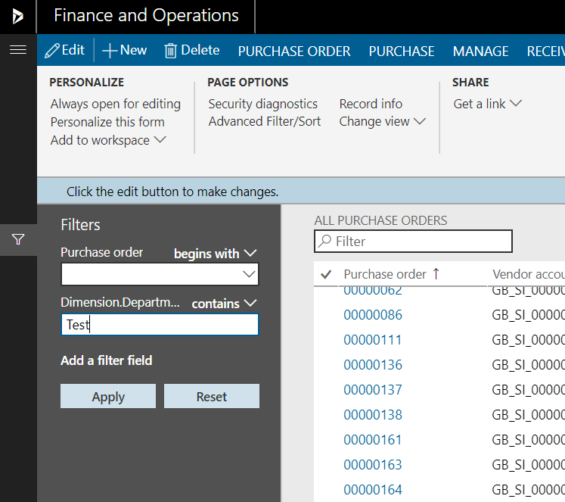
Filter Pane and its Characteristics
The Filter Pane provides an easy-to-use interface for filtering full page lists.
The Filter Pane is available for all forms except the following forms – Drop dialogs, Dialogs, Enhanced previews, Lookups, Form parts, parts, Table of Contents form type, forms that have no data sources.
The fields that are initially shown in the Filter Pane are selected
All ranges/filters
No ranges filters exist on the query
No fields from the primary index
Notes:
Filter Pane
The Filter Pane provides an easy-to-use interface for filtering full page lists. The Filter Pane is an inline pane that slides in from the left side of the screen and pushes the page content to the right, so that users can see the data that they want to filter. Users open this filter mechanism by clicking the system-defined Show filters button on the left side of the page. After it has been opened, the Filter Pane remains visible until the user goes to a new page, or until the user closes the Filter Pane by using the Hide filters button.
When is the Filter Pane available?
Currently, the Filter Pane is available for all forms except the following forms:
Drop dialogs
Dialogs
Enhanced previews
Lookups
Form parts
Parts
Table of contents form type
Forms that have no data sources
Note: The availability of the Filter Pane on particular forms and form types is evolving, so this list might change.
What data does the Filter Pane work on?
Because the Filter Pane is targeted at full page lists, it works only on the tables and fields that are directly joined (by inner/outer joins) to the first master data source on the form. This filtering mechanism isn't intended for filtering on secondary collections, or for filtering on other root data sources and their directly joined data sources. Other filtering mechanisms (QuickFilter, grid column filtering, and so on) are available to meet these other requirements.
What fields are initially shown in the Filter Pane?
Here is how the fields that are initially shown in the Filter Pane are selected:
All ranges/filters that currently exist on the query (only non-hidden filters/ranges are shown) are used.
If no ranges filters currently exist on the query, the fields from the primary index from the first master data source are used.
If there are no fields from the primary index from the first master data source, the TitleFields that are defined directly on the first master data source are used. If no TitleFields are defined, no default fields are shown. (Currently, if the first master data source extends another table (for example, table B), we don't show the TitleFields from table B. However, we plan to add that check in the future.)
Can I control the default fields that appear in the Filter Pane?
Developers can make sure that a particular field appears in the Filter Pane by adding an empty filter for that field to the query. For an example, see the FmCustomer form, which adds the filters post super() in form in it(). Note that after an empty field has been added to guarantee that it appears in the Filter Pane, the fields in the Filter Pane will always be those that are explicitly on the query, and will never be the TitleFields or fields from the primary index on the first master data source.
I don’t want users to be able to filter on a specific field or modify an existing filter. How do I accomplish this?
Developers can affect whether users can modify/add filters on certain fields by changing the status of the filters. The allowed values are in the RangeStatus.
Open (default) – The user can see and modify this filter.
Locked – The user can see the filter value but can't modify it. The user also can't add another filter on this column.
Hidden – The user can't see that there is a filter on this column. The user also can't add another filter on this column.
Can I control the fields that appear in the Add a filter field list in the Filter Pane?
The fields that appear in the Add a filter field list are all the filterable fields from the query that involves the first master data source on the form. Therefore, developers can't control the fields that appear in this list. Usually, if you see unexpected fields or can't find the fields that you want to filter on, the fields that you're expecting are either on a different master data source (not the first) or on a child collection.
How is the Filter Pane used?
The Filter Pane is simple and straightforward to use. First, select a filtering operator in the list that is associated with each filter field. Note that the set of operators that appears depends on the data type of the field. Then enter an appropriate value for the filter condition, and click Apply. The form is updated based on the filter criteria that you specified.
https://docs.microsoft.com/en-us/dynamics365/fin-ops-core/dev-itpro/user-interface/filtering#quickfilter

Slide 26
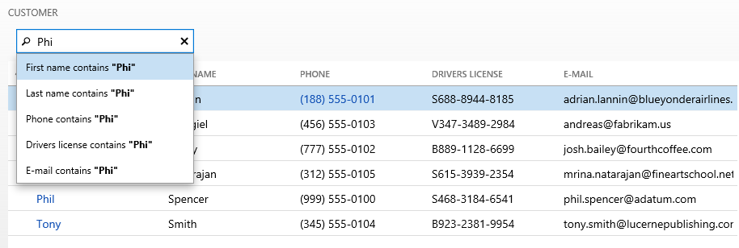
Overview of QuickFilter
In Finance and Operations apps, the QuickFilter is now a modeled control that can be associated with any grid in the system.
Notes:
QuickFilter
In Finance and Operations apps, the QuickFilter is a modeled control that can be associated with any grid in the system. As the user starts to type, a column selector drop-down menu appears to guide the user toward the column that the filter will be applied to. The developer can also specify the default column for the QuickFilter. If no column is specified, the default column is the first field that can be filtered in the grid.
Why don't I have a column selector in my QuickFilter?
Column selectors are shown only for QuickFilters that are attached to grids. If you don't see a column selector, the most likely reason is that the TargetControl property on the QuickFilter is blank. This property must point to the grid that it should operate on. If the TargetControl property is set correctly, but you don't see a column selector, you might not have any filterable columns in your grid. In addition to non-text controls (such as images), controls that are bound to data methods aren't filterable.
Can I use the QuickFilter to filter other collection controls (such as trees)?
Yes, you can use the QuickFilter to filter other collection controls, but you must manually wire up the filtering. Here are the general steps:
Leave the TargetControl property blank.
Override the applyFilter() method on the QuickFilter.
Write code in that method to perform the desired filtering.
https://docs.microsoft.com/en-us/dynamics365/fin-ops-core/dev-itpro/user-interface/filtering#quickfilter

Slide 27
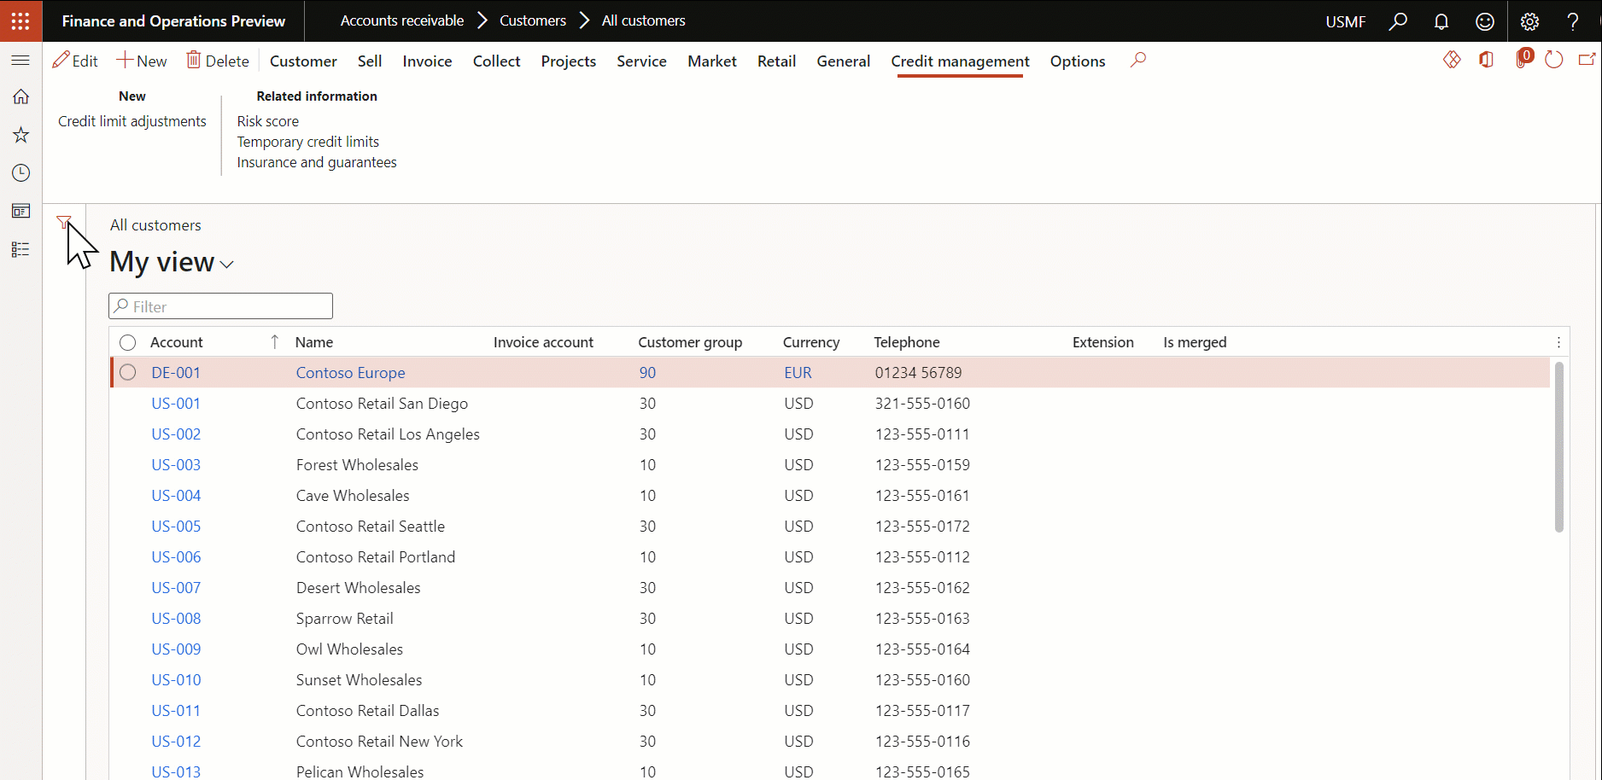
Grid column header filtering/sorting
In Finance and Operations apps, the grid filtering experience is more closely aligned with the experience in Microsoft Excel. When the user clicks a column header, a drop-down dialog appears, and the user can use it to filter the column
Notes:
Grid column header filtering/sorting
In Finance and Operations apps, the grid filtering experience is more closely aligned with the experience in Microsoft Excel. When the user clicks a column header, a drop-down dialog appears, and the user can use it to filter the column. The filtering experience here mimics the filtering experience in the Filter pane. Additionally, there are options to sort the grid based on the column that is currently selected.
Note
Some columns in a grid may not be filterable. In these cases, the column header will not be clickable. From a technical perspective, only columns corresponding to fields in a SQL table can be filtered on or sorted. Columns whose values are computed via code are not filterable or sortable using grid column headers, the Filter pane, QuickFilter, or Advanced filter or sort.
https://docs.microsoft.com/en-us/dynamics365/fin-ops-core/dev-itpro/user-interface/filtering#quickfilter

Slide 28
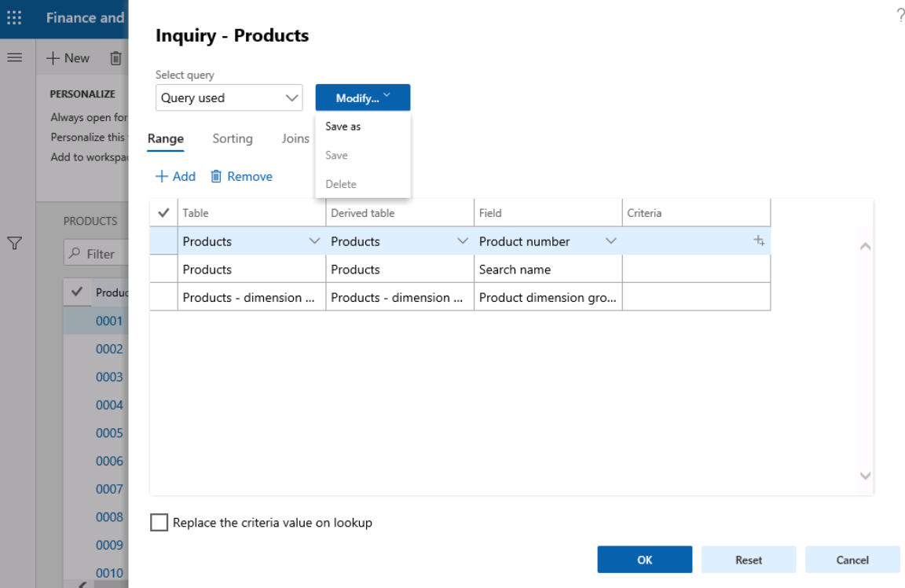
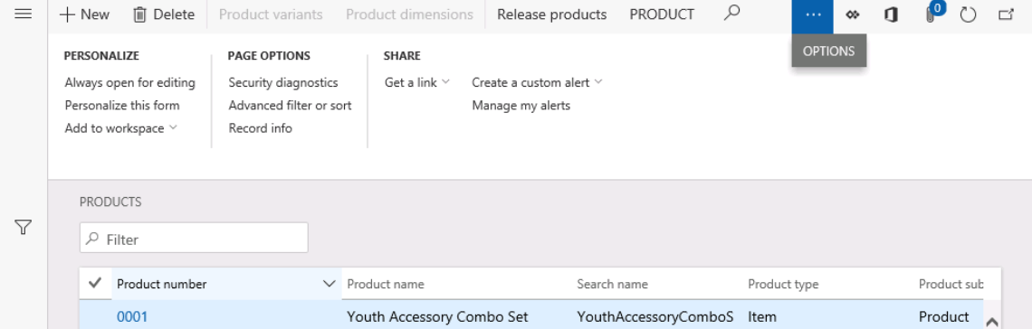
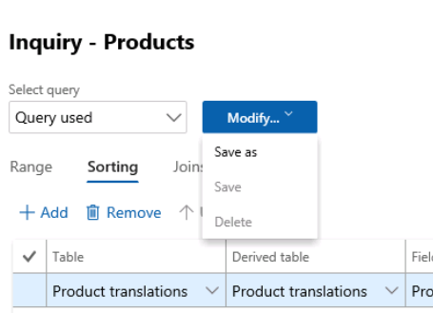
Advanced Filter
Notes:
This is an animated slide
Advanced filter
To use the advanced filter, Select Options, then Advanced filter or sort.
The resulting screen will allow you to modify the query used in the form by:
Specifying a range for fields
Specifying sorting
Note
here you may specify multi-level sorts
Adding data sources via joins
You can also save the query for future use, and it will be available until user data is cleared.
https://docs.microsoft.com/en-us/learn/modules/configure-your-ui-dynamics-365-finance-operations-apps/manage-forms-filters-ranges

Slide 29
About Filtering Expressions
Filter operator
Finance and Operations apps query syntax
Is exactly “circle” / Is equal to “circle”
Is not “circle” / Is not equal to “circle”
Is one of “circle”, “square”, “circlesquare”
Contains “circle”
Does not contain “circle”
Begins with “circle”
After “circle” / Greater than “circle”
Greater than or equal “circle”
Before “circle” / Less than “circle”
Less than or equal “circle”
Between “square” and “circle”
“circle”
“!circle”
“circle,square,circlesquare”
“*circle*”
“!*circle*”
“circle*”
“>circle”
“circle..”
“<circle”
“..circle”
“square..circle”
Notes:
Filter expressions
One important difference between filtering in Finance and Operations apps and filtering in Dynamics AX 2012 is related to the way that query symbols are used when filter values are defined (for example, "*" to match 0 or more characters, or ".." to specify a range of values to match). In Dynamics AX 2012, these symbols are highly visible during the filtering experience. For example, for the filter by grid option, if a user selects the contains operator on a field, the system translates that operator by adding wildcard characters (*) to each end of the current expression. In the current version, the query symbols are implied by the selected operator and aren't injected into the user interface. This makes filtering more intuitive and simpler for users. For users who want to specify additional filter conditions by using specific query symbols, or users who must enter more complex conditions, the matches operator is provided for each data type. For all other operators, the query symbols are interpreted as literals. For example, the filter condition "First name MATCHES A" finds all records where the first name starts with the letter A. However, the filter condition "First Name IS A*" finds records where the first name is literally equal to "A*." The following table shows how the client translates between Finance and Operations apps filter operators and Dynamics AX 2012 query syntax.
Any query syntax that doesn't match the preceding templates is interpreted as the matches operator.
Other frequent filter expressions
Users may want to filter for blank values in column. While there is no filter operator for this specifically, the syntax for performing this filtering remains the same as Dynamics AX 2012. With either the matches operator or the is equal to operator, users can type "" to retrieve rows with blank values for the current column. For example, First Name IS "" will find all records where the first name is blank. Note that "" only matches rows where the column value is the empty string and does not match rows where the column value is NULL or 0.
Users may also want to filter for records that do not belong to a specific list of values. While "is not one of" is not a filter operator, this filter expression can be achieved using the matches operator by negating each list item in the list. For example, !circle, !square will find all records that are neither "circle" nor "square."
https://docs.microsoft.com/en-us/dynamics365/fin-ops-core/dev-itpro/user-interface/filtering#filter-expressions

Slide 30
Configuring user options
1
Visual Options
2
Preferences
3
Account Information
4
Workflow
Notes:
Finance and Operations apps offers some various color themes and element sizes to create an aesthetically pleasing interface. You can use the User options page to control basic features and behavior of your environment that are specific to you as a user. The system administrator can control these user options from the Users page in the System administration module.
https://docs.microsoft.com/en-us/learn/modules/personalize-finance-operations/3-user-options

Slide 31
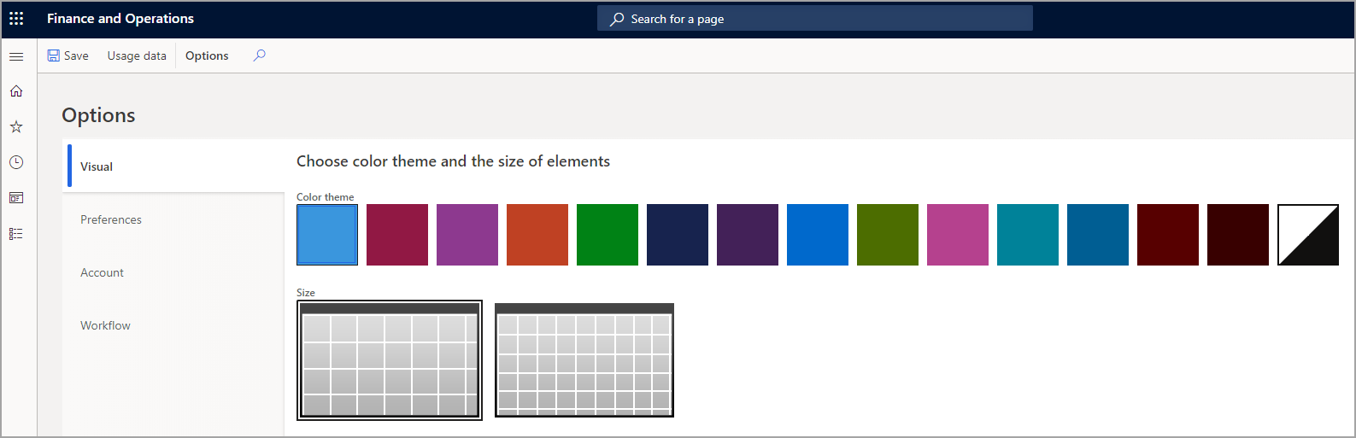
Visual Options
Settings menu
User options
Notes:
Visual options
On the Navigation bar, you'll find a gear wheel icon that accesses the Settings menu. Opening the Settings menu will show several choices. Selecting User options will open the User options page. There you'll find four option tabs, one of which is named Visual. You can personalize many options such as the color theme and time zone for each user.
With the Visual tab, you can select a color theme to apply to the system and determine whether you'd like larger or smaller element sizes on your pages.
Ref: https://docs.microsoft.com/en-us/learn/modules/personalize-finance-operations/3-user-options

Slide 32
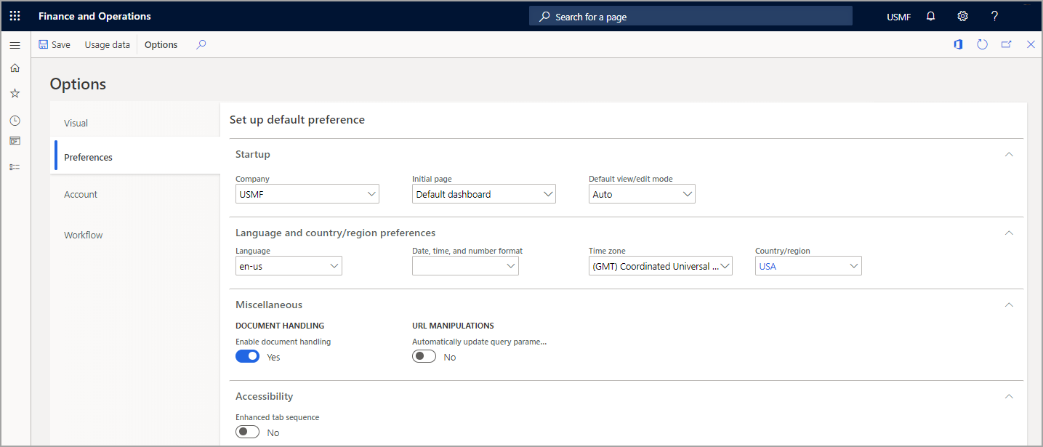
Preferences
Preferences >User options page,
Company
Initial Page
Default dashboard
System administration
Essential dashboard
Employee self-service dashboard
Prospective vendor registration
Default View/Edit mode
Language and country/region preferences
Document Handling enabled
Automatically update query parameter
Enhanced Tab sequence
Notes:
Preferences
On the Preferences tab on the User options page, you have a variety of options that you can select. You can select default values that are used every time that you open Finance and Operations apps.
These values include the company, initial page, and default view/edit mode. The view/edit mode determines whether a page is locked for viewing or opened for editing every time that you open it.
The Preferences tab also includes options for the language, time zone, and date, time, and number format. This tab also includes several miscellaneous preferences that vary from release to release.
Company - This allows you to define which company you sign in to when you access Finance and Operations apps. You can always change the company that you are connected to using the Navigation bar.
A legal entity is an organization that has a registered or legislated legal structure. Legal entities can enter into legal contracts and are required to prepare statements that report on their performance. The country or region that you select for the primary address of the legal entity controls the country and region-specific features that are available for the legal entity.
Initial page - There are a variety of options you can select here to define which page will open when you first launch Finance and Operations apps.
Default dashboard - This Refers to the home page that you have seen in most demonstrations of Finance and Operations apps.
System administration - This option will default the user into the System administration workspace. This option is useful for system administrators.
Essentials dashboard - This option defaults the user to the Retail essentials workspace, which has a different layout that is targeted and designed for back-office retail workers.
Employee self-service dashboard - This option is designed for the typical worker or manager who only uses a few areas of the system on a regular basis.
Prospective vendor registration - This page is designed for prospective vendors to complete their application and onboarding process. This option is not typically selected for a regular user.
Default view/edit mode - This option allows you to select between Auto, View, and Edit. The default option is Auto. When you change this option to View, all forms by default will open in View only mode. This is useful for users who do not typically make changes to the system, such as system administrators. The users must then click the Edit button to make any changes. The Edit option is used to force all pages to open in edit mode so that users can make modifications without having to click the Edit button in the Action Pane. This is useful for users who always modify data on every page that they open. You can control this setting based on pages, which overrides the option you select here.
Language and country/region preferences - On this FastTab, you can control settings for language, date, time and number format, time zone, and country/region the users will operate with. Changing these selections will only change how the user interface appears to the selected user, not how the data is stored in the database.
Document handling enabled - This option determines whether the paper clip icon with document handling is activated for the selected user. When the option is enabled, you can see a number on the paper clip icon that indicates the number of attachments for a selected document. This can have a performance impact if attachments are used heavily.
Automatically update query parameter - When this option is turned on, the system will automatically save any filters that you have created on a form when adding the URL to your favorites or sharing the URL from the Options tab on the pane.
Enhanced tab sequence - In everyday system use, not every field is required to perform typical tasks. Therefore, by default, the tab sequence is optimized. Tab stops are set only on those fields that are essential for typical scenarios. However, you might find that some fields that you often use to perform tasks aren't included in the default tab sequence. In this case, if you use Windows Narrator, you can use Windows Narrator's keyboard actions to access those fields and inspect their content. Alternatively, you can enable the Enhanced tab sequence option on the User options page, which makes all editable and read-only fields part of the tab sequence. You can then use page personalization to create a custom tab sequence and omit fields from the tab sequence.
Ref: https://docs.microsoft.com/en-us/learn/modules/personalize-finance-operations/3-user-options

Slide 33
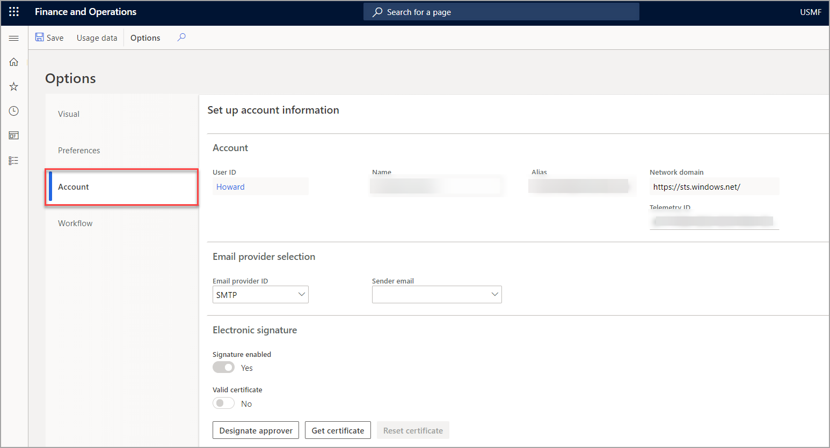
Account Information
User options > Account tab
Which account in the Active Directory it’s linked to
How emailing and electronic signatures are controlled for user accounts
User name and other account-related options
Email provider selection
Electronic Signature
Notes:
Set up Account Information
The Account tab on the User options page contains a variety of options that control account functions, such as which account in the Active Directory it’s linked to, and how emailing and electronic signatures are controlled for user accounts. These settings are typically controlled by your administrator. You can also adjust your user name and other account-related options on this page.
Ref: https://docs.microsoft.com/en-us/learn/modules/personalize-finance-operations/3-user-options

Slide 34
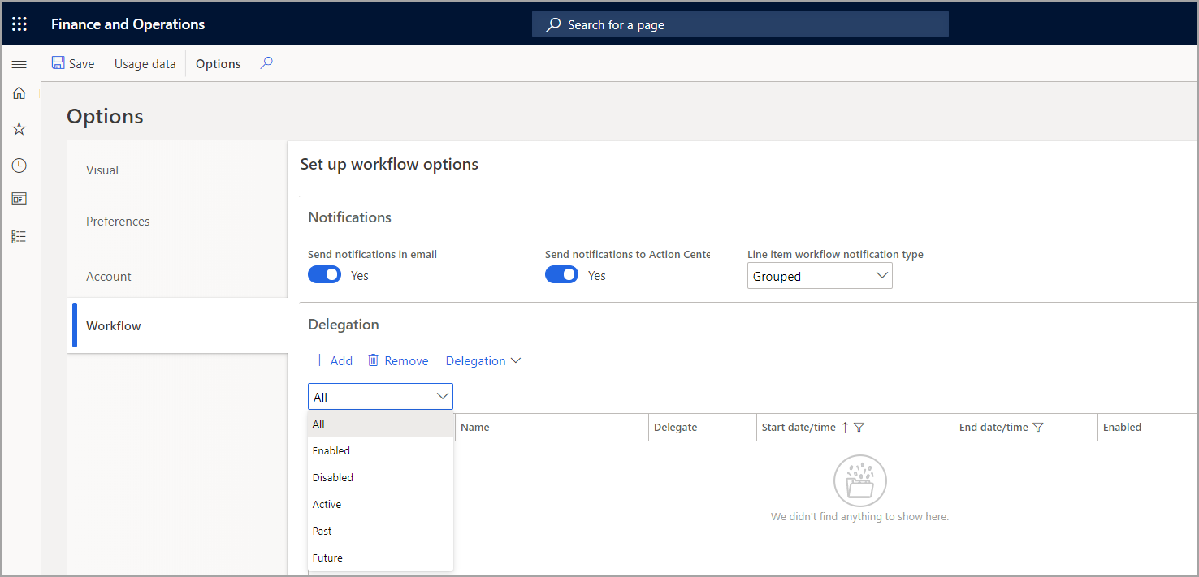
Workflow
User options >Workflow tab
Allows you to control how notifications for workflow will be delivered
Notes:
Workflow
The Workflow tab on the User options page allows you to control how notifications for workflow will be delivered. You can also use the Delegation FastTab to control exactly which workflows and time periods you want to use to delegate your workflow tasks and approvals.
Ref: https://docs.microsoft.com/en-us/learn/modules/personalize-finance-operations/3-user-options

Slide 35
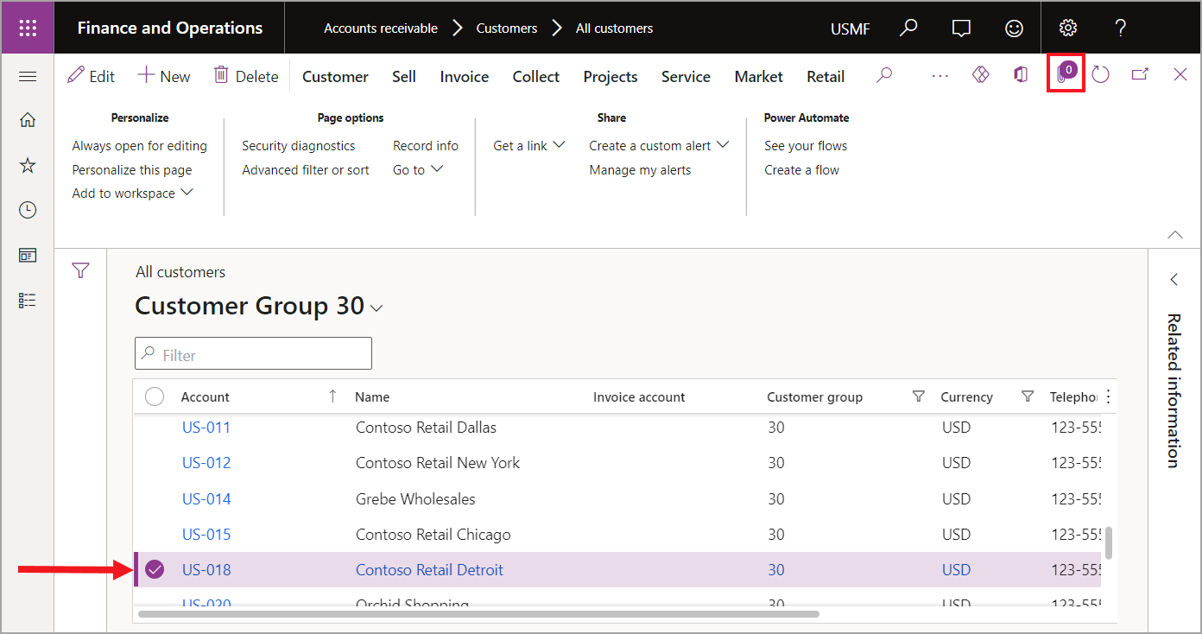
Document handling
To add an attachment to a record, follow these steps
Select the Record
Select the Paperclip
Select New in the Action pane
Browse to the file you wish to attach
Add additional notes and details
Notes:
Document handling
You may need to add attachments to a record in the system, this might include an invoice from a vendor, customer receipts, product details for a purchase requisition, or expense receipts, just as some examples. You can easily add attachments to records that allow document handling in Finance and operations apps. You can also view attachments from all tables on the pages that are related to the active record.
To add an attachment to a record, follow these steps;
Select the record you wish to attach a document to (such as a customer, invoice, or vendor).
Select the paperclip icon on the top right corner of the page.
On the Attachment page, select New in the Action pane, then select the type of document you are attaching.
Browse to the file you wish to attach. The file will upload and be attached to the record.
You can add additional notes and details to the attachment on the page.
Ref: https://docs.microsoft.com/en-us/learn/modules/personalize-finance-operations/3-user-options

Slide 36
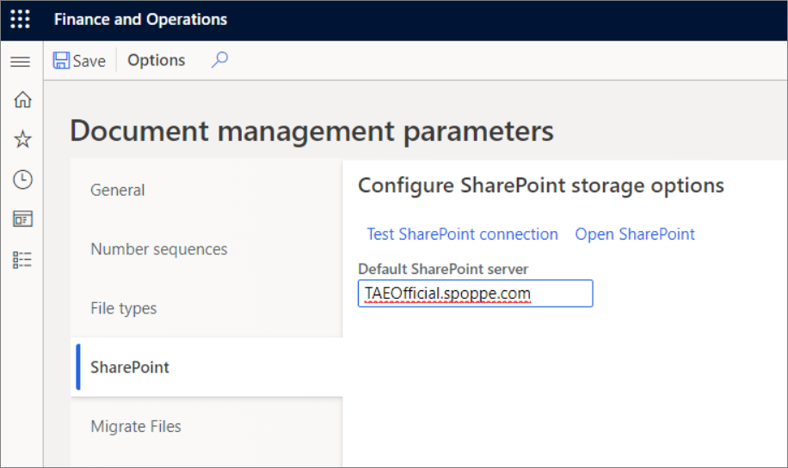
Managing documents
Document management supports saving record attachments in Azure Blob storage and SharePoint Online
Preview documents
You can specify the destinations for various print management actions for configurable business documents.
Templates
A template is an artifact that needs to be maintained and versioned.
Scan file attachments for malicious threats.
Notes:
Document management supports saving record attachments in Azure Blob storage and SharePoint Online. Database storage is obsolete. Azure Blob storage is equivalent to storage in the database because documents can only be accessed through the application, and it offers the added benefit of providing storage that doesn't negatively affect the performance of the database.
Azure blob storage is the default and works immediately. SharePoint storage will work immediately if you have a Microsoft 365 license because it auto-discovers the SharePoint tenant, such as a user on the TenantA.onmicrosoft.com. Microsoft 365/Azure AD tenant gets TenantA.sharepoint.com as the SharePoint site. If document management has been turned off by the user, turn it on by selecting Common > Setup > User options > Preferences > Miscellaneous and setting Document handling active to Yes.
On any page that has data, an Attach button will be available in the upper-right corner. The Attachments page provides a view of the attachments (documents) that are associated with the record that was selected on the previous page. You can add new attachments to the record by selecting the New button (+) in the app bar. For the File and Image document types, you will be prompted to provide the associated file.
A preview for supported file types is provided on the Preview FastTab. Basic document types, such as PNG images and text files, are supported by default. Office document types, such as Microsoft Word, Excel, and PowerPoint files, must use a production Office Web Apps Server, which might not be available in a OneBox configuration.
The automatically generated Open in Excel experiences that are created for entities have a single table binding.
A developer in your team can help you achieve the following by using Visual Studio.
You can suppress the static Export to Excel mechanism for a grid or change the label that appears on the Open in Microsoft Office menu.
The list of fields that are added to that table binding is defined by the AutoReport field group if the table binding contains fields. Otherwise, the key and mandatory fields for the entity are automatically added. The order of fields in the AutoReport group determines the order of fields in the table binding.
Templates that are registered as system-defined templates are loaded at deployment. This behavior is useful for independent software vendors (ISVs) and partners that want to package templates together with other model artifacts.
Preview documents
You can specify the destinations for various print management actions for configurable business documents. This means that for a preview, the scenario Preview/Print > Original can be used, and for email and printing, Preview/Print > Use print management can be used.
Templates
When a template listed in the Common > Common > Office integration > Document templates page (DocuTemplate) has ShowInOpenInOfficeMenu set to Yes and has the same root data source (table) as the current page, it will be added as an option in the Open in Excel section of the Open in Microsoft Office menu.
A template is an artifact that needs to be maintained and versioned.
Create a template if:
You need additional content or formatting in the template.
You want to combine multiple entities or data sources in the same workbook.
When creating a template for an entity that has country or region-specific fields, you should leave those region-specific fields out of the template. Otherwise, all users will see the country or region-specific fields.
Scan file attachments for malicious threats
When working with file attachments, your organization may want files to be scanned for any malicious threats before the document is uploaded to Dynamics 365. There is an extension point in the application that lets you integrate file scanning software of your choice into the file upload process. There are also similar extension points that are available for scanning attachments.
The FileUploadResultBase class exposes the delegateScanStream() delegate. The delegate applies to any file upload where the Upload strategy class has been specialized. If the scanning software determines that the upload is malicious, the upload process will fail.
Ref: https://docs.microsoft.com/en-us/learn/modules/implement-common-integration-features-finance-ops/4-documents

Slide 37
Demo: Personalize a Workspace
Notes:
Scenario: In USMF, you need to add additional tiles, links, or list to a workspace that can save end users’ time clicking, give them a quick summarize view, and make Dynamics 365 Finance and Operations apps more efficient for them while perform their daily tasks.
For steps Refer to the text.

Slide 38
Exercise 1: Work with an Operational Workspace
Notes:
Scenario: In USMF, you are acting as a sales representative to sell item A0001 to your customers. You need to check the available on-hand quantity of the items, find out if there are any default sales price for the item, or trade agreement price per customer.
If there is not enough quantity, you need to create a purchase order for the customer to fulfill the demand.
For steps Refer to the text.

Slide 39
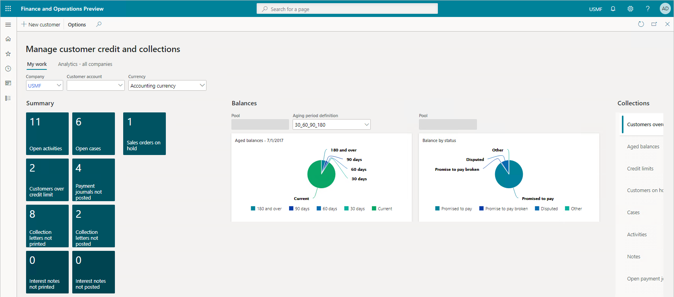
Group Discussion: List Top Five Benefits Gained by Using Operational Workspaces
Discuss how City Power & Light use cases for customers in the public sector.
Hint
Sent some time researching workspaces offered by Microsoft and use your experience to complete your task.
Notes:
Key points:
Optimize your team’s productivity with seamless, integrated processes and tasks.
Enable fast user actions and decisions with over 50 role-based workspaces.
Gain global visibility into the financial health of your business.
Optimize workforce productivity.
Why it matters: Role-based workspaces provide a high-level view of key business metrics and make it possible to drill down into transactions and KPIs. Ultimately, this makes it easier to monitor and accelerate business performance.

Slide 40
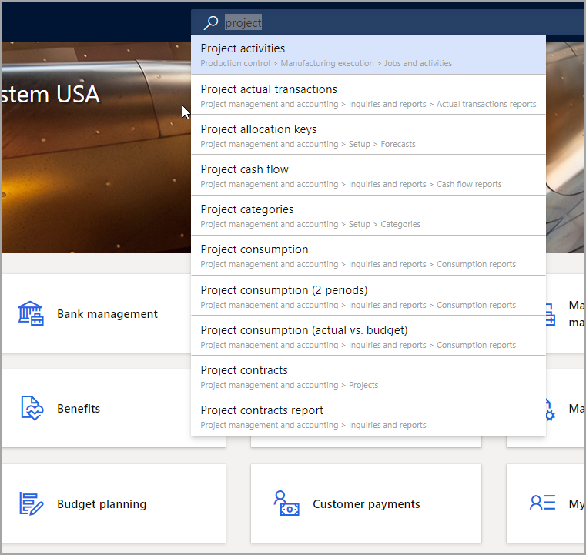
Search in Finance and Operations Apps
Search mechanism is used for finding and navigating to pages and workspaces that appear in the navigation pane and on the dashboard
Two specific ways to search:
Keywords
Form names
Notes:
The search mechanism is used for finding and navigating to pages and workspaces that appear in the navigation pane and on the dashboard. The search keywords are matched not only to the caption of the navigation elements but also to the corresponding path.
For example, a search on the keywords returns a list of navigation elements that match those keywords.
There are two specific ways to search:
Keywords - Using the search feature, you can enter keywords to find a specific page. The results in the list will include complete and partial matches, as well as the manual navigation path for the page.
Form names - Technical users who are looking for a specific form name in the system can use the search feature by entering “form:” followed by the actual form name, such as “vendInvoice” to find specific pages in the system that use that form. The list will populate with pages that use the form specified.
There are two important things to consider when using search:
The search feature is used to locate pages in the system, not specific data, or actions.
The results will also include partial hits for the navigation path. For instance, searching the word “receivable” will include a larger number of hits than “all purchase orders” because the word “receivable” is included in the navigation path for many pages.
To use the search feature, select the Search icon to display the Search box. You can then type one or more words in the box. Finance and Operations apps instantly searches for relevant pages in the application that match the words that you entered.
For example, you could type “l e” as the input, and then the system displays results that match that input. In this case, it will show all pages that start with letter “l” and then letter “e”.
In the screenshot below, you will see the results of a search using the word "project".
Ref: https://docs.microsoft.com/en-us/learn/modules/navigate-finance-operations/5-searching

Slide 41
Exercise 2: Perform Searches and Work with Filters
Notes:
When you navigate and open a list page, it may include many records. In Dynamics 365 Finance and Operations, there are many options to narrow down your search result in a list page such as quick filer, filter the column grids, and selecting the filter icon. Quick filters show the column names when you enter a value to search for. If you wish to clear a filer, select the X icon or delete the value and press Enter. No operators can be used for the quick filters.

Slide 42
Exercise 3: Create Search Queries and Save for Future Use
Notes:
The Advanced filter or sort button from Options action pane tab launches the inquiry dialog box in which you can select related and derived tables to the form you are working on derived tables into the Range tab and choose your desired field(s) and assign criteria.
You can also set up and assign sorting, and date options, and view the joins based on selected criteria.
Aside from the Default Dashboard, from anywhere in Dynamics 365 Finance and Operations apps, you can directly access the inquiry dialog box with the shortcut key Ctrl+Shift+F3.

Slide 43
What are Record Templates?
Record templates can help you to create records more quickly, however you can only create record templates for some record types.
For example, imagine you are entering rental information for a car rental business that is located in San Francisco. Since most of the customers are likely to be from the San Francisco area, it would be nice if you could automatically fill in the values for the State, Country, and City fields on the rental form.
Notes:
Record templates can help you to create records more quickly, however you can only create record templates for some record types.
For example, imagine you are entering rental information for a car rental business that is located in San Francisco. Since most of the customers are likely to be from the San Francisco area, it would be nice if you could automatically fill in the values for the State, Country, and City fields on the rental form.
When one or more templates that you have access to exist for a specific form and you attempt to create a new record in the form, the Select a template for page is displayed. When you select a template from the list, the new record is created and contains default information that is based on the template that you selected. If you do not want to use templates when you create new records, select the Do not ask again check box in the Select a template for page. To display the template selection dialog box again, right-click any record, click Record info, and then click Show template selection.
Ref: https://docs.microsoft.com/en-us/dynamics365/fin-ops-core/fin-ops/organization-administration/record-templates

Slide 44
Exercise 4: Work with Record Templates
Notes:
Record templates can help you to create records more quickly; however, you can create record templates for only some record types. For example, imagine you are entering rental information for a car rental business in San Francisco. Since most of the customers are likely to be from the San Francisco area, it would be convenient if you could automatically fill in the values for the State, Country, and City fields on the rental form.

Slide 45
Introduction to Financial Reporting
Financial reporting allows financial and business professionals to create, maintain, and view financial statements
Map the following to gain better insight of financial data
Main accounts
Financial dimensions
Combinations of the two
The Financial reporting database is deployed to its own SQL Azure database on the same SQL Azure service as the Finance and Operations apps instance
Notes:
Financial reporting allows financial and business professionals to create, maintain, and view financial statements. It moves beyond traditional reporting constraints to help you efficiently design various types of reports.
Financial reporting includes dimension support to determine what financial dimensions you want to include, and the sequence, and enables the building of a custom reporting structure.
You can map the following to gain better insight of financial data:
Main accounts
Financial dimensions
Combinations of the two
For example, you can create financial row structures to focus on cost accounts. You can set up unlimited financial dimensions that allow for cost detail. The following financial dimensions are examples that might be associated with cost accounts:
Cost centers
Departments
Combinations of the two
The Financial reporting database is deployed to its own SQL Azure database on the same SQL Azure service as the Finance and Operations apps instance. This means that the database is preconfigured when you deploy Finance and Operations apps, and automatically links to available databases so that the Financial report designer can connect to it.
Ref: https://docs.microsoft.com/en-us/learn/modules/work-analytics-reporting-finance-operations/3-financial-reporting

Slide 46
Inquiry and report types available in a default installation
1
Excel and Microsoft Office integration. Manage and analyze data using Microsoft Excel.
2
Embedded analytics and native controls. These are built-in and used in operational reports. They allow you to add aggregate data to workspaces by using native controls, such as charts and grids.
Financial Report Designer. It is a powerful and flexible tool to create custom and complex financial statements such as balance sheets, income statements, cashflow statements, and advanced financial reports for financial leaders.
3
4
Dashboards and workspaces. This report contains predefined and personalized views.
5
SQL Server Reporting Services (SSRS). This report is used for business documents and frequent, high-volume printed materials, such as invoices, packing slips, and picking lists.
Notes:
A report can be defined simply as a structured presentation of data. Under ideal circumstances, reports materialize data in such a way that it allows the user to make informed decisions. Dynamics 365 Finance and Operations supports a broad spectrum of information access scenarios: cross company all-up financial reporting; analytical dashboards and tiles; electronically transferable funds; customer sales invoices; checks and tax documents; and many more.
Financial reporting allows financial and business professionals to create, maintain, and view financial statements. It moves beyond traditional reporting constraints to help you efficiently design various types of reports.
Financial reporting includes dimension support to determine what financial dimensions you want to include, and the sequence, and enables the building of a custom reporting structure.
You can map the following to gain better insight of financial data:
Main accounts
Financial dimensions
Combinations of the two
For example, you can create financial row structures to focus on cost accounts. You can set up unlimited financial dimensions that allow for cost detail. The following financial dimensions are examples that might be associated with cost accounts:
Cost centers
Departments
Combinations of the two
The Financial reporting database is deployed to its own SQL Azure database on the same SQL Azure service as the Finance and Operations apps instance. This means that the database is preconfigured when you deploy Finance and Operations apps, and automatically links to available databases so that the Financial report designer can connect to it.
Ref: https://docs.microsoft.com/en-us/learn/modules/work-analytics-reporting-finance-operations/3-financial-reporting

Slide 47
Business Document Management
1
Configure electronic reporting (ER) parameters.
2
Import ER solutions.
3
Configure access permissions.
4
Use business document management to edit templates.
5
Initiate editing templates owned by your or other configuration providers.
6
Start editing a template.
Notes:
Business document management is built on top of the ER framework and enables business users to edit business document templates by using the Microsoft 365 service or appropriate Microsoft Office desktop applications. Edits to the documents might include changing business document designs and adding placeholders for additional data without source code changes and new deployments. No knowledge of the ER framework is required to update templates of business documents.
Ref: https://docs.microsoft.com/en-us/dynamics365/fin-ops-core/dev-itpro/analytics/er-business-document-management

Slide 48
Financial Reporting – Report Designer
By using Report designer, you will be able to
Save and reuse dimension combinations for multiple reports.
Control how to format and display the dimension descriptions.
Identify the accounts or dimensions that have been omitted from report building blocks.
Format the headers for rolling forecasts.
Interactive features
Change the report date for the report that you’re viewing.
Change the currency of the report that you’re viewing.
View the report in either a summary view or a detailed view.
Add dimension filters to limit the report content to a specific dimension or combination of dimensions.
Add attribute filters to limit the report content to a specific attribute or a combination of attributes.
Notes:
Report designer
By using Report designer, you will be able to:
Save and reuse dimension combinations for multiple reports.
Control how to format and display the dimension descriptions.
Identify the accounts or dimensions that have been omitted from report building blocks.
Format the headers for rolling forecasts.
You can manage the generation and distribution of reports by using the following features:
Scheduling reports so that they are automatically generated on a daily, weekly, monthly, or annual basis.
Exporting the report result to the read-only PDF format, which provides better document security through digital signatures.
Exporting to a Microsoft Excel worksheet.
Interactive features let you perform the following tasks within Financial reporting:
Change the report date for the report that you're viewing.
Change the currency of the report that you're viewing.
View the report in either a summary view or a detailed view.
Add dimension filters to limit the report content to a specific dimension or combination of dimensions.
Add attribute filters to limit the report content to a specific attribute or a combination of attributes.
We recommend that you link your main accounts to your main account categories. This makes it easier and faster when setting up your reporting in Financial reporting.
For example, if you are creating a report, rather than listing many main accounts, you can simply list your main account category and get a total of all the main accounts in that category.
Ref: https://docs.microsoft.com/en-us/learn/modules/work-analytics-reporting-finance-operations/3-financial-reporting

Slide 49
Accessing Financial Reporting
Before creating and generating the financial reports, ensure that the following items have been set up for your company
Currency
Fiscal calendar
Chart of accounts
Ledger
You can find the Financial reporting menu in the following locations in Dynamics 365 Finance
General Ledger > Inquiries and reports
Budgeting > Inquires and reports > Basic budgeting
Budgeting > Inquiries and reports > Budget planning
Budgeting > Inquiries and reports > Budget control
Consolidations
Notes:
Accessing financial reporting
Before creating and generating the financial reports, ensure that the following items have been set up for your company:
Currency
Fiscal calendar
Chart of accounts
Ledger
You can find the Financial reporting menu in the following locations in Dynamics 365 Finance:
General Ledger > Inquiries and reports
Budgeting > Inquires and reports > Basic budgeting
Budgeting > Inquiries and reports > Budget planning
Budgeting > Inquiries and reports > Budget control
Consolidations
Ref: https://docs.microsoft.com/en-us/learn/modules/work-analytics-reporting-finance-operations/3-financial-reporting

Slide 50
Financial Reporting Setup
The Financial reporting setup page in General ledger > Ledger setup has a list of all financial dimensions in the system
Two sections
Dimensions tab
Attributes tab
This page allows you to set the order in which you want financial dimensions to appear
You can select whether you want to use vendors and customers as attributes for filtering and report design
Notes:
Financial reporting setup
The Financial reporting setup page in General ledger > Ledger setup has a list of all financial dimensions in the system. It has two sections that determine the data that you will report on in Financial reporting:
Dimensions tab - Because different companies use different dimensions and account structures, there is no way to determine the order in which users want to view all financial dimensions on reports. This page allows you to set the order in which you want financial dimensions to appear when you build and view a report in Financial reporting.
Attributes tab - This is where you can select whether you want to use vendors and customers as attributes for filtering and report design. Reporting on vendor and customer will only be valuable if you do not enter multiple vendors or customers in a single voucher when posting transactions. Selecting Vendor and/or Customer will add more time to the integration.
Ref: https://docs.microsoft.com/en-us/learn/modules/work-analytics-reporting-finance-operations/3-financial-reporting

Slide 51
Financial Reporting Components
Components of financial reporting
Two default balance sheet reports
Three trial balance reports
Report designer
Report Schedules
Balance Sheet – Default
Side by Side Balance Sheet – Default
Detailed Trial Balance – Default
Summary Trial Balance – Default
Summary Trial Balance Year Over Year – Default
Notes:
Financial reporting components
The following components of financial reporting make it easy to create, view, and schedule reports:
Report designer - Create report building blocks that can be combined to define and generate a report. Advanced users can create new report building blocks or modify existing building blocks to meet their requirements.
Report schedules - Schedule a single report, or a group of reports, so that it is generated on a regular basis.
The financial statement functionality simplifies your ability to build reporting structures for internal analytical purposes. You can create many financial reports to comply with requirements and international accounting standards.
There are two default balance sheet reports:
Balance Sheet – Default - The sections are stacked. Provides a view of the organization's financial position for the year.
Side by Side Balance Sheet – Default The sections are side by side. Provides a view of the organization's financial position for the year. Assets and liability and shareholder’s equity are side by side.
The three trial balance reports are:
Detailed Trial Balance – Default - Provides balance information for all accounts, and includes debit and credit balances, and the net of these, together with the transaction date, voucher, and journal description.
Summary Trial Balance – Default - Provides balance information for all accounts and includes opening and closing balances, and debit and credit balances, together with their net difference.
Summary Trial Balance Year Over Year – Default - Provides balance information for all accounts and includes opening and closing balances, and debit and credit balances, together with their net difference for the current year and the past year.
The Income Statement – Default report provides a view of the organization’s profitability for the current period and for the year to date.
Ref: https://docs.microsoft.com/en-us/learn/modules/work-analytics-reporting-finance-operations/3-financial-reporting

Slide 52
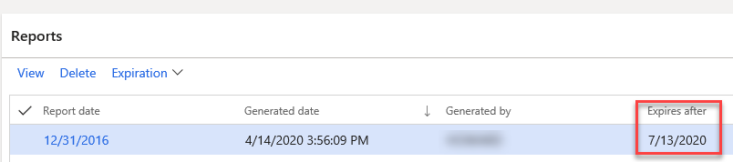
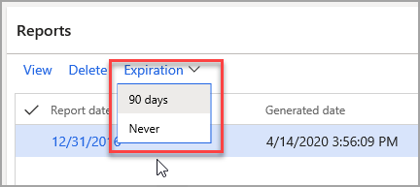
Financial Report Retention Policies
Any reports can be retained for regulatory purposes
Notes:
As you run Financial reports, default expiration dates are applied to each one to automatically delete them after a period of time. Any reports can be retained for regulatory purposes, however, by using the Expiration feature in Financial reports. You have two choices:
90 days
Never
Ref: https://docs.microsoft.com/en-us/learn/modules/work-analytics-reporting-finance-operations/3-financial-reporting

Slide 53
Exercise 5: Prepare, Enable, and Use Business Document Management
Notes:
Scenario: In USMF, you are acting as a sales representative to sell item A0001 to your customers. You need to check the available on-hand quantity of the items, find out if there are any default sales price for the item, or trade agreement price per customer.
If there is not enough quantity, you need to create a purchase order for the customer to fulfill the demand.
For steps Refer to the text.

Slide 54
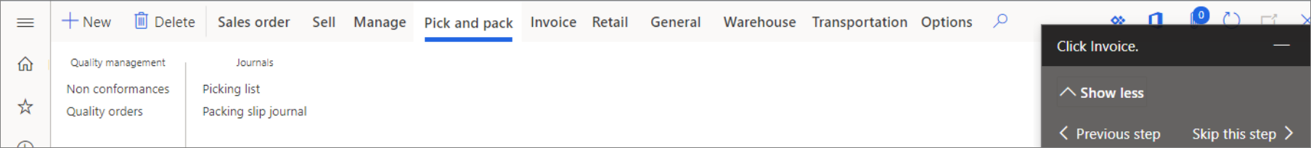
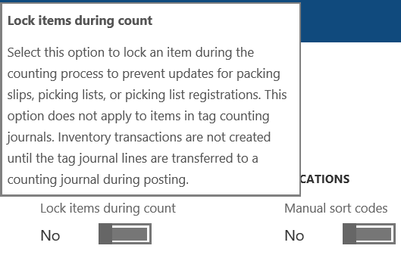
In-Product Help
View and export field descriptions – View field descriptions in the UI by hovering over a field.
Access topics on the Docs site – To open the Help pane in Finance and Operations apps, you can either select the Help button (?) and then select Help, or press Ctrl+Shift+?
Access task guides – A task guide is a controlled, guided, interactive experience that leads you through the steps of a task or business process.
Notes:
You can see field descriptions in the user interface (UI). Additionally, from the Help pane, you can access both topics on the Docs site and task guides.
View and export field descriptions
You can view field descriptions in the UI by hovering over a field. You can also use the Field descriptions page to view and export field descriptions for a specific page.
Access topics on the Docs site
To open the Help pane in Finance and Operations apps, you can either select the Help button (?) and then select Help, or press Ctrl+Shift+?. From the Help pane, you can access both topics on the Docs site and task guides.
When you first open the Help pane, the Help tab shows a list of the topics that apply to the page that you're currently on in Finance and Operations apps. If no topics are found, you can search for the content that interests you.
When you select a topic title in the Help pane, the topic is opened on a new browser tab.
Access task guides
A task guide is a controlled, guided, interactive experience that leads you through the steps of a task or business process. You can open and play task guides from the Help pane.
Open the Help pane, and select the Task Guides tab. You'll see a list of task guides that apply to the page that you're currently on in Finance and Operations apps. If no task guides are found, you can enter keywords to Refine your search.
If you don't see any task guides, you might need to ask a system admin to set up the Help system for your organization.
When you first select a task guide, the Help pane shows the step-by-step instructions for the task. To begin the guided, interactive experience, select Start task guide at the bottom of the Help pane. A black pointer appears and indicates the actions that you must perform. Follow the directions that appear in the UI, and enter data as directed.
See field descriptions in the user interface
You can view field descriptions by hovering over a field. If no description is available, you see the field name when you hover over the field.
The following illustration shows the field description that appears when you hover over the Lock items during count field.
https://docs.microsoft.com/en-us/learn/modules/get-help-finance-operations/4-in-product-help

Slide 55

Customizing Help Options
Task guides
Your admin team can help you create custom task guides for your environment. It can also invest in connecting a custom Help site for your environment, if your business needs require it.
Field descriptions
You can customize field descriptions if, for example, you want to add company-specific information. You can also add descriptions for additional fields.
Field description that appears when you hover over the Lock items during count field
Notes:
Task guides
Your admin team can help you create custom task guides for your environment. It can also invest in connecting a custom Help site for your environment, if your business needs require it.
Field descriptions
You can customize field descriptions if, for example, you want to add company-specific information. You can also add descriptions for additional fields.
https://docs.microsoft.com/en-us/learn/modules/get-help-finance-operations/4-in-product-help
Image Source - https://docs.microsoft.com/en-us/dynamics365/fin-ops-core/fin-ops/get-started/view-export-field-descriptions

Slide 56
Introduction to Saved Views
Features of Saved Views
Views Have multiple named sets of personalization’s per form, which they can quickly switch between as needed
Views created for page types can also include user-added filters or sorts,
Views can be published to users in specific security roles and specific legal entities
Views aren’t automatically saved when a user performs personalization's or filters a list
Views can be added to workspaces as tiles, lists, or links
Creating and modifying views
To create a new view, select Save As and enter a name and a description.
Managing Personal Views
Manage my views dialog box gives you basic maintenance capabilities over your personal views.
Managing personalizations at an organizational level with views
Administrators would apply a set of personalizations for a page to a user or a group of users via the Personalization page.
Publishing Views
Create and save a personal copy of the view that you want to publish.
With that view currently loaded, select the view name to open the view selector drop-down menu.
Select the More button and then select Publish. The Publish dialog box will open.
Notes:
Introduction
Personalization plays an important role in allowing users and organizations to optimize the user experience to meet their needs.
Traditional personalization let users have only one set of personalizations per page. The Saved views feature expands on personalization in several important ways:
Views permit users to have multiple named sets of personalizations per form, which they can quickly switch between as needed. This allows a user to create multiple optimized views of a page, where each view has been tailored to fit the needs of performing a particular business task.
Views created for particular page types can also include user-added filters or sorts, which allows users to quickly return to commonly filtered datasets.
Views can be published to users in specific security roles and specific legal entities. Therefore, any user who has a specified role and access to a specified legal entity can access and use that view, even if that user doesn't not have permission to personalize. This publish capability lets organizations define corporate, standard views that are optimized for their business.
Unlike traditional personalization, views aren't automatically saved when a user performs personalizations or filters a list. Explicit saves are required to give users the flexibility to create a view before or after the changes that are associated with that view have been made. This requirement also ensures that view definitions aren't unintentionally changed by filters or personalizations that aren't intended for long-term use. Items that the system automatically stores as part of typical page usage (for example, column widths, or the expanded or collapsed state of sections) will be saved per view.
Views can be added to workspaces as tiles, lists, or links. Therefore, a filtered data set can be surfaced in a workspace, and users can associate a set of personalizations that is relevant to that data set with a tile or link.
Ref: https://docs.microsoft.com/en-us/dynamics365/fin-ops-core/fin-ops/get-started/saved-views

Slide 57
Sharing Personalizations
Publish views to users
Copy Views or personalizations to users
Export and import views or personalizations
When the Saved views feature is turned on, and if the page supports views, the best way to share personalizations with other users is to publish the view to users who have one or more security roles.
When the Saved views feature is turned off, or if the page doesn't support views, the recommended way to share personalizations is to copy them between users. This method is available only to privileged users.
Export: We can export views or personalizations by opening the appropriate page, opening the Personalization toolbar, and then selecting Export.
Import: To import a view or personalization, open the Personalization toolbar and select Import. Additionally, admins can import a file and immediately give it to one or more users.
Notes:
Sharing personalizations
After you personalize a page, there are a few methods that you can use to share your personalizations with other users. In the following list, the methods are arranged in order from most recommended to least recommended.
Publish views to users.
Copy views or personalizations to users.
Export and import views or personalizations.
Publish views to users
If the Saved views feature is turned on, and if the page supports views, the best way to share personalizations with other users is to publish the view to users who have one or more security roles. For more information, see Publishing views.
Copy views or personalizations to users
If the Saved views feature is turned off, or if the page doesn't support views, the recommended way to share personalizations is to copy them between users. This method is available only to privileged users (for example, system admins). However, admins can look up a specific user's personalization in the system (including the user's personal view if saved views are enabled) and copy the configuration to other users.
If saved views are enabled, follow these steps to copy personalizations.
Go System administration > Setup > Personalization.
Follow these steps to copy personal views:
Select Personal views.
Select the desired views in the list.
Select Copy to users.
Select the users to distribute the views to.
Follow these steps to copy personalizations on pages that don't support views:
Select User settings.
Select the user who has the personalization that you want to distribute.
Select Manage all personalizations.
Select the desired personalizations in the list.
Select Copy to users.
Select the users to distribute the personalizations to.
If saved views aren't enabled, follow these steps to copy a personalization.
Go System administration > Setup > Personalization.
Select Apply.
Select the users to distribute the personalization to.
Select Select existing personalization.
Find and select the (single) personalization that you're interested in.
Select OK.
Export and import views or personalizations
Another way to share personalizations is via export and import. Individual users, or an admin who acts on their behalf, can use this method to export their personalizations or views, and then give the exported file to other users to import. Alternatively, users can give their exported personalizations to a user who has admin privileges, and that user can then use the Personalization administration page to apply the personalization file to many users at the same time.
Important
As personalizations persist across updates, re-importing all personalizations after a service update or at any other time is unnecessary and highly discouraged.
Export
In general, you can export one of your own views or personalizations by opening the appropriate page, opening the Personalization toolbar, and then selecting Export. For more information about the toolbar, see the Personalization toolbar section earlier in this article. Alternatively, if saved views are enabled, you can go to Settings > User options > Personalization to view a list of all your personalizations in the system. From there, you can select the views or personalizations to export, and then select Export.
Additionally, admins can export other users' personalizations by following these steps.
Go to System administration > Setup > Personalization.
On the Users tab, select the desired user.
Find and select the view or personalization that you're interested in.
Select Export.
Import
To import a view or personalization, you can just open the Personalization toolbar and select Import. Additionally, admins can import a file and immediately give it to one or more users.
If saved views are enabled, follow these steps.
Go to System administration > Setup > Personalization.
On the Action Pane, select Import views > User views.
Select the import mode:
Select specific users – Give the view or personalization to selected users.
Import as-is – Import the view or personalization to the same user who exported it.
Select Browse, and find and select the personalization to import.
Select Next.
If you selected Select specific users in step 3, select the users to import the personalization to.
Select Import.
Resolve conflicts as required.
If saved views aren't enabled, follow these steps.
Go to System administration > Setup > Personalization.
Select Apply.
Select the users to distribute the personalization to.
Select Import personalizations from a file.
Select Browse, and find and select the personalization to import.
Select OK.
https://docs.microsoft.com/en-us/dynamics365/fin-ops-core/fin-ops/get-started/personalize-user-experience#sharing-personalizations

Slide 58
Exercise 6: Work with Saved Views
Notes:
https://docs.microsoft.com/en-us/dynamics365/fin-ops-core/fin-ops/get-started/saved-views

Slide 59
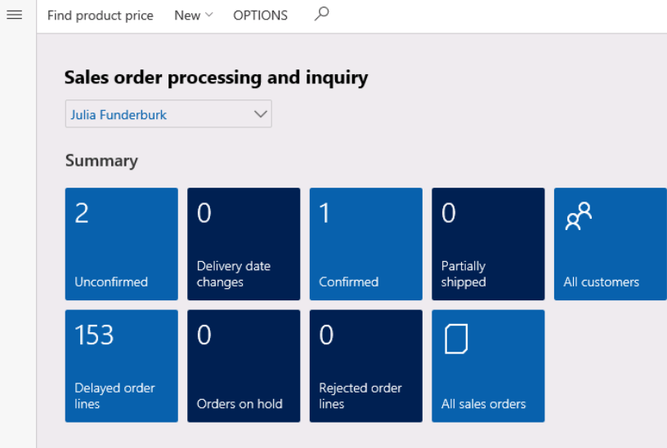
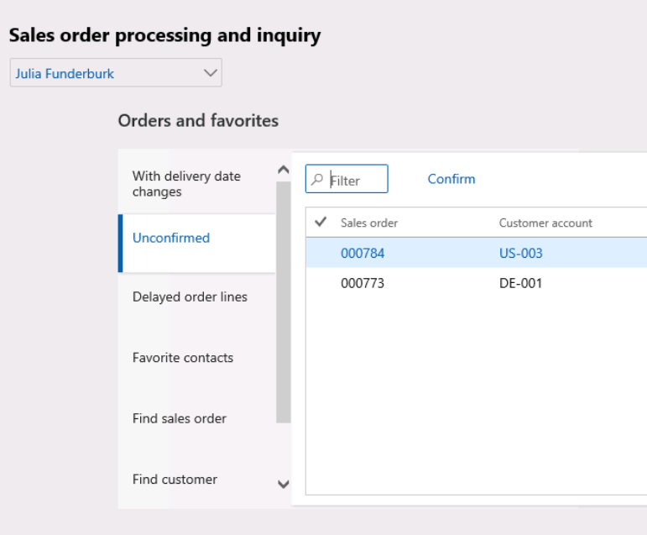
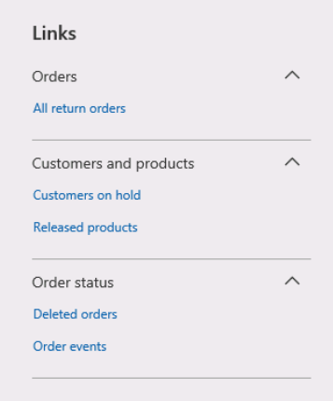
Managing Menus: Key Performance Indicators (KPI)
Select the Tile
Select Orders and favorites
Viewing a List of Links
Notes:
Microsoft Dynamics 365 Finance uses Power BI for data exploration. Many Power BI apps are provided for you.
Navigate to Workspaces and Sales order processing and inquiry.
Notice the tiles and KPIs available to you. For example, in the screenshot below, there are two unconfirmed sales orders. If you select that tile, you’re brought to a form, which shows these two orders.
Each tile is a quick link to the underlying data that it summarizes.
The dashboard also shows lists with quick data under the heading Orders and favorites. You can view these same unconfirmed orders right here.
Finally, at the far right, you can see a group list of Links.
You may customize the dashboard as well, if you've written a Power App. Select Options and Personalize this form.
You may hide parts of the form, add fields, and Add a PowerApps.
For a PowerApps, many options are available – the name, input data, size, and which legal entities it pulls data from.
To add a tile to a workspace, first filter the list on the page so that it shows the data that should be summarized or that you want quick access to. (If the Saved views feature is turned on, you can't continue until you save a view that has these conditions.) Then select Add to workspace. Select a workspace, and then, in the Presentation field, select Tile. After you select Configure, a dialog box appears, where you can specify the label that should be used for the tile in the workspace. You can also specify whether the tile should show a count. After the tile is added to the workspace, you can select it to open the current page from the workspace. You can then view the filtered list that is associated with the tile. Starting in version 10.0.26, if the Allow users to select and change tile sizes feature is enabled, you can select one of four available Tile sizes for your new tile in the Configure tile dialog. This feature also allows you to adjust the tile size after it's created directly from the workspace
Ref: https://docs.microsoft.com/en-us/learn/modules/configure-your-ui-dynamics-365-finance-operations-apps/manage-menus-key-performance-indicators?ns-enrollment-type=LearningPath&ns-enrollment-id=learn.wwl.config-d365-finance-operations-apps

Slide 60
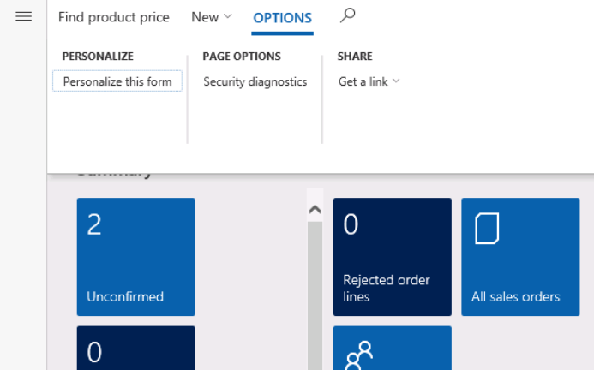
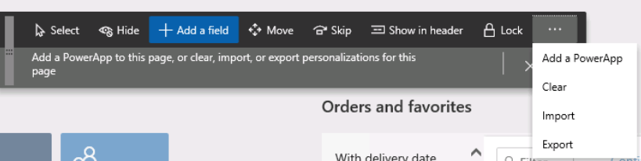
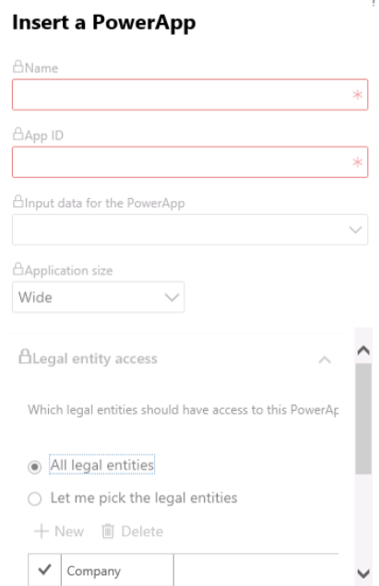
Managing Menus: Key Performance Indicators (KPI)
Personalizing the form
Hiding the parts of Form
List of Options Available
Notes:
Microsoft Dynamics 365 Finance uses Power BI for data exploration. Many Power BI apps are provided for you.
Navigate to Workspaces and Sales order processing and inquiry.
Notice the tiles and KPIs available to you. For example, in the screenshot below, there are two unconfirmed sales orders. If you select that tile, you’re brought to a form, which shows these two orders.
Each tile is a quick link to the underlying data that it summarizes.
The dashboard also shows lists with quick data under the heading Orders and favorites. You can view these same unconfirmed orders right here.
Finally, at the far right, you can see a group list of Links.
You may customize the dashboard as well, if you've written a Power App. Select Options and Personalize this form.
You may hide parts of the form, add fields, and Add a PowerApps.
For a PowerApps, many options are available – the name, input data, size, and which legal entities it pulls data from.
Ref: https://docs.microsoft.com/en-us/learn/modules/configure-your-ui-dynamics-365-finance-operations-apps/manage-menus-key-performance-indicators?ns-enrollment-type=LearningPath&ns-enrollment-id=learn.wwl.config-d365-finance-operations-apps

Slide 61
Manage Menus: Favourites
Favorites are a way to create shortcuts to forms, reports, and queries. Navigation menus on the left include a Favorites menu, so that you have quick access to frequently used menu items.
In order to create a favorite,
Navigate to the module the item is in, and hover over the item
You will see a star to the right of the menu item name. Select this star
Navigate to the Favorites menu and notice your item listed there
Notes:
Favorites are a way to create shortcuts to forms, reports, and queries. Navigation menus on the left include a Favorites menu, so that you have quick access to frequently used menu items. This ability is especially helpful when your item is several submenus deep, or when your job consists of just a few forms and reports.
In order to create a favorite, follow these steps:
Navigate to the module the item is located in, and hover over the item.
You will see a star to the right of the menu item name. Select this star.
Navigate to the Favorites menu and notice your item listed there.
You cannot group or rearrange favorites.
Ref: https://docs.microsoft.com/en-us/learn/modules/configure-your-ui-dynamics-365-finance-operations-apps/manage-menus-favorites

Slide 62
Lesson 3: Dynamics 365 Finance and Operations Features and Functionality

Slide 63
Dynamics 365 FO Features and Functionality
In this lesson, you will learn how to:
Common processes including Procure to Pay, quote to cash, plan to produce, record to report, and register to control
1
6
Exercise 7: Configuring Address Books
2
Describe Dynamics 365 Finance modules and features
7
Create and use Alert rules
3
8
Describe the use cases and configure print management for documents
Set up Number Sequences
4
9
Use Feature management to understand and enable new features
Exercise 6: Set up Number Sequences
5
Describe global address book features and their use cases
10
Identify use cases for localization

Slide 64
Dynamics 365 FO Features and Functionality – Continued
In this lesson, you will learn how to:
1
Describe global address book features and their use cases
2
Describe capabilities relative to General Data Protection Regulation (GDPR) and other data privacy regulations
3
Describe options for protecting and personally identifiable information (PII) data

Slide 65
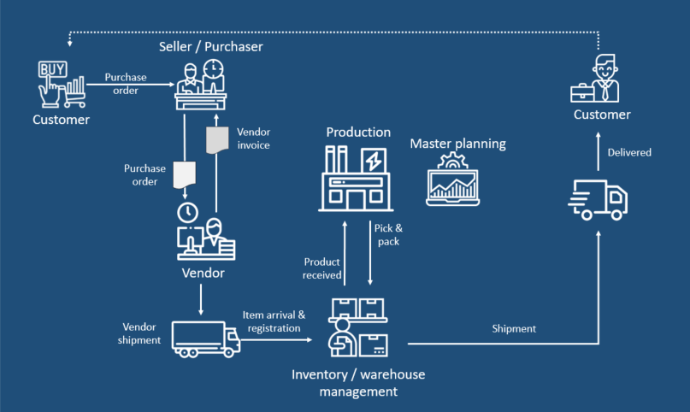
Common Processes in Dynamics 365
Procure to Buy
Quote to Cash
Plan to Produce
In the Procurement and sourcing module in Dynamics 365 Supply Chain Management, you create purchasing policies to control the purchasing process.
You identify suppliers, onboard suppliers as new vendors, maintain vendor information, create agreements with your vendors, order items and services, maintain purchase orders, and confirm receipt of products.
This area includes capabilities that expedite the end-to-end quoting process. Sellers and their customers can quickly and accurately create quotes, generate contract documents, and execute e-signatures to complete their deals and bring in revenue with these rich, intuitive, end-to-end experiences.
If the Planned order type field is set to Production, planned production orders are created.
Planning Optimizations supports several production scenarios
Notes:
Procure to buy
In the Procurement and sourcing module in Dynamics 365 Supply Chain Management, you create purchasing policies to control the purchasing process. Additionally, you identify suppliers, onboard suppliers as new vendors, maintain vendor information, create agreements with your vendors, order items and services, maintain purchase orders, and confirm receipt of products. After vendor transactions are processed through Accounts payable, you can also analyze spending and vendor performance.
https://docs.microsoft.com/en-us/learn/modules/configure-perform-procure-purchase-dyn365-supply-chain-mgmt/1-introduction
Quote to cash
This area includes capabilities that expedite the end-to-end quoting process. Sellers and their customers can quickly and accurately create quotes, generate contract documents, and execute e-signatures to complete their deals and bring in revenue with these rich, intuitive, end-to-end experiences.
https://docs.microsoft.com/en-us/dynamics365-release-plan/2020wave2/sales/dynamics365-sales/quote-cash
Plan to Produce
Planned production orders
When master planning creates planned orders to fulfill requirements, the order type is determined by the value of the Planned order type field. If the Planned order type field is set to Production, planned production orders are created. These planned production orders include information about the active bill of materials (BOM) and the route ID from the related production setup.
Planning Optimizations supports several production scenarios. If you're migrating from the existing, built-in master planning engine, it's important to be aware of some changed behavior.
https://docs.microsoft.com/en-us/dynamics365/supply-chain/master-planning/planning-optimization/production-planning

Slide 66
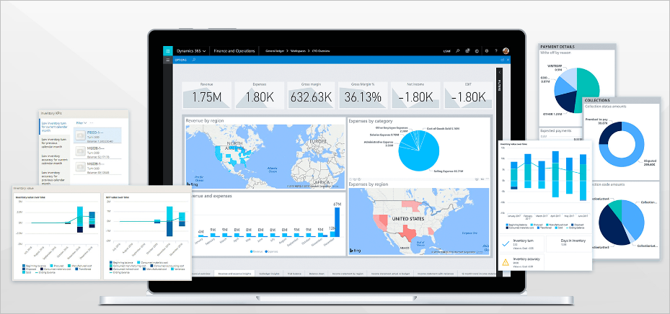
Dynamics 365 Finance – Introduction
Dynamics 365 Finance provides fast, dependable, and comprehensive accounting, financial reporting, and analysis
Two objectives of a typical financial management system in any company are
Maximize profit
Maximize wealth
Notes:
This slide is an animated slide –
Dynamics 365 Finance provides fast, dependable, and comprehensive accounting, financial reporting, and analysis. It also provides all the functionality that you need to update accounts efficiently and comply with reporting requirements.
This module introduces Dynamics 365 Finance, and its features and related modules in Finance and Operations apps. Additionally, it explains how this functionality helps businesses make better decisions quickly by bringing together a complete set of adaptable finance capabilities with built-in analytics and intelligence across industries, such as distribution, retail, supply chain, manufacturing, service industries, and public sector.
Two objectives of a typical financial management system in any company are:
Maximize profit - Trying to earn maximum profits for the company in the short term and the long term. Finance keeps all financial transactions in a ledger, and also offers tools and features to provide insight into incurring costs and projected revenue so that financial leaders can make proper decisions.
The General ledger module is the core of Finance and is integrated with other sub ledgers in Finance.
The Cash and bank management module allows companies to manage their banks and balances, and reconcile the bank statements with the General ledger module.
Maximize wealth - Earning maximum wealth for the shareholders of the company by increasing the market value of the shares, which is directly related to the performance of the company. A company must have a good cash flow to pay the daily expenses such as purchase of raw materials, wages, rent, electricity bills, and more. If the company has good cash flow, it can take advantage of many opportunities such as getting cash discounts on purchases, making large-scale purchases, giving credit to customers, and more. A healthy cash flow improves a company's chances of survival and success.
Ref: https://docs.microsoft.com/en-us/learn/modules/get-started-financial-management-dyn365-finance/1-introduction

Slide 67
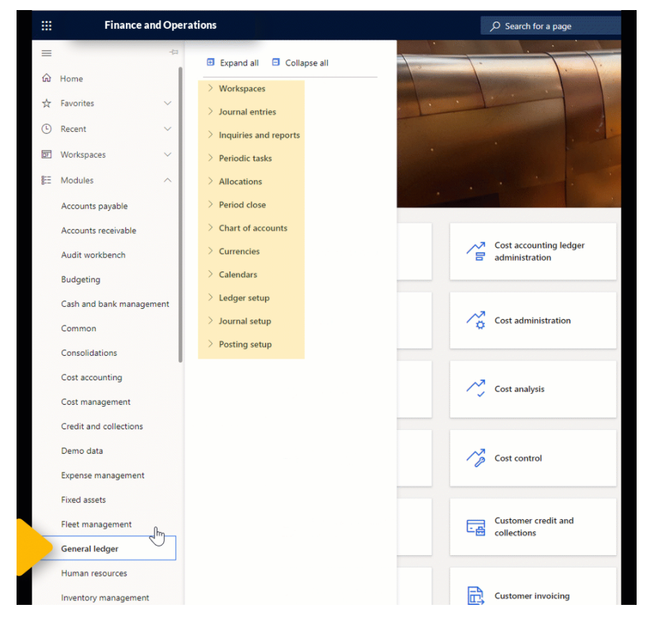
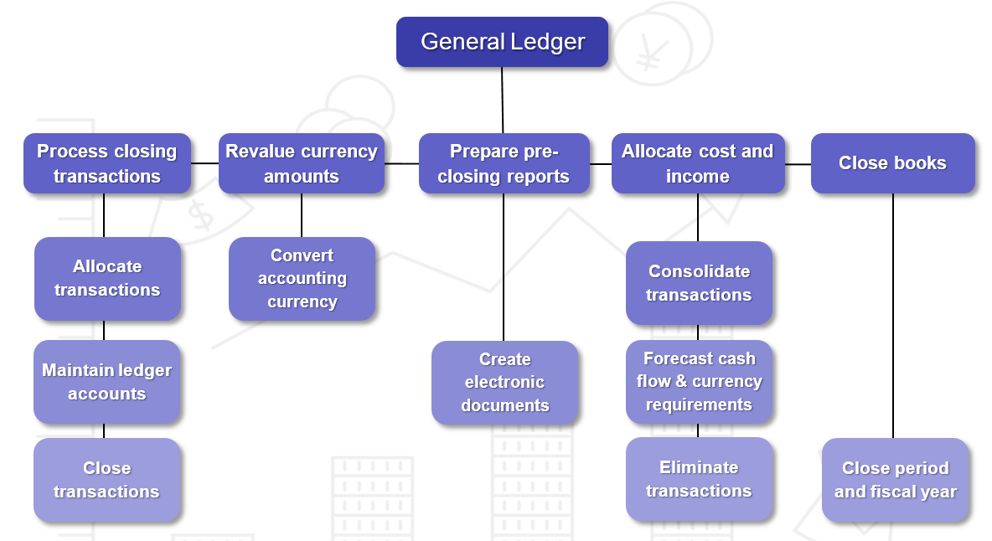
Dynamics 365 Finance – Modules
General ledger
Notes:
This slide is an animated slide –
You can use the General ledger module in Finance to define and manage the legal entity's financial structure. The general ledger is a register of debit and credit entries.
The General ledger module is the center of Finance and records all financial transactions from any other modules.
The examples of features in the General ledger module:
Accruals are used in accrual accounting to track revenue that is recognized in the period that it's earned in, not when payment is received, and to track expenses (costs) that are recognized when they occur, not when payment is made.
You can allocate, or distribute, monetary amounts to one or more accounts, or to account and dimension combinations, based on allocation rules. The two types of allocations are fixed and variable. You can also settle transactions between ledger accounts and revalue currency amounts.
At the end of a fiscal year, you must generate closing transactions and prepare your accounts for the next fiscal year. You can use the consolidation functionality to combine the financial results for several subsidiary legal entities into results for a single, consolidated organization. The subsidiaries can be in the same Finance database or in separate databases.
Financial reporting can consolidate multiple companies during report generation. The financial reports that are available out-of-the-box in Finance and Operations can be run at any time. These reports provide many additional benefits, such as the ability to drill down to all companies and dimensions.
The following figure illustrates the typical processes of the General ledger module in a company.
Ref: https://docs.microsoft.com/en-us/learn/modules/get-started-financial-management-dyn365-finance/4-general-ledger
Cash and bank management
You can use the Cash and bank management module in Finance to maintain a company's bank accounts and the financial instruments that are associated with those bank accounts. These instruments include deposit slips, checks, bills of exchange, and promissory notes. You can also reconcile bank statements and print bank data on standard reports.
The following are examples of tasks that you can perform in the Cash and bank management module:
Manage letters of credit and import collections for the purchase and sale of goods across international borders.
Manage letters of guarantee to manage agreement by a bank (the guarantor) to pay a set amount of money to some person (the beneficiary).
Perform bank reconciliation by importing bank statements and by using matching rule criteria to automatically select transactions for reconciliation, which saves significant time for accountants.
Deposit and transfer bank funds.
Cancel wrong deposits.
Update and maintain bank balances.
Define formats for checks.
Use the cash flow forecasting tools to analyze upcoming cash flow and currency requirements so that you can estimate the company's future need for cash.
Ref: https://docs.microsoft.com/en-us/learn/modules/get-started-financial-management-dyn365-finance/5-cash-bank
Tax
Every company must collect and pay taxes to various tax authorities. The rules and rates vary by country or region, state, county, and city.
Also, the rules must be updated periodically when tax authorities change their requirements.
Sales tax codes contain the basic information about how much you collect and pay to the authorities. When setting up sales tax codes, you define the amounts or percentages that must be collected. You also define the various methods by which those amounts or percentages are applied to transaction amounts.
The sales tax framework supports many types of indirect taxes, such as sales tax, value-added tax (VAT), goods and services tax (GST), unit-based fees, and withholding tax. These taxes are calculated and documented during purchase and sales transactions. Periodically, they must be reported and paid to tax authorities.
https://docs.microsoft.com/en-us/learn/modules/get-started-financial-management-dyn365-finance/6-tax
Accounts payable
The Accounts payable module in Finance lets you set up vendor groups, vendors, posting profiles, various payment options and parameters regarding vendors, charges, deliveries and destinations, promissory notes, and other types of accounts payable information.
You can also set up accounts payable to record vendor invoices, generate and post vendor payments, and perform settlements.
The following are examples of tasks that you can perform in the Accounts payable module:
Enter vendor invoices manually or receive them electronically through a data entity. After the invoices are entered or received, you can review and approve the invoices by using an invoice approval journal or the Vendor invoice page.
Use invoice matching, vendor invoice policies, and workflow to automate the review process so that invoices that meet certain criteria are automatically approved, and the remaining invoices are flagged for review by an authorized user.
Resolve discrepancies during invoice totals matching.
Set up default offset accounts for vendor invoice journals and an invoice approval journal.
Manage daily tasks by using workspaces.
Define vendor payment terms and fees.
Set up and generate positive pay files.
Create vendor payments by using a payment proposal.
Credit vendor payments for a partial amount.
Take a cash discount outside the cash discount period.
Reverse a vendor payment.
Prepare prepayment invoices and a prepayments overview.
Settle a partial vendor payment before the discount date.
Ref: https://docs.microsoft.com/en-us/learn/modules/get-started-financial-management-dyn365-finance/1-introduction

Slide 68
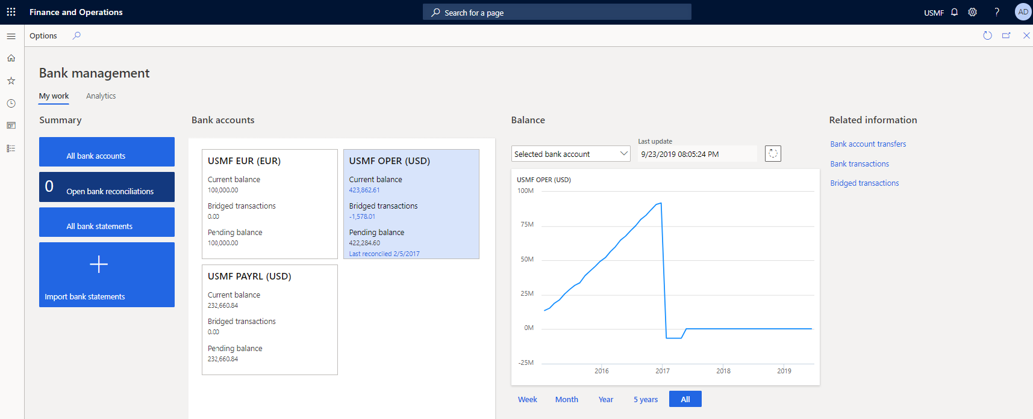
Dynamics 365 Finance – Modules
Cash and Bank Management
Notes:
This slide is an animated slide –
You can use the General ledger module in Finance to define and manage the legal entity's financial structure. The general ledger is a register of debit and credit entries.
The General ledger module is the center of Finance and records all financial transactions from any other modules.
The examples of features in the General ledger module:
Accruals are used in accrual accounting to track revenue that is recognized in the period that it's earned in, not when payment is received, and to track expenses (costs) that are recognized when they occur, not when payment is made.
You can allocate, or distribute, monetary amounts to one or more accounts, or to account and dimension combinations, based on allocation rules. The two types of allocations are fixed and variable. You can also settle transactions between ledger accounts and revalue currency amounts.
At the end of a fiscal year, you must generate closing transactions and prepare your accounts for the next fiscal year. You can use the consolidation functionality to combine the financial results for several subsidiary legal entities into results for a single, consolidated organization. The subsidiaries can be in the same Finance database or in separate databases.
Financial reporting can consolidate multiple companies during report generation. The financial reports that are available out-of-the-box in Finance and Operations can be run at any time. These reports provide many additional benefits, such as the ability to drill down to all companies and dimensions.
The following figure illustrates the typical processes of the General ledger module in a company.
Ref: https://docs.microsoft.com/en-us/learn/modules/get-started-financial-management-dyn365-finance/4-general-ledger
Cash and bank management
You can use the Cash and bank management module in Finance to maintain a company's bank accounts and the financial instruments that are associated with those bank accounts. These instruments include deposit slips, checks, bills of exchange, and promissory notes. You can also reconcile bank statements and print bank data on standard reports.
The following are examples of tasks that you can perform in the Cash and bank management module:
Manage letters of credit and import collections for the purchase and sale of goods across international borders.
Manage letters of guarantee to manage agreement by a bank (the guarantor) to pay a set amount of money to some person (the beneficiary).
Perform bank reconciliation by importing bank statements and by using matching rule criteria to automatically select transactions for reconciliation, which saves significant time for accountants.
Deposit and transfer bank funds.
Cancel wrong deposits.
Update and maintain bank balances.
Define formats for checks.
Use the cash flow forecasting tools to analyze upcoming cash flow and currency requirements so that you can estimate the company's future need for cash.
Ref: https://docs.microsoft.com/en-us/learn/modules/get-started-financial-management-dyn365-finance/5-cash-bank
Tax
Every company must collect and pay taxes to various tax authorities. The rules and rates vary by country or region, state, county, and city.
Also, the rules must be updated periodically when tax authorities change their requirements.
Sales tax codes contain the basic information about how much you collect and pay to the authorities. When setting up sales tax codes, you define the amounts or percentages that must be collected. You also define the various methods by which those amounts or percentages are applied to transaction amounts.
The sales tax framework supports many types of indirect taxes, such as sales tax, value-added tax (VAT), goods and services tax (GST), unit-based fees, and withholding tax. These taxes are calculated and documented during purchase and sales transactions. Periodically, they must be reported and paid to tax authorities.
https://docs.microsoft.com/en-us/learn/modules/get-started-financial-management-dyn365-finance/6-tax
Accounts payable
The Accounts payable module in Finance lets you set up vendor groups, vendors, posting profiles, various payment options and parameters regarding vendors, charges, deliveries and destinations, promissory notes, and other types of accounts payable information.
You can also set up accounts payable to record vendor invoices, generate and post vendor payments, and perform settlements.
The following are examples of tasks that you can perform in the Accounts payable module:
Enter vendor invoices manually or receive them electronically through a data entity. After the invoices are entered or received, you can review and approve the invoices by using an invoice approval journal or the Vendor invoice page.
Use invoice matching, vendor invoice policies, and workflow to automate the review process so that invoices that meet certain criteria are automatically approved, and the remaining invoices are flagged for review by an authorized user.
Resolve discrepancies during invoice totals matching.
Set up default offset accounts for vendor invoice journals and an invoice approval journal.
Manage daily tasks by using workspaces.
Define vendor payment terms and fees.
Set up and generate positive pay files.
Create vendor payments by using a payment proposal.
Credit vendor payments for a partial amount.
Take a cash discount outside the cash discount period.
Reverse a vendor payment.
Prepare prepayment invoices and a prepayments overview.
Settle a partial vendor payment before the discount date.
Ref: https://docs.microsoft.com/en-us/learn/modules/get-started-financial-management-dyn365-finance/1-introduction

Slide 69
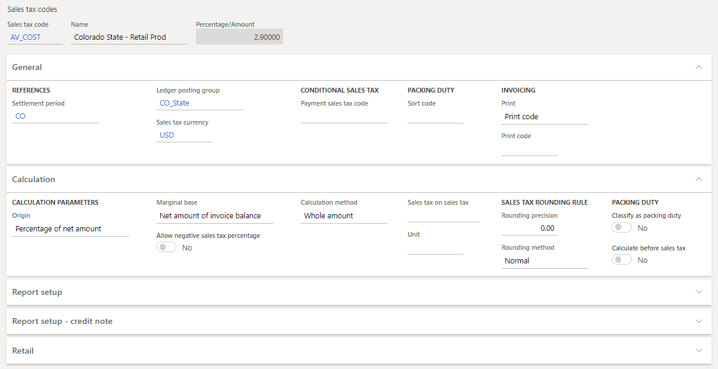
Dynamics 365 Finance – Modules
Tax
Notes:
This slide is an animated slide –
You can use the General ledger module in Finance to define and manage the legal entity's financial structure. The general ledger is a register of debit and credit entries.
The General ledger module is the center of Finance and records all financial transactions from any other modules.
The examples of features in the General ledger module:
Accruals are used in accrual accounting to track revenue that is recognized in the period that it's earned in, not when payment is received, and to track expenses (costs) that are recognized when they occur, not when payment is made.
You can allocate, or distribute, monetary amounts to one or more accounts, or to account and dimension combinations, based on allocation rules. The two types of allocations are fixed and variable. You can also settle transactions between ledger accounts and revalue currency amounts.
At the end of a fiscal year, you must generate closing transactions and prepare your accounts for the next fiscal year. You can use the consolidation functionality to combine the financial results for several subsidiary legal entities into results for a single, consolidated organization. The subsidiaries can be in the same Finance database or in separate databases.
Financial reporting can consolidate multiple companies during report generation. The financial reports that are available out-of-the-box in Finance and Operations can be run at any time. These reports provide many additional benefits, such as the ability to drill down to all companies and dimensions.
The following figure illustrates the typical processes of the General ledger module in a company.
Ref: https://docs.microsoft.com/en-us/learn/modules/get-started-financial-management-dyn365-finance/4-general-ledger
Cash and bank management
You can use the Cash and bank management module in Finance to maintain a company's bank accounts and the financial instruments that are associated with those bank accounts. These instruments include deposit slips, checks, bills of exchange, and promissory notes. You can also reconcile bank statements and print bank data on standard reports.
The following are examples of tasks that you can perform in the Cash and bank management module:
Manage letters of credit and import collections for the purchase and sale of goods across international borders.
Manage letters of guarantee to manage agreement by a bank (the guarantor) to pay a set amount of money to some person (the beneficiary).
Perform bank reconciliation by importing bank statements and by using matching rule criteria to automatically select transactions for reconciliation, which saves significant time for accountants.
Deposit and transfer bank funds.
Cancel wrong deposits.
Update and maintain bank balances.
Define formats for checks.
Use the cash flow forecasting tools to analyze upcoming cash flow and currency requirements so that you can estimate the company's future need for cash.
Ref: https://docs.microsoft.com/en-us/learn/modules/get-started-financial-management-dyn365-finance/5-cash-bank
Tax
Every company must collect and pay taxes to various tax authorities. The rules and rates vary by country or region, state, county, and city.
Also, the rules must be updated periodically when tax authorities change their requirements.
Sales tax codes contain the basic information about how much you collect and pay to the authorities. When setting up sales tax codes, you define the amounts or percentages that must be collected. You also define the various methods by which those amounts or percentages are applied to transaction amounts.
The sales tax framework supports many types of indirect taxes, such as sales tax, value-added tax (VAT), goods and services tax (GST), unit-based fees, and withholding tax. These taxes are calculated and documented during purchase and sales transactions. Periodically, they must be reported and paid to tax authorities.
https://docs.microsoft.com/en-us/learn/modules/get-started-financial-management-dyn365-finance/6-tax
Accounts payable
The Accounts payable module in Finance lets you set up vendor groups, vendors, posting profiles, various payment options and parameters regarding vendors, charges, deliveries and destinations, promissory notes, and other types of accounts payable information.
You can also set up accounts payable to record vendor invoices, generate and post vendor payments, and perform settlements.
The following are examples of tasks that you can perform in the Accounts payable module:
Enter vendor invoices manually or receive them electronically through a data entity. After the invoices are entered or received, you can review and approve the invoices by using an invoice approval journal or the Vendor invoice page.
Use invoice matching, vendor invoice policies, and workflow to automate the review process so that invoices that meet certain criteria are automatically approved, and the remaining invoices are flagged for review by an authorized user.
Resolve discrepancies during invoice totals matching.
Set up default offset accounts for vendor invoice journals and an invoice approval journal.
Manage daily tasks by using workspaces.
Define vendor payment terms and fees.
Set up and generate positive pay files.
Create vendor payments by using a payment proposal.
Credit vendor payments for a partial amount.
Take a cash discount outside the cash discount period.
Reverse a vendor payment.
Prepare prepayment invoices and a prepayments overview.
Settle a partial vendor payment before the discount date.
Ref: https://docs.microsoft.com/en-us/learn/modules/get-started-financial-management-dyn365-finance/1-introduction

Slide 70
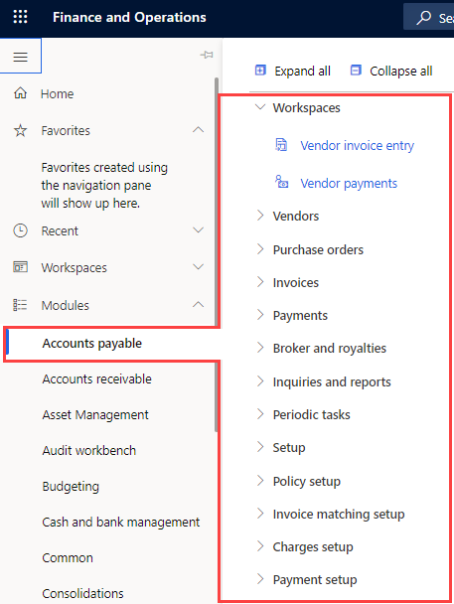
Dynamics 365 Finance – Modules
Accounts Payable
Accounts Receivable
Notes:
This slide is an animated slide –
You can use the General ledger module in Finance to define and manage the legal entity's financial structure. The general ledger is a register of debit and credit entries.
The General ledger module is the center of Finance and records all financial transactions from any other modules.
The examples of features in the General ledger module:
Accruals are used in accrual accounting to track revenue that is recognized in the period that it's earned in, not when payment is received, and to track expenses (costs) that are recognized when they occur, not when payment is made.
You can allocate, or distribute, monetary amounts to one or more accounts, or to account and dimension combinations, based on allocation rules. The two types of allocations are fixed and variable. You can also settle transactions between ledger accounts and revalue currency amounts.
At the end of a fiscal year, you must generate closing transactions and prepare your accounts for the next fiscal year. You can use the consolidation functionality to combine the financial results for several subsidiary legal entities into results for a single, consolidated organization. The subsidiaries can be in the same Finance database or in separate databases.
Financial reporting can consolidate multiple companies during report generation. The financial reports that are available out-of-the-box in Finance and Operations can be run at any time. These reports provide many additional benefits, such as the ability to drill down to all companies and dimensions.
The following figure illustrates the typical processes of the General ledger module in a company.
Ref: https://docs.microsoft.com/en-us/learn/modules/get-started-financial-management-dyn365-finance/4-general-ledger
Cash and bank management
You can use the Cash and bank management module in Finance to maintain a company's bank accounts and the financial instruments that are associated with those bank accounts. These instruments include deposit slips, checks, bills of exchange, and promissory notes. You can also reconcile bank statements and print bank data on standard reports.
The following are examples of tasks that you can perform in the Cash and bank management module:
Manage letters of credit and import collections for the purchase and sale of goods across international borders.
Manage letters of guarantee to manage agreement by a bank (the guarantor) to pay a set amount of money to some person (the beneficiary).
Perform bank reconciliation by importing bank statements and by using matching rule criteria to automatically select transactions for reconciliation, which saves significant time for accountants.
Deposit and transfer bank funds.
Cancel wrong deposits.
Update and maintain bank balances.
Define formats for checks.
Use the cash flow forecasting tools to analyze upcoming cash flow and currency requirements so that you can estimate the company's future need for cash.
Ref: https://docs.microsoft.com/en-us/learn/modules/get-started-financial-management-dyn365-finance/5-cash-bank
Tax
Every company must collect and pay taxes to various tax authorities. The rules and rates vary by country or region, state, county, and city.
Also, the rules must be updated periodically when tax authorities change their requirements.
Sales tax codes contain the basic information about how much you collect and pay to the authorities. When setting up sales tax codes, you define the amounts or percentages that must be collected. You also define the various methods by which those amounts or percentages are applied to transaction amounts.
The sales tax framework supports many types of indirect taxes, such as sales tax, value-added tax (VAT), goods and services tax (GST), unit-based fees, and withholding tax. These taxes are calculated and documented during purchase and sales transactions. Periodically, they must be reported and paid to tax authorities.
https://docs.microsoft.com/en-us/learn/modules/get-started-financial-management-dyn365-finance/6-tax
Accounts payable
The Accounts payable module in Finance lets you set up vendor groups, vendors, posting profiles, various payment options and parameters regarding vendors, charges, deliveries and destinations, promissory notes, and other types of accounts payable information.
You can also set up accounts payable to record vendor invoices, generate and post vendor payments, and perform settlements.
The following are examples of tasks that you can perform in the Accounts payable module:
Enter vendor invoices manually or receive them electronically through a data entity. After the invoices are entered or received, you can review and approve the invoices by using an invoice approval journal or the Vendor invoice page.
Use invoice matching, vendor invoice policies, and workflow to automate the review process so that invoices that meet certain criteria are automatically approved, and the remaining invoices are flagged for review by an authorized user.
Resolve discrepancies during invoice totals matching.
Set up default offset accounts for vendor invoice journals and an invoice approval journal.
Manage daily tasks by using workspaces.
Define vendor payment terms and fees.
Set up and generate positive pay files.
Create vendor payments by using a payment proposal.
Credit vendor payments for a partial amount.
Take a cash discount outside the cash discount period.
Reverse a vendor payment.
Prepare prepayment invoices and a prepayments overview.
Settle a partial vendor payment before the discount date.
Ref: https://docs.microsoft.com/en-us/learn/modules/get-started-financial-management-dyn365-finance/1-introduction

Slide 71
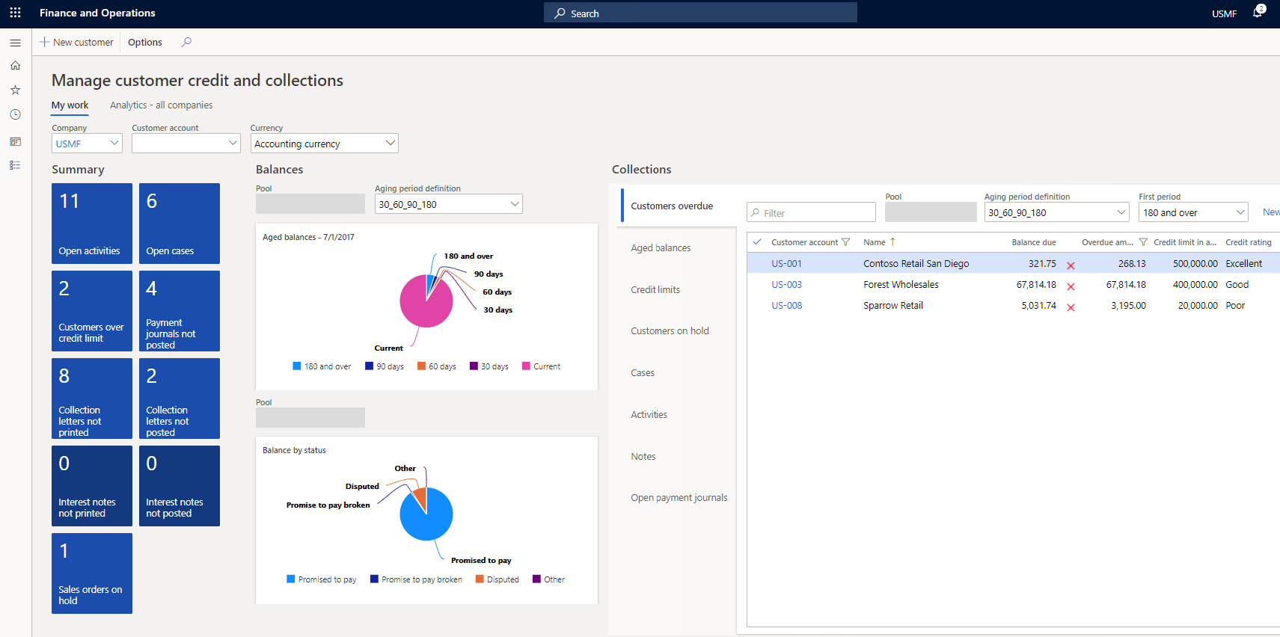
Dynamics 365 Finance – Modules
Credits and Collections
Notes:
Accounts receivable collections information can be managed in one central view by using the Collections page in Finance.
Collection agents can begin the collections process from generated customer lists by using predefined collection criteria, or from the Customers page.
Before you begin to set up or work with collections, you should understand the following concepts:
Customer aging snapshots contain aged balance information at a point in time.
Collections customer pools help you organize your work.
Collections agents can have their own customer pools.
List pages organize collections customers, activities, and cases.
All collections information for a customer is on one page and you can take action from that page.
Waiving, reinstating, or reversing interest and fees can be done in one step.
You can manage delinquent customers.
You can create write-off transactions in one step.
Processing Not Sufficient Funds (NSF) payments can be done in one step.
https://docs.microsoft.com/en-us/learn/modules/get-started-financial-management-dyn365-finance/9-credit-collections

Slide 72
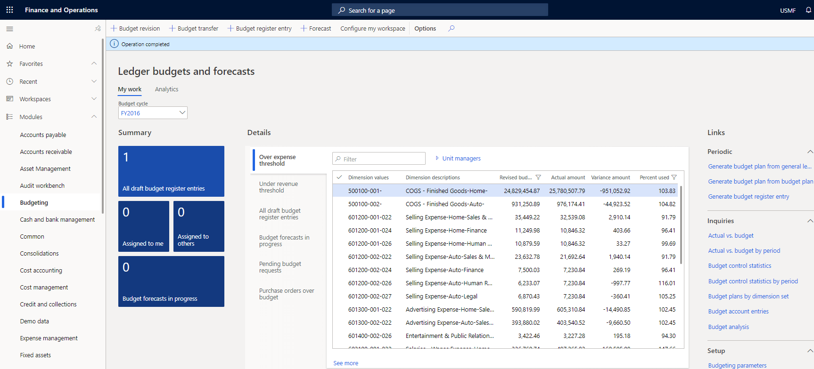
Dynamics 365 Finance – Modules
Budgeting
Notes:
With a proper budgeting process, companies can benefit from forecasting and use financial insights to compare actuals against allocated budget. You can use the Budgeting module in Finance for basic budgeting, budget planning, and budget control.
After a budget is established and approved in Finance, you can convert the budget plan to a budget register entry. Budget register entries provide tools for maintaining the budget and for keeping amounts traceable through budget codes.
Budget register entries let you revise original budgets, perform transfers, and carry forward budget amounts from the previous year. Based on the established budget, a company can enable budget control. The level of control depends on the organizational culture and the organization's level of maturity.
Finance includes a budget control framework that lets the company's management select either hard control (which prevents postings that would go over the budget) or soft control (where users are warned that they will exceed the available budget funds but can decide for themselves how to proceed).
Finally, you can use rolling forecasts. A rolling forecast is a regular comparison of budget to actuals and is used to define how well the company operates against the budget. A rolling forecast is also used to identify trends. In Finance, rolling forecasts are supported through a budget plan document as initial planning activities. Rolling forecasts can be done in parallel with planning for the upcoming budget cycle.
https://docs.microsoft.com/en-us/learn/modules/get-started-financial-management-dyn365-finance/10-budgeting

Slide 73
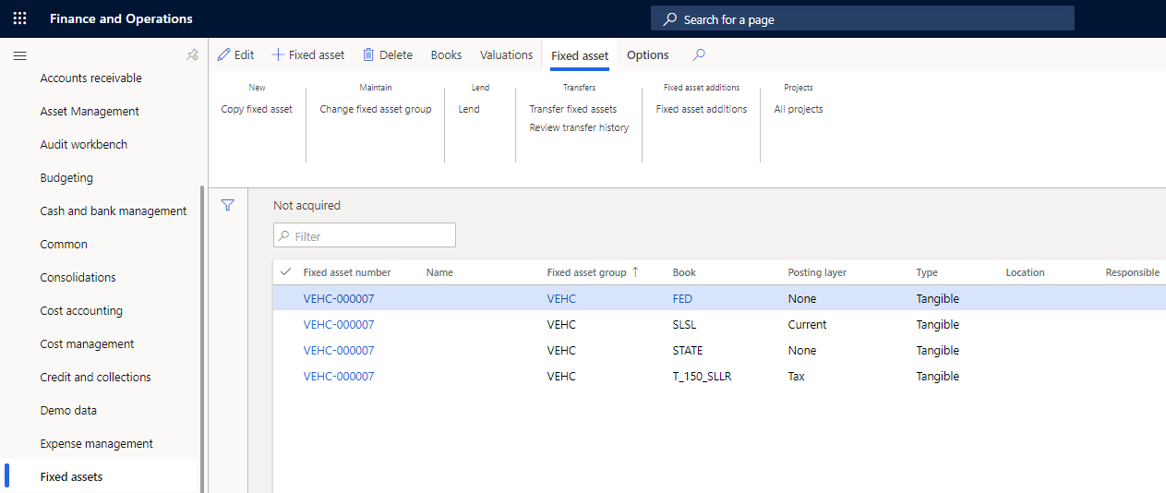
Dynamics 365 Finance – Modules
Fixed Assets
Notes:
Fixed assets are items of value, such as buildings, vehicles, land, and equipment, that are owned by an individual or a company.
You can set up and enter acquisition information for fixed assets, and then manage them by depreciating them and setting a capitalization threshold to determine depreciation.
The following are tasks that you can perform in the Fixed assets module:
Create fixed assets
Capitalize fixed assets
Transfer or lend fixed assets
Revalue or update fixed assets
Split fixed assets
Depreciate or amortize fixed assets
Dispose or retire fixed assets
When you use general ledger with fixed assets, you can view the current value of all fixed assets.
The way in which fixed assets are handled must correspond with both international accounting standards and the accounting legislation in each country or region. Requirements might include rules for recording acquisition and disposal transactions, depreciation, lifetimes, and write ups and write downs of fixed assets.
The fixed assets functionality in Finance incorporates many of these standards and rules.
https://docs.microsoft.com/en-us/learn/modules/get-started-financial-management-dyn365-finance/11-fixed-assets

Slide 74

Dynamics 365 Finance – Modules
Cost Accounting
Notes:
Cost accounting lets you collect data from various sources, such as the general ledger, subledgers, budgets, and statistical information. You can then analyze, summarize, and evaluate cost data to enable management to make the best possible decisions for the following task, amongst others:
Price updates
Budgets
Cost control
The Cost control workspace is a central point where managers who are responsible for controlling a cost object or a set of cost objects within a dimension or across dimensions (for example, cost centers and product groups) can access reports. The reports in the Cost control workspace are managed by cost accountants so that the layout and data that are used for reporting can be consistent across the organization.
https://docs.microsoft.com/en-us/learn/modules/get-started-financial-management-dyn365-finance/12-cost-accounting

Slide 75
Dynamics 365 Finance – Modules
Electronic Invoicing
1
Fast and easy adoption of country/region-specific requirements
2
Standardized implementations of an Electronic invoicing solution
3
Enhanced traceability of document history and Shorter implementation cycle
4
Reduced total cost of ownership (TCO) and easily adjustable configurations that don’t require code changes
Notes:
Fixed assets are items of value, such as buildings, vehicles, land, and equipment, that are owned by an individual or a company.
You can set up and enter acquisition information for fixed assets, and then manage them by depreciating them and setting a capitalization threshold to determine depreciation.
The following are tasks that you can perform in the Fixed assets module:
Create fixed assets
Capitalize fixed assets
Transfer or lend fixed assets
Revalue or update fixed assets
Split fixed assets
Depreciate or amortize fixed assets
Dispose or retire fixed assets
When you use general ledger with fixed assets, you can view the current value of all fixed assets.
The way in which fixed assets are handled must correspond with both international accounting standards and the accounting legislation in each country or region. Requirements might include rules for recording acquisition and disposal transactions, depreciation, lifetimes, and write ups and write downs of fixed assets.
The fixed assets functionality in Finance incorporates many of these standards and rules.
https://docs.microsoft.com/en-us/learn/modules/get-started-financial-management-dyn365-finance/11-fixed-assets

Slide 76
Revenue Recognition Overview
1
Allocate revenue, to help ensure that the appropriate revenue price is recognized, based on the value of the components on multi-element orders.
2
Defer revenue, based on a revenue schedule that represents the contractual time frame and percentages for recognizing revenue over time.
The Revenue recognition feature provides a flexible framework that lets you define company-specific rules for recognizing both the revenue price and the revenue schedule.
3
4
Released products are used to support revenue recognition on sales order documents
Notes:
Companies in industries that sell multiple elements, such as products, services, subscriptions, and so on, must be able to break out multi-element orders so that revenue can be recognized based on a set of company-specific and industry-specific guidelines.
Revenue recognition, including bundle functionality, isn't supported for use in Commerce channels (e-commerce, POS, call center). Items configured with revenue recognition should not be added to orders or transactions created in Commerce channels.
In general, the revenue recognition process can be used to perform these tasks:
Allocate revenue, to help ensure that the appropriate revenue price is recognized, based on the value of the components on multi-element orders.
Defer revenue, based on a revenue schedule that represents the contractual time frame and percentages for recognizing revenue over time.
The Revenue recognition feature provides a flexible framework that lets you define company-specific rules for recognizing both the revenue price and the revenue schedule.
Released products are used to support revenue recognition on sales order documents. The released products contain the setup that is required to determine the revenue price and the revenue schedule. The sales order can originate from a Time and materials project.
Companies can use the revenue schedule functionality without using the revenue price functionality. Therefore, the price on the sales order lines will be used as either revenue or deferred revenue. If a revenue schedule exists on the sales order line, the price on the sales order line will be deferred. If a revenue schedule doesn't exist on the sales order line, the price on the sales order line will be posted to a revenue account when it's invoiced.
The revenue price is calculated either when the sales order is confirmed or when the invoice is posted. To preview the revenue price before the invoice is posted, you must confirm the sales order.
When the sales order is confirmed, an expected revenue schedule is also created if any sales order line has a revenue schedule. When the sales order is invoiced, the expected revenue schedule is deleted, and the expected revenue schedule is replaced with the actual revenue recognition schedule.
The details of the revenue recognition schedule are maintained for each sales order line. Therefore, the revenue recognition manager can view the details and can release lines to revenue when the contractual obligation has been completed. At the end of each period, the revenue recognition manager can create a revenue journal to release any schedule lines that are due on or before a date they define. This revenue journal isn't posted immediately. Therefore, the revenue recognition manager can verify that the correct amounts are being released from deferred revenue to actual revenue.
If a contractual change causes a new sales order line to be added either to the existing sales order or a new sales order, a reallocation process can be run to correct the revenue price across all lines on the sales orders.
https://docs.microsoft.com/en-us/dynamics365/finance/accounts-receivable/revenue-recognition-overview

Slide 77

Overview of Supply Chain Management
Notes:
Distribution and trade in Supply Chain Management is organized into various modules and role-based workspaces that focus on daily tasks that are related to the assigned role.
Role-based security in Supply Chain Management and Dynamics 365 Finance helps keep financial and operational data secure.
Below are the responsibilities of operational leaders.
Increase operational efficiency - Trying to accelerate the speed and accuracy of the business operations with streamlined processes that effectively coordinate people, assets, and resources to reduce costs, improve service levels, and drive growth.
In Finance, the Fixed assets module controls the assets in the supply chain by integrating with the Inventory management module in Supply Chain Management.
The Human resources module in Finance, and Organization administration modules control resources such as people, machines, and vendors.
Improve strategic planning – The Master planning and Inventory management modules assist companies in improving strategic planning by providing a unified view of inventory, warehouse, manufacturing, service, and logistics with predictive analytics that turn data into insights to support better strategic decisions.
Optimize workforce productivity - Providing a single source of business intelligence that drives productivity from assets and resources, aligns employees toward strategic goals, and enables real-time response to organizational and customer demands.
Supply Chain Management offers tools and features with built-in intelligent controls such as charts, Key Performance Indicators (KPIs), and workspaces to optimize workforce productivity.
Ref: https://docs.microsoft.com/en-us/learn/modules/get-started-supply-chain-management-dyn365-supply-chain-mgmt/3-overview-scm

Slide 78

Benefits of Dynamics 365 Supply Chain Management
Create an ideal manufacturing mix from discrete, lean, and process in a single, unified solution to support processes across the supply chain.
Optimize manufacturing parameters for each product family, including make to stock, make to order, pull to order, configure to order, and engineer to order.
Streamline scheduling with real-time visibility into resources by using a unified resource model and scheduling engine by using the Financial management module in Supply Chain Management.
Optimize the flow of manufacturing material and finished goods with advanced warehouse and logistics management.
Improve product quality by identifying and resolving issues through real-time insights and predictive intelligence.
Notes:
Distribution and trade in Supply Chain Management is organized into various modules and role-based workspaces that focus on daily tasks that are related to the assigned role.
Role-based security in Supply Chain Management and Dynamics 365 Finance helps keep financial and operational data secure.
Below are the responsibilities of operational leaders.
Increase operational efficiency - Trying to accelerate the speed and accuracy of the business operations with streamlined processes that effectively coordinate people, assets, and resources to reduce costs, improve service levels, and drive growth.
In Finance, the Fixed assets module controls the assets in the supply chain by integrating with the Inventory management module in Supply Chain Management.
The Human resources module in Finance, and Organization administration modules control resources such as people, machines, and vendors.
Improve strategic planning – The Master planning and Inventory management modules assist companies in improving strategic planning by providing a unified view of inventory, warehouse, manufacturing, service, and logistics with predictive analytics that turn data into insights to support better strategic decisions.
Optimize workforce productivity - Providing a single source of business intelligence that drives productivity from assets and resources, aligns employees toward strategic goals, and enables real-time response to organizational and customer demands.
Ref: https://docs.microsoft.com/en-us/learn/modules/get-started-supply-chain-management-dyn365-supply-chain-mgmt/3-overview-scm

Slide 79

Dynamics 365 Supply Chain Management
Modules of Dynamics 365 Supply Chain Management
Cost Accounting
Cost Management
Inventory Management and Warehouse Management
Master Planning
Procurement and Sourcing
Vendor Collaboration
Sales and Marketing
Customer Portal
Production Information Management
Production Control
Intercompany Trade
Transportation Management
Notes:
Dynamics 365 Supply Chain Management provides a single source of business intelligence that drives productivity from assets and resources, aligns employees toward strategic goals, and enables real-time response to organizational and customer demands.
Ref: https://docs.microsoft.com/en-us/learn/modules/get-started-supply-chain-management-dyn365-supply-chain-mgmt/4-cost-accounting

Slide 80

Dynamics 365 Commerce – Introduction
Dynamics 365 Commerce is a complete retail solution that gives you a unified experience across all channels.
Dynamics 365 Commerce includes sales, mobility, intelligence, and productivity to help you achieve more in a cloud-first, mobile first way.
Features of Dynamic 365 Commerce
Unified commerce
Modern point of sale (MPOS)
Merchandise management
Customer loyalty
Notes:
The modern retail customer is well informed and demands a great shopping experience. They want to feel in control their experience, from researching product price and quality, to purchasing from the brand that offers the most personalized, convenient service, to maximizing the value of every dollar spent. Their shopping journey can start in one channel, progress in another, and then end in a third channel of the customer’s choice.
To meet the customer’s demands, you need a solution that can:
Attract customers with personalized experiences and streamlined store operations.
Compete better by helping your customers be nimble and build lasting relationships with them.
Create rich customer-first experiences at all touchpoints tied with backend operations.
Improve merchandising efficiencies with intelligent insights.
Unify data and take advantage of a data-driven approach.
Give your employees the tools and information they need for ultra-responsive customer service.
To meet these requirements, you need a modern, flexible cloud commerce solution like Dynamics 365 Commerce. Dynamics 365 Commerce is a complete retail solution that gives you a unified experience across all channels. Dynamics 365 Commerce includes sales, mobility, intelligence, and productivity to help you achieve more in a cloud-first, mobile first way.
Ref: https://docs.microsoft.com/en-us/learn/modules/introduction-dynamics-365-commerce/1-introduction
The following list is the key features of Dynamics 365 Commerce:
Unified commerce: You can create unified shopping experiences across stores, web, mobile, and call centers.
Modern point of sale (MPOS): MPOS is a point of sale (POS) app for devices. With MPOS, you can process transactions and orders from any device.
Merchandise management: You can create and configure your product catalog before offering items for sale.
Customer loyalty: You can track your customers' trends and habits and then send personalized notifications and offers that make shopping your channels easier.
Let's review the features one by one.
Ref: https://docs.microsoft.com/en-us/learn/modules/introduction-dynamics-365-commerce/3-features

Slide 81
Unified Commerce and Point of Sale (POS)
Unified Commerce
Point of sale (POS)
It Support diverse types of stores, including the traditional brick-and-mortar store, online stores, and call centers
Each store can have its own payment methods, delivery methods, price groups, income and expense accounts, registers, and staff
You give customers the convenience and flexibility to buy-in store, pick up in other locations, or get home delivery
Dynamics 365 Commerce supports the following POS options:
Retail Modern POS (MPOS)
Cloud POS (CPOS)
The POS shares the same core application code
Notes:
Unified commerce
Retail organizations are no longer just brick and mortar stores. You need the ability to unify the shopping experience across all retail experiences. You must support diverse types of stores, including the traditional brick-and-mortar store, online stores, and call centers. Each store can have its own payment methods, delivery methods, price groups, income and expense accounts, registers, and staff. But across all the purchasing channels, you give customers the convenience and flexibility to buy-in store, pick up in other locations, or get home delivery with optimized ordering and fulfillment tools.
Point of sale (POS)
You can support and manage your POS experiences with Dynamics 365 Commerce. You configure your operations across stores and online, while using intelligent product and inventory search tools. You create buttons for functional actions, process sales, and manage receipts after customers complete sales.
Dynamics 365 Commerce supports both cloud and MPOS experiences. Use the cloud POS on browsers with mobile devices, or use MPOS to process sales, orders, operations, and inventory across other devices. You can track and control commissions and receipts during and after sale events.
Dynamics 365 Commerce supports the following POS options:
Retail Modern POS (MPOS) for Windows operating systems and mobile devices.
Cloud POS (CPOS) that enables POS features in supported browsers.
In all cases, the POS shares the same core application code. This point is important for the following reasons:
The user interface (UI) is consistent, whatever of the platform or form factor.
Most of the capabilities are the same, whatever of the platform or form factor. However, there are some important differences.
In each, you can combine and run the POS variations concurrently. For example, for its main registers, you can use MPOS on devices that run Windows. However, you can supplement those registers with browser-based terminals or mobile devices.
You can use customizations and extensions across platforms and form factors. Because the core application shares code, you can implement most customizations once instead of multiple times.
With Dynamics 365 Commerce, you can use wide range of devices with MPOS and CPOS. Both MPOS and CPOS offer multiple interfaces and deployment options to help you with your various business scenarios.
The virtual peripheral simulator allows you to test physical peripheral devices without having to deploy the POS client. It includes both a virtual peripheral simulator and a POS simulator to test the compatibility of physical peripheral devices.
Ref: https://docs.microsoft.com/en-us/learn/modules/introduction-dynamics-365-commerce/3-features

Slide 82


Merchandise Management and Customer Loyalty
Merchandise Management
Customer Loyalty
Notes:
Merchandising and inventory
You can strategically plan your merchandising and inventory to increase sales and profitability. Before you can offer products for sale in your retail channels, you must create and configure the products in Dynamics 365 Commerce. You create the products, define the product properties and attributes, and assign the products to retail category hierarchies. To make the products available to your retail channels and add them to an active assortment, you release the products to the legal entities where they're available.
You can change a product’s price and set up discounts applied to a line item or a transaction at the POS, in a call center sales order, or in an online order.
The following screenshot is the category and product management screen.
Clientele overview
You want your employees to form long-term relationships with your key customers. You expect the employees to know about these customers' likes and dislikes, purchase history, product preferences, and important dates, such as anniversaries and birthdays.
Employees need a place where they can capture and find this information. When information is available in a single view, your employees can target customers who meet specific criteria. For example, they can find all customers who prefer to shop for handbags, or customers who have a birthday or anniversary approaching.
With Dynamics 365 Commerce clientele tools and integration with Dynamics 365 Customer Insights, you gain a comprehensive view of your customers. You can respond to their needs at every level of engagement, based on customer profile, history, and preferences that flow across physical and digital channels.
You can foster lasting relationships through AI-driven recommendations, customer insights, inventory checks, endless aisle, and loyalty programs that elevate brand appeal.
Customer loyalty
Loyalty programs increase customer loyalty by rewarding customers for their interactions with your brand. In Dynamics 365 Commerce, you can set up loyalty programs that apply across your legal entities in any retail channel.
You can set up loyalty programs for the different reward incentives that you offer including:
Defining earning rules to show the activities that customers must complete to earn rewards.
Issuing loyalty cards from any retail channel that takes part in your loyalty programs.
Linking loyalty cards to any loyalty programs that customers can take part in.
Linking customers’ records to a loyalty card, so that the customers can pool loyalty points from multiple cards and redeem them.
The following screenshot shows the loyalty points a customer has accumulated.
Assisted selling in Dynamics 365 Commerce works across devices while harnessing the power of the cloud. You can create product recommendations across e-commerce and POS experiences. As customers interact with your store, they build up loyalty programs, which create loyal return customers. Finally, give your customers the ability to leave reviews and ratings so you can improve your processes for the future.
Now let's turn our attention to other Dynamics 365 Commerce capabilities.
Ref: https://docs.microsoft.com/en-us/learn/modules/introduction-dynamics-365-commerce/3-features

Slide 83


Managing your organization with Dynamics 365 human resources
Notes:
Dynamics 365 Human Resources helps you balance operational excellence, organizational agility, and the employee experience to create a workplace where people and your business thrive.
Dynamics 365 Human Resources helps you manage and develop your employees, with everything from guided learning experiences to performance assessments. You can create streamlined, talent-centric processes and effective programs that optimize workforce costs, deliver business impact, and drive an agile, high-performance culture. Human Resources helps you set up and manage all your HR programs, and gives you capabilities to better manage:
Personnel and organizational management
Benefits and compensation
Leave and absence management
Compliance (health and safety)
With the extensive capabilities of Human Resources, you can transform and automate the following tasks:
Administer organizational structures.
Maintain comprehensive employee information from hire to retire.
Manage employee competencies.
Define and administer benefit plans, enroll employees, assign dependent coverage, and designate beneficiaries.
Establish and monitor absence policies.
Implement and track profile-based time management and generate pay information to export to a payroll system.
Review performance and implement employee goals.
Set up, deliver, and analyze training courses that include agendas, sessions, and tracks.
Track compliance (health and safety).
Manage employee development (standardized training, certifications, skills tracking, performance feedback).
Manage the employee and manager experience (self-service, manager dashboards, employee profiles).
Complete HR reporting with embedded dashboards and Microsoft Power BI for workforce analytics.
Integrate payroll through Ceridian Dayforce.
Dynamics 365 Human Resources capabilities simplify and optimize benefits, compensation programs, leave and absence, certifications and training, and compliance.
https://docs.microsoft.com/en-us/learn/modules/introduction-human-resources/2-manage-organization

Slide 84
Dynamics 365 Project Operations
It connects sales, resourcing, project management, and finance teams in a single application to win more deals, accelerate project delivery, and maximize profitability
Leaders get business insights
Sales is enabled
Resourcing is set up to optimize
Project managers can accelerate
Team members can improve productivity
Finance can simplify project accounting
Notes:
Dynamics 365 Project Operations
Dynamics 365 Project Operations connects your project selling, staffing and resourcing, project management, and finance teams in a single application designed to help accelerate project delivery, and maximize profitability.
Some of the benefits of Projects Operations are:
Leaders get business insights - To increase visibility across all teams, data, and processes, plus AI capabilities for better and faster business decisions.
Sales is enabled - To accelerate the sales cycle with fast and accurate quotes, flexible pricing, and seamless transitions from estimate to execution.
Optimized resourcing - By aligning the right people, with the right skills, to the right projects. This improves quality and helps to retain top performers.
Project managers can accelerate project delivery - With built-in project management that uses familiar, easy-to-use Microsoft Project capabilities.
Team members can improve productivity, collaboration, and visibility - With integration to Microsoft Teams, and submit time and expenses from anywhere.
Finance can simplify project accounting - With time and expense tracking governance, project costing, budgeting, invoicing, revenue recognition, compliance, and visibility into key business health metrics.
Project Operations is powerful on its own, but can be expanded by our customers who require more capabilities from Dynamics 365. These capabilities include Marketing, Human Resources, Customer Service, and more. Whether you want the added functionality of another Dynamics 365 application or to add on a custom application built with Power Apps, everything works together and works like you expect because they share the common foundation of a secure, private, and compliant cloud-delivered solution.
Ref: https://docs.microsoft.com/en-us/learn/modules/examine-dynamics-365-project-operations/4-examine-project-services-lifecycle

Slide 85
Number sequence overview
Number sequences in Finance and Operations apps are used to generate readable, unique identifiers for master data records and transaction records that require identifiers
When you set up a number sequence, you must specify a scope, which defines which organization uses the number sequence
Shared
Company
Legal Entity
Operating Unit
Company and Fiscal Calendar Period
Legal entity and Fiscal calendar period
Operating unit type
Notes:
Before you can create new records for a Reference, you must set up a number sequence and associate it with the Reference for a specific module in Finance and Operations apps.
Number sequences in Finance and Operations apps are used to generate readable, unique identifiers for master data records and transaction records that require identifiers. A master data record or transaction record that requires an identifier is Referred to as a Reference.
We recommend that you use the pages in Organization administration to set up number sequences. If module-specific settings are required, you can use the Parameters page in a module to specify number sequences for the References in that module. For example, in Accounts receivable and Accounts payable, you can set up number sequence groups to allocate specific number sequences to specific customers or vendors.
You can set up all required number sequences at the same time by using the Set-up number sequences wizard, or you can create or modify individual number sequences by using the Number sequences page.
When you set up a number sequence, you must specify a scope, which defines which organization uses the number sequence.
By default, the following scopes can be used:
Shared - A single number sequence is used for all organizations. The Shared scope is available only for some References.
Company - A separate number sequence is used for each company. Use the Company scope when the underlying table includes the DataAreaId field. For example, use this scope for the number sequence for the customer account number that is in the Customer table CustTable.
Legal entity - A separate number sequence is used for each legal entity. Use the Legal entity scope when the underlying table does not include the DataAreaId field and has a foreign key to the legal entity table CompanyInfo. For example, use this scope for the number sequence for the expense report number that is in the expense report table TrvExpTable.
Operating unit - A separate number sequence is used for each operating unit.
Company and Fiscal calendar period - A separate number sequence is used for each company and fiscal calendar period combination.
Legal entity and Fiscal calendar period - A separate number sequence is used for each legal entity and fiscal calendar period combination.
Operating unit type - A separate number sequence is used for each type of operating unit.
For example, you can set up separate number sequences for cost centers and departments.
The scope defines which organizations use the number sequence. In addition, number sequence formats consist of segments. Number sequences with a scope other than Shared can contain segments that correspond to the scope. For example, a number sequence with a scope of Legal entity can contain a legal entity segment. By including a scope segment in the number sequence format, you can identify the scope of a record by looking at its number.
In addition to segments that correspond to scopes, number sequence formats can contain Constant and Alphanumeric segments. A Constant segment contains a set of letters, numbers, or symbols that does not change.
An Alphanumeric segment contains a set of letters or numbers that increment every time that a number is used. Use a number sign (#) to represent incrementing numbers and an ampersand (&) to represent incrementing letters. For example, the format #####_2017 creates the sequence 00001_2017, 00002_2017, and so on.
After you have configured the system-required number sequences, during the implementation phase of financial management you will probably need to create additional number sequences that address the specific requirements to identify certain records with specific formats.
For example, you might need to create a number sequence with a format of GTL-APINV-&#######, which will result in a range of values like; GTL-APINV-A0000001 through GTL-APINV-Z9999999. When this number sequence is out of available values, as part of periodic processing, you need to create a new number sequence and replace it in any References where it has been assigned.
Often, some businesses, or country/region requirements, demand that you change number sequences even when there are still available values. For example, in Italy, at the end of each fiscal year end the invoice numbers must start again at 1.
Ref: https://docs.microsoft.com/en-us/learn/modules/plan-implement-legal-entities-finance-operations/3-create-number-sequence

Slide 86
Creating a number sequence
1
Number sequences can be continuous or non-continuous
A continuous number sequence does not skip any numbers, but numbers may not be used sequentially.
Numbers from a non-continuous number sequence are used sequentially, but the number sequence can skip numbers.
Example – If a user cancels a transaction, a number is generated, but not used. In a continuous number sequence, that number is recycled later. In a non-continuous number sequence, the number is not used.
2
Chronological numbering
For available document References, you can create period-effective number sequence groups and connect them to unique number sequences
3
Automatic cleanup of number sequences
You can run the cleanup process manually or automatically to recover the lost numbers.
Notes:
Continuous and non-continuous number sequences
Number sequences can be continuous or non-continuous.
A continuous number sequence does not skip any numbers, but numbers may not be used sequentially.
Numbers from a non-continuous number sequence are used sequentially, but the number sequence can skip numbers.
For example, if a user cancels a transaction, a number is generated, but not used. In a continuous number sequence, that number is recycled later. In a non-continuous number sequence, the number is not used.
We do not recommend changing a non-continuous number sequence to a continuous number sequence. The number sequence will then not be truly continuous. This change can also cause duplicate key violations in the database. In addition, continuous number sequences have a larger effect on performance.
Continuous number sequences are typically required for external documents, such as purchase orders, sales orders, and invoices. However, continuous number sequences can adversely affect system response times because the system must request a number from the database every time that a new document or record is created.
If you use a non-continuous number sequence, you can enable Pre-allocation on the Performance FastTab on the Number sequences page. When you specify a quantity of numbers to pre-allocate, the system selects those numbers and stores them in memory. New numbers are requested from the database only after the pre-allocated quantity has been used.
Unless there is a regulatory requirement that you use continuous number sequences, we recommend that you use non-continuous number sequences for better performance.
Chronological numbering
For available document References, you can create period-effective number sequence groups and connect them to unique number sequences. When creating similar documents based on document dates, a proper number sequence category will be automatically assigned.
When you post a document, the document is assigned to the appropriate number sequence category based on the document's posting date, which is then used to create a document number based on the detected number sequence. A notification about the number sequence group assignment is sent by the system.
Note
For some countries or regions, there is a specific logic already implemented for document numbering. In this case, country-specific or region-specific logic will override the Chronological numbering feature.
Automatic cleanup of number sequences
In case of a power failure, an application error, or other unexpected failure, Finance and Operations apps cannot recycle numbers automatically for continuous number sequences. You can run the cleanup process manually or automatically to recover the lost numbers.
Carefully consider server usage when you plan the cleanup process. We recommend that you perform the cleanup as a batch job during non-peak hours.
After number sequences are configured, the next logical step is to plan and organize organization hierarchies.
Ref: https://docs.microsoft.com/en-us/learn/modules/plan-implement-legal-entities-finance-operations/3-create-number-sequence

Slide 87
Exercise 7: Set up Number Sequence
Notes:
Number sequences are used to generate readable, unique identifiers for master data records and transaction records that require them. A master data or transaction record that requires an identifier is Referred to as a Reference.

Slide 88

Overview of Global Address Book
You can run the cleanup process manually or automatically to recover the lost numbers.
Party Record – It stores locations, or addresses, and is assigned a party role
Party Roles – Roles that are associated with party records are Referred to as party roles
Customer
Prospect
Worker
Vendor
Competitor
Applicant
Contact
Notes:
The global address book (GAB) is a centralized repository for master data that must be stored for all internal and external persons and organizations that the company interacts with. When an address changes, the update only needs to be made in one place. The global address book is included out of the box with all Finance and Operations apps.
The data that is associated with party records includes the party's name, address, and contact information. Other details vary, depending on whether the party is a person or an organization.
Each party record is assigned to a party, and each party can be associated with one or more party roles in a company. Party roles include customer, prospect, worker, user, vendor, competitor, applicant, and contact.
A party record can belong to one or more address books. Each party record can store one or more locations, or addresses, and is assigned a party role. The role that is assigned to the party record can have specific transactions types associated with it. The following sections provide more information about party roles, locations, and transaction types.
The global address book can help you understand the relationships among people and organizations that are associated with your organization.
For example, a customer can also be a vendor in a marketing campaign, or a worker in your organization can also be a vendor.
Party roles
Roles that are associated with party records are Referred to as party roles. There are several party roles, and they can be assigned to both party types, person and organization. Here are the definitions for each party role:
Customer - Individuals, companies, or other entities who purchase goods and services that are produced by other individuals, companies, or entities.
Prospect - A party that might provide a service or benefit to a legal entity.
Worker - A person who assumes the role of an employee or a contractor, and who is paid in exchange for services.
Vendor - A party that supplies products to one or more legal entities in exchange for payment.
Competitor - A person or organization that provides goods or services that are similar to the goods or services that your business provides.
Applicant - A person who makes a formal written or electronic request to work for or fill an open position in an organization.
Contact - A person, either inside or outside your organization, that you have created an entry for. In this entry, you can save information such as the person's street and email addresses, telephone and fax numbers, and webpage URLs.
Ref: https://docs.microsoft.com/en-us/learn/modules/plan-config-global-address-book-finance-operations/1-introduction
https://docs.microsoft.com/en-us/learn/modules/plan-config-global-address-book-finance-operations/2-gab-function

Slide 89
Global Address Book – Sample Parties
1
Customer: Individuals, companies, or other entities who purchase goods and services that are produced by other individuals, companies, or entities
2
Vendor: A party that supplies products to one or more legal entities in exchange for payment.
3
Contact: A person, either inside or outside your organization, that you have created an entry for.
4
Prospect: A party that might provide a service or benefit to a legal entity.
Notes:
The global address book is a centralized repository for master data that must be stored for all internal and external people and organizations that the company interacts with. The data that is associated with party records includes the party's name, address, and contact information. Other details vary, depending on whether the party is a person or an organization.

Slide 90
Exercise 8: Configuring Address Books
Notes:
Read this first - before you start the lab!
Important
For this lab, you CANNOT sign in with your own credentials. Use the following steps to sign in to your lab environment with the correct credentials.
Select Launch VM mode or Sign in to launch VM mode in this unit.
In the Resources tab on the lab side bar, select the T icon next to Password in the MININT box, to have the administrator password for the Virtual Machine entered for you.
Press Enter.
In the Networks window that opens, select No to not allow your PC to be discoverable.
You'll see a PowerShell window and a Windows Command window appear. After about two to three minutes, they'll close and Internet Explorer will open automatically. Wait for it to navigate to the Sign in page for Finance and Operations.
On the Microsoft Sign in page in Finance and Operations, insert your mouse cursor into the Username field.
On the Resources tab of the lab side bar, below the Azure portal heading, select the T icon next to Username, then press Enter.
Your mouse cursor will now be in the Password page.
On the Resources tab of the lab side bar, below the Azure portal heading, select the T icon next to select Password, then press Enter.
Don't stay signed in, or store the password on the virtual machine.
To see the lab instructions, select the Instructions tab on the lab side bar.
You can now begin your work on this lab.
Scenario
As an IT manager in USMF, you need to create an address book and describe the party records for each retail store location. You also need to create a new party and associate the party with an address book. Finally, you need to use this party to create a prospect.
Go to Organization administration > Global address book > Address books.
Select New.
In the Name field, enter Denver.
In the Description field, enter Denver Store.
Select Save.
In the Available Teams list, find and select the Safety team.
Select the right arrow to add the Selected Teams.
Select Save.
Go to Common > Common > Global address book.
Select New.
In the Type field, select Person.
In the First name field, enter your first name.
In the Last name field, enter your last name.
In the Address books field, select Denver.
Select Select
Select Save.
Select Prospect to view the new prospect information.
Close all pages.
Go to the next lab instructions from the lab environment
Select the Next button in the bottom-right corner of the lab side bar.
Ref: https://docs.microsoft.com/en-us/learn/modules/plan-config-global-address-book-finance-operations/4-exercise

Slide 91

Create and use Alert rules
Alert rules scenarios in ERP:
Scenario 1: Create an alert rule for new sales orders
Scenario 2: Create an alert rule for postponement of a delivery date
After you close the dialog box, your rule appears on the Manage alert Create alert rule rules page.
You can use the Manage alert rules page to update your existing alert rules.
When you create alert rules, you can associate a predefined event with a specific field.
Components of alert rule
Event
Condition
Expiry of rule
Contents
User
Notes:
About alerts
Alerts form a notification system for critical events in the system. You can use alerts to stay informed about events that you want to track during the workday. You can easily create your own set of alert rules so that you're alerted about deliveries that are overdue, orders that are deleted, prices that change, or other events that you must respond to.
In enterprise resource planning (ERP), there are several typical scenarios where the alerts feature can be used. Here are some examples.
Scenario 1: Create an alert rule for new sales orders
Open the All sales orders page.
On the Action Pane, on the Options tab, in the Share group, select Create a custom alert.
In the Create alert rule dialog box, on the Alert me when FastTab, in the Event field, select Record has been created.
Scenario 2: Create an alert rule for postponement of a delivery date
Open the All purchase orders page.
Select a purchase order ID to access the purchase order details.
Expand the Purchase order header FastTab.
On the Action Pane, on the Options tab, in the Share group, select Create a custom alert.
In the Create alert rule dialog box, on the Alert me when FastTab, in the Field field, select Delivery date.
In the Event field, select has been postponed.
After you close the Create alert rule dialog box, your rule appears on the Manage alert rules page. You can use the Manage alert rules page to update your existing alert rules. For example, you can modify event triggers, update event notifications, and update expiration dates. To open the Manage alert rules page, use the Alert me button on the Options tab of the Action Pane.
What occurs when an alert rule is created?
When you create alert rules, you can associate a predefined event with a specific field. For example, the date that is specified in the field arrives, or the contents of the field change. Alternatively, you can associate an event with the records on a specific page. For example, a record is created, or a record is deleted.
When the selected event occurs for the field or for a record on the page, an alert is sent to you. For example, you create a rule where you associate the Delivery date field on a specific purchase order line with the was due this amount of time ago event. You set the time frame to five days. In this case, an alert is sent five days after the delivery date of that purchase order line.
Additionally, you can Refine alert rules by setting conditions. For example, you can be alerted about new purchase orders that are created for specific vendor accounts.
Components of an alert rule
An alert rule has five components:
Event – The event that triggers an alert rule can be a date that arrives or a specific change that occurs. You define events on the Send email alerts for job status changes FastTab of the Create alert rule dialog box.
Condition – On the Alert me for FastTab of the Create alert rule dialog box, you can select the scope of the condition, to control when you're alerted about events. You can apply the rule either to the current record only or to all visible records on the page. If the rule applies across legal entities, you can set the Organization-wide option to Yes.
Expiry of rule – On the Alert me until FastTab of the Create alert rule dialog box, you can specify how long the alert rule should be active.
Contents – On the Alert me with FastTab of the Create alert rule dialog box, you can specify the subject text and message text that the alert messages should use.
User – On the Alert who FastTab of the Create alert rule dialog box, you can specify which user should receive the alert messages. By default, your user ID is selected.
Ref: https://docs.microsoft.com/en-us/dynamics365/fin-ops-core/fin-ops/get-started/alerts-overview

Slide 92
Printing Management for documents
The application provides integrated services and client applications that make it easy to generate, store, and distribute documents that support business activity
The following table describes the three primary printing scenarios.
Scenario
Goal
Solution
Printing what you see
Print what is currently shown in the browser
A “print-friendly” version of the webpage
Interactive printing
Print a precision document on a locally connected device
You can export a PDF version
Printing on a network device
Send a precision document to a domain printer device
A precision document is sent to a client application
Notes:
You can print documents by using either a local printer or a network-connected device. This article provides an overview of how documents are printed.
Printing overview
The application provides integrated services and client applications that make it easy to generate, store, and distribute documents that support business activity. You can print documents by using either a local printer or a network-connected device. In addition, you can export pages and reports directly from the client, as PDF files or Microsoft Office documents. Finally, the distributed workload lets you print business documents directly from a mobile device by using network resources. Although printing requirements might vary, all industries typically must create hard copies of business documents by using the application. Printing documents on network devices from hosted applications presents a unique set of challenges. Here are some examples:
Print drivers might not be available on the user's device.
The user's device might not be connected to the corporate network.
By using a dedicated host and following a few easy steps, system administrators can configure deployments so that users can print directly from business applications on network devices.
Application printing scenarios
The following table describes the three primary printing scenarios.
Because the solution varies, depending on the scenario, applications provide built-in services and tooling to help users accomplish their goals:
Scenario 1 is supported by the browser's rendering of the HTML5 client.
Scenario 2 uses client applications and Microsoft 365 services.
Scenario 3 requires support from client applications and from services that are hosted in Microsoft Azure.
In addition to the platform that is deployed to the Azure subscription, Finance and Operations applications provide customers with an integrated, first-party Azure application that helps them more easily use domain-hosted devices to print documents.
Ref: https://docs.microsoft.com/en-us/dynamics365/fin-ops-core/dev-itpro/analytics/print-documents

Slide 93

Enabling new features using Feature Management
Feature Management Workspace
Shows a list of features for all releases that are supported by the Feature management experience
Feature states
Preview features (optional)
Released features (optional)
On by default features (optional)
Released features (mandatory)
If a feature hasn’t been turned on, an Enable now button appears in the details pane. You can use this button to enable the feature.
Some features can’t be disabled after you enable them.
Disable a feature
If a feature has been enabled, a Disable button appears in the details pane.
The Disable button isn’t available if the feature can't be disabled.
Notes:
Features are added and updated in every release. The Feature management experience provides a workspace where you can view a list of features that have been delivered in each release. You can then use the workspace to view feature documentation, and to enable or disable features.
The Feature management workspace
You can open the Feature management workspace by selecting the appropriate tile on the dashboard. You will see a page that shows a list of features for all releases that are supported by the Feature management experience.
The feature list includes the following information:
Feature name – A description of the feature that was added.
Status – A symbol indicates whether a feature is turned on (check mark), is turned off (blank), is scheduled to be turned on (clock), is mandatory (lock), requires attention before you turn it on (warning symbol), or can't be turned on (X). The setting that is shown is used for all legal entities. Note that even when a feature has been turned on, it's still controlled by security. Therefore, the feature will be available only to users who have access to it based on their security role. It will also be available only in legal entities that the user has access to.
Enable date – The date when the feature was turned on or is scheduled to be turned on.
Feature added – The date when the feature was added to your environment. This date is automatically entered when you update your environment during the monthly release cycles.
Feature state – The current lifecycle state of the feature: Preview, Released (shown as blank), On by default, and Mandatory. The states are covered in more details later in this topic.
Module – The module that is affected by the new feature.
When you select a feature, more information appears in the details pane to the right of the feature list. At the top of the pane, you will see the feature name, the date when the feature was added, the module that is affected by the feature, and a Learn more link. Select this link to view the documentation for the feature. If documentation isn't available, you're taken to a temporary page. The details pane also includes a Comments field where you can add your own comments about the feature.
The Feature management workspace also has several tabs, each of which shows a list of features.
New – This tab shows all features that have been added since the last monthly update. If you've skipped any monthly updates, the tab shows all the new features that have been added since the last time that you updated. The newest features appear at the top of the list. The total number of new features is also shown on a tile at the top of the page.
Not enabled – This tab shows all features that aren't turned on. The newest features appear at the top of the list. In addition, a tile at the top of the page shows the total number of new features that are currently off.
Scheduled – This tab shows all features that have been scheduled to be turned on in the future. The features that have the earliest scheduled date appear at the top of the list. In addition, a tile at the top of the page shows the total number of scheduled features.
All – This tab shows all features. The newest features appear at the top of the list.
Ref: https://docs.microsoft.com/en-us/dynamics365/fin-ops-core/fin-ops/get-started/feature-management/feature-management-overview
docs.microsoft.com/en-us/dynamics365/fin-ops-core/fin-ops/get-started/feature-management/feature-management-overview#enable-a-feature

Slide 94
Regulatory Updates in Dynamics 365
Regulatory updates are features that are implemented to support new or changed country-specific legislation
Microsoft delivers regulatory updates in One Version service updates that are released in time for customers
In case of Late announcement dates, the regulatory update will be shipped as hot fixes for relevant available monthly updates.
Regulatory updates that are released as part of the monthly updated are indicated by release version only.
Notes:
This topic lists the regulatory updates that are planned and released in Dynamics 365 Finance supported localizations. Delivery timelines might change, and projected functionality might be different or might not be released.
Regulatory updates are features that are implemented to support new or changed country-specific legislation.
Microsoft strives to implement new regulatory requirements as early as possible. The actual delivery date depends on the law announcement date, availability of the requirement details from the local authorities, the availability of the validation tools, and on the size and complexity of the change.
We plan to deliver regulatory updates in One Version service updates that are released in time for customers to update and be ready for the enforcement date (for transactional regulatory updates), or for the first mandatory reporting deadline (for regulatory updates related to reporting). Customers and partners can preview the new regulatory updates in the Preview Early Adoption Program (PEAP).
In case of late announcement dates, late availability of requirement details or validation tools, or exceptionally large and complex changes, it might not be possible to make a regulatory update available by the General Availability date of a monthly update. In these cases, the regulatory update will be shipped as hot fixes for relevant available monthly updates.
Regulatory updates that are released as part of the monthly updated are indicated by release version only. Regulatory updates that are delivered either as hot fixes or as part of a release preview can be identified through the abbreviations HF and PEAP, respectively.
Ref: https://docs.microsoft.com/en-us/dynamics365/finance/localizations/regulatory-updates

Slide 95
Globalization Resources
Local and regional deployments
If the government regulations require data to be stored differently or serviced differently than is required for other countries/regions, there might be country/region requirements you must consider during deployment.
Localization and regulatory features
Finance and Operations apps include functionality for the country/regions documented in the Product localization and translation availability guide. This functionality is enabled based on the primary address of the active legal entity.
Local and regional deployments
The following resources provides guidance and information that can help developers and ISVs who are creating country/region-specific customizations or are creating a solution for a country that Microsoft does not support.
Separation of localization models
Apply country/region context
Regulatory certification information in feature titles
Classification of localization features
Country Codes – ISO 3166
Regulatory updates and communication
Regulatory updates
Communication and alerts
Dynamics 365 release plans
Finance and Operations apps what's new
Notes:
Local and regional deployments
If your government regulations require data to be stored differently or serviced differently than is required for other countries/regions, there might be country/region requirements you must consider during deployment.
Localization and regulatory features
Finance and Operations apps include functionality for the country/regions documented in the Product localization and translation availability guide. This functionality is enabled based on the primary address of the active legal entity.

Slide 96
Protecting the Privacy and Personal Data of your Customers
The European Union sets a new global standard for protecting the privacy and personal data for the citizens and residents of the European Union (EU)
Privacy regulations give EU citizens specific Data Subject Rights (DSRs) that let them perform the following actions
View their personal data
Correct errors in their personal data
Erase their personal data
Object to processing of their personal data
Export their personal data
Notes:
The European Union sets a new global standard for protecting the privacy and personal data for the citizens and residents of the European Union (EU). These privacy regulations govern the handling and use of personal data of EU citizens and residents. Non-compliance of these privacy regulations has significant consequences.
Privacy regulations give EU citizens specific Data Subject Rights (DSRs) that let them perform the following actions:
View their personal data.
Correct errors in their personal data.
Erase their personal data.
Object to processing of their personal data.
Export their personal data.
https://docs.microsoft.com/en-us/learn/modules/get-help-finance-operations/6-gdpr

Slide 97


Overview of General Data Protection Regulation(GDPR) Features
Asset classifications
Person search report
Manage access to sensitive data
Customer content
End User Identifiable Information (EUII)
End User Pseudonymous Information (EUPI)
Organizational Identifiable Information (OII)
System metadata
Object metadata
Account data
Support data
Notes:
Asset Classification
Finance and Operations apps provide a default set of classifications for the kinds of data that are stored in each table. These classifications are subject to change depending on the need to identify different kinds of data. The actual classification for each field in each table can change at any time, depending on differing needs for identifying data.
Through customization, you can change the classification of the following data to meet your own classification and tracking needs.
Customer content – Data collected and managed by the controller (some of which can be personal data).
End User Identifiable Information (EUII) – A natural value used to identify a user of the service.
End User Pseudonymous Information (EUPI) – A generated value used to identify the user of the service.
Organizational Identifiable Information (OII) – A value used to identify the organization using the service.
System metadata – A value that describes the software or used by the software, typically generated by the software.
Object metadata – A value that describes the software or used by the software, but can be provided by the tenant or user of the software.
Account data – A value provided by or used by the tenant to identify the billing information or identify the software used by the tenant.
Support data – Information used to provide customer support.
Ref: https://docs.microsoft.com/en-us/dynamics365/fin-ops-core/dev-itpro/gdpr/gdpr-asset-classification-values
Person Search Report
The Person search report is a Refinement of the existing Data management framework of Finance and Operations apps. The Data management framework offers a pre-packaged set of entities that Microsoft authored to identify personal data that is used to define a person and the roles that a person might be assigned to in Finance and Operations applications.
You can use the Global address book to create an instance of a person that is described in the data model as a party.
When you add a contact, customer, user, worker, or other person in Finance and Operations data, you typically start by creating an address book entry for that person. Each person in the address book is Referred to as a party and is assigned a PartyID. The person also takes on a role in the system, such as customer, user, or worker, and has a role ID: CustID, UserID, WorkerID, and possibly others.
At times, you might want to verify that the information that is entered and used to describe or otherwise identify a person is correct. Situations might also arise where it's useful to share that information with the data subject who requested the data. The Person search report can help with both these tasks.
The Person search report is extensible. If you find that the existing entities do not contain all of the personal data you are looking for, they can be extended, or new entities can be written. In addition, you can change the data mappings for each entity and remove fields that you don't want to export.
The Person search report lets you specify different identifiers for a person, such as a CustomerID or VendorID. It will then collect, filter, and populate the entity collection set with personal data that is related only to the person you specified.
On rare occasions, a single person might be entered in your system more than once. The Person search report lets you specify each person instance to be included on a single report. For example, someone named Fred Smith might be both "Fred Smith" and "F. D. Smith" in your address book.
An individual might exist as multiple parties in data. You can provide multiple identifiers for each party type, and each party type's personal data will be included on a single report.
Ref: https://docs.microsoft.com/en-us/dynamics365/fin-ops-core/dev-itpro/gdpr/gdpr-person-search-report
Sensitive Data
System administrators can use the User log page to keep an audit log of users who have logged on to the system. Knowing who has logged in can help protect your organization's data. We've enhanced the user logging capability to let the administrator identify roles that provide access to sensitive data.
Ref: https://docs.microsoft.com/en-us/dynamics365/fin-ops-core/dev-itpro/gdpr/gdpr-auditing-sensitive-data

Slide 98
Protecting Data and Privacy in Dynamics 365
Microsoft Dynamics 365 is committed to helping our customers meet their privacy and personal data requirements, as well as General Data Protection Regulation (GDPR)
The Resources that Support
White papers, security reports, penetration tests, and risk assessment tools
Data Subject Requests
Compliance Manager
Webcasts
Blog Posts and e-books
Notes:
Privacy and personal data for Microsoft Dynamics 365
Microsoft Dynamics 365 is committed to helping our customers meet their privacy and personal data requirements, as well as General Data Protection Regulation (GDPR). In this topic, you will find information and resources to help you understand how Microsoft Dynamics 365 supports protecting and enabling the privacy rights of individuals, and how we provide the information and tools that our customers need in order to define and support their specific obligations.
White papers, security reports, penetration tests, and risk assessment tools
To find detailed information about privacy and personal data for Dynamics 365 applications and services, visit Data Protection Resources. This site provides white papers, FAQs, security reports, penetration tests, risk assessment tools, and other resources. In particular, the site provides guidance about how you should consider enhancing your data protection capabilities and how you might want to think about compliance as a process that has four stages: discover, manage, protect, and report.
Data subject requests
The General Data Protection Regulation (GDPR) is fundamentally about protecting and enabling the privacy rights of individuals. For information about the opportunities GDPR brings for organizations in the context of their business applications, whether there are any specific risks and measures to be taken in the GDPR context, and any potential impact on how business applications need to be used,
The GDPR grants individuals (or data subjects) certain rights in connection with the processing of their personal data. These rights include the right to correct inaccurate data, erase their data or restrict its processing, receive their data, and fulfill a request to transmit their data to another controller. The resources in this section will help Dynamics 365 customers respond to data subject requests (DSRs).To find information about what the GDPR requires of controllers (you) and processors (Microsoft) when you respond to DSRs, and how Microsoft enables you to do so,
Compliance Manager
Compliance Manager is a cross–Microsoft cloud services solution that is designed to help organizations meet complex compliance obligations like the GDPR. It does real-time risk assessment that Reflects your compliance posture against data protection regulations when you use Microsoft cloud services. It also provides recommended actions and step-by-step guidance.
Webcasts
Hear from Microsoft about how we support privacy and personal data requirements, and learn how we are helping our Microsoft Dynamics 365 customers support their requirements.
Blog posts and e-books
Read more about Microsoft privacy and personal data compliance, what it means to our customers, and what it means to us as a corporation.
Ref: https://docs.microsoft.com/en-us/dynamics365/get-started/gdpr/

Slide 99
Module Summary

Slide 100
Summary
In this module, you learned:
1
The capabilities of operational workspaces.
2
Benefits of the global address book features and its use cases.
3
Benefits of Case management.
4
The Finance and Operations apps available for different business processes
5
How to perform searches, work with filters, create search queries and create record templates.
6
Microsoft Power Platform enables users to Gain insights from data (Analyze), Drive intelligent business processes via apps they build (Act), and Automate business processes (Automate).
7
Power virtual agents eliminates the gap between subject matter experts and the development teams building the chatbots.
8
Power BI helps you analyze and visualize data on a unified platform with data from internal and external sources.
9
Power Apps helps you build and deploy customized apps that work across web and mobile, embedded or standalone, on any device.
10
Power Automate helps you create automation workflows, from simple to advanced scenarios.
Notes:
You have learned how to:
Use common functionality and implementation tools .
Describe uses cases for, and capabilities of, workspaces.
Use and personalize operational workspaces.
Describe case management.
Describe global address book features and their use cases.
Identify the inquiry and report types available in a default installation.
Describe use cases for the business document management and electronic reporting features.
Navigate and efficiently use search filtering and create search queries.
Understand and use record templates.
The Finance and Operations apps available for different business processes
Describe use cases for Power Platform apps and services.
Identify when to use Power Platform in the Dynamics 365 Dynamics 365 Finance app.
Integrate Power BI with Dynamics 365 Dynamics 365 Finance apps. rephrased

Slide 101
Knowledge Check
Notes:
It is time to check your knowledge by answering the questions and clarifying your answers.

Slide 102
Closing slide

